Slide 1

From features to compounds:
How to get started and move forward
27. May 2016
Jan Stanstrup
stanstrup@gmail.com
http://stanstrup.github.io
@JanStanstrup
Notes:
Thank you …
I will get right to it since we have a lot to cover
in this talk that should show you how to get from features in your peaktable to compounds

Slide 2
Disclaimer
With this webinar we want to try something new:
  The target is researchers with no or little experience in compound identification.
  Tutorial/Course like.
  You won’t become an expert in 40 min and this talk doesn’t cover all nuances.
  Hopefully you will know how to get started.
Notes:
… And this talk doesn’t cover every trick in the book at all

Slide 3
Agenda
Molecular formula
From mass alone
How to know if a molecular formula is possible (nitrogen rule & DBE)
Using isotopic pattern
Using isotopic fine pattern
Automatic decomposition
Finding the pseudo-molecular ion
Adducts
In source fragmentation
Plausible compound candidates from databases
Compound databases
Spectral databases
Fragmentation pattern
The manual way
Automated in silico tools
Retention time
Is it useful?
How can we use it?
How sure are you?
MSI levels
Are MSI levels all we need to know?

Slide 4
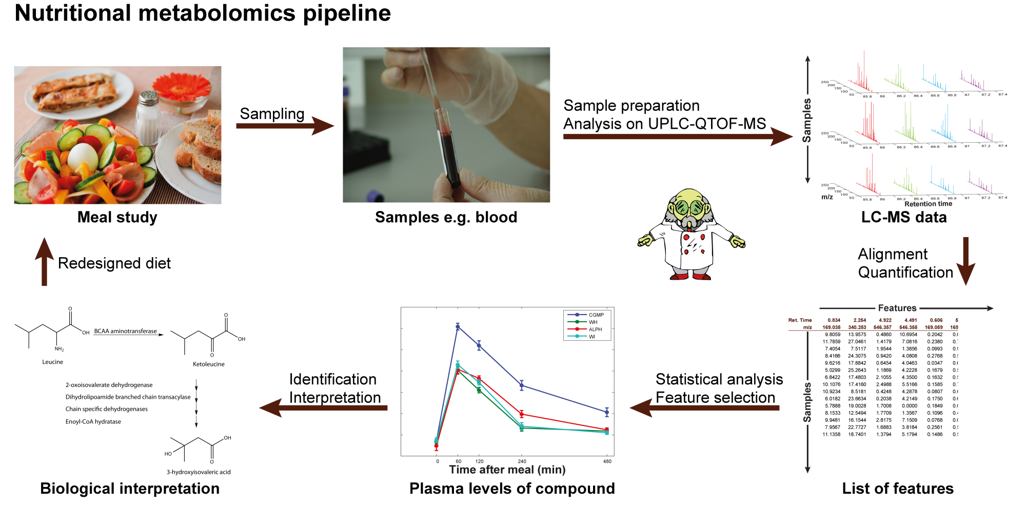
Why is identification important?
No ID → no biological context
Database hits are not enough!
Most time-consuming part of the whole pipeline
Notes:
Where we are in the pipeline
Why ID important
ID and inter together.
That is because they are very much tied in to each other
Therefore I think that everybody - even if you are working mainly on the biological aspects on the study – should have some idea how ID is done

Slide 5
Finding the molecular formula

Slide 6
Molecular formula: Mass alone
Mass = 46. What can it be?
Formula | Nitrogen rule | DBE | Calc. m/z
NS | Invalid | 1.5 | 45.9751
CH₂S | Valid | 1 | 45.9877
NO₂ | Invalid | 1.5 | 45.9929
CH₂O₂ | Valid | 1 | 46.0055
H₂N₂O | Valid | 1 | 46.0167
CH₄NO | Invalid | 0.5 | 46.0293
H₄N₃ | Invalid | 0.5 | 46.0405
C₂H₆O | Valid | 0 | 46.0419
CH₆N₂ | Valid | 0 | 46.0531
C₂H₈N | Invalid | -0.5 | 46.0657
C₃H₁₀ | Valid | -1 | 46.0783
H₁₄S | Valid | -6 | 46.0816
H₁₄O₂ | Valid | -6 | 46.0994
H₁₆NO | Invalid | -6.5 | 46.1232
H₁₈N₂ | Valid | -7 | 46.1470
 | Mass
H | 1.0078
C | 12.0000
N | 14.0031
O | 15.9949
P | 30.9738
S | 31.9721
Cl | 34.9689
Nitrogen dioxide
Formic acid
Ethanol

Slide 7
Molecular formula: Nitrogen rule
For organic compounds containing exclusively H, C, N, O, Si, P, S, and the halogens:
odd nominal mass → odd number of N atoms
even nominal mass → zero or even number of N atoms
N.B.:
Reverses for +H and –H charged compounds!
Does NOT reverse for electron impact (i.e. classical GC since only an electron is lost)
Only works for small molecules (the non-integer part of masses will add up)
http://fiehnlab.ucdavis.edu/projects/Seven_Golden_Rules/Nitrogen_Rule
Notes:
No clever reason why this is like this
Consequence of the number of bonds the different atoms make

Slide 8
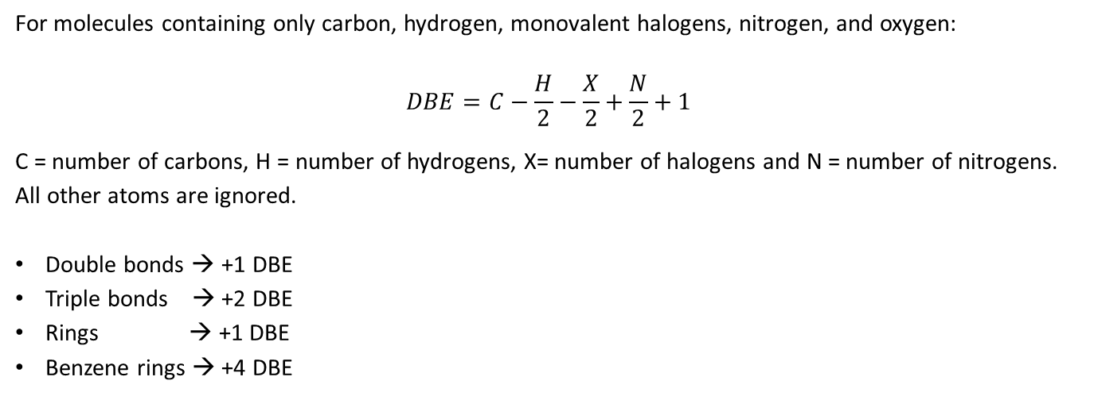
Molecular formula: Double bond equivalent
Double bond equivalent (DBE) == Ring Double Bond Equivalents (RDBE) ==
Degree of unsaturation (UN, DoU) == Pi Bonds or Rings (PBoR)
For molecules containing only carbon, hydrogen, monovalent halogens, nitrogen, and oxygen:
$$DBE=C−\frac{H}{2}−\frac{X}{2}+\frac{N}{2}+1$$
C = number of carbons, H = number of hydrogens, X= number of halogens and N = number of nitrogens.
All other atoms are ignored.
Double bonds → +1 DBE
Triple bonds → +2 DBE
Rings → +1 DBE
Benzene rings → +4 DBE
DBE = 1 !
Fiehn regarding why DBE is misleading: http://fiehnlab.ucdavis.edu/projects/Seven_Golden_Rules/Ring-Double-Bonds
Notes:
Cannot have a negative number of double bonds
Cannot have half a double bond
Hint of benzene

Slide 9
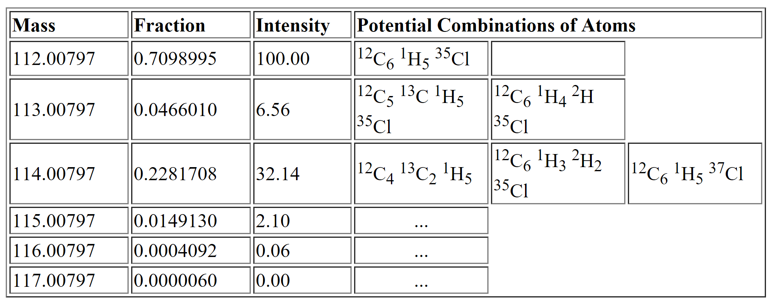
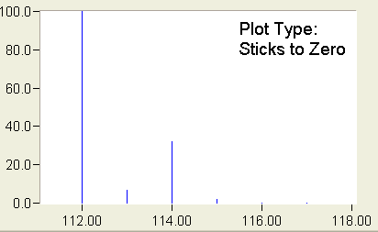
Molecular formula: Isotope pattern
C₆H₅Cl
 | Mass | Rel. abundance
H | 1.0078 | 0.999885
 | 2.0141 | 0.000115
C | 12.0000 | 0.9893
 | 13.0033 | 0.0107
N | 14.0031 | 0.99636
 | 15.0001 | 0.00364
O | 15.9949 | 0.99757
 | 16.9991 | 0.00038
 | 17.9992 | 0.00205
P | 30.9738
S | 31.9721 | 0.9499
 | 32.9715 | 0.0075
 | 33.9679 | 0.0425
Cl | 34.9689 | 0.7576
 | 36.9659 | 0.2424
0.9893⁶ • 0.999885⁵ • 0.7576 = 0.7098
monoisotopic mass
6 • (0.9893⁵ • 0.0107 • 0.999885⁵ • 0.7576) +
5 • (0.9893⁶ • 0.999885⁴ • 0.000115 • 0.7576)
= 0.04647
+1
+2
+3
(difference to table due to differences in
abundances in sources data)
http://www.alchemistmatt.com/mwthelp/isotopicdistribution.htm
http://www.chem.uoa.gr/applets/AppletMS/Appl_Ms2.html
Notes:
Which means if we propose a formula for or our unknown we can check if the experimental isotopic pattern fit the theoretical pattern that we can calculate

Slide 10
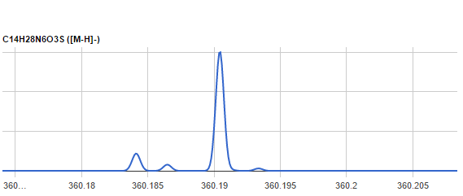

Molecular formula: Isotopic fine pattern
¹³C,¹⁵N
¹³C
³⁴S
¹³C,³³S
¹⁸O
¹⁵N
²H
¹³C, ¹³C
³³S
+1 Isotope
+2 Isotope
Notes:
So the last calculation we did before with the carbon and hydrogen isotope would actually be two different mass peaks at very slightly different mass.

Slide 11
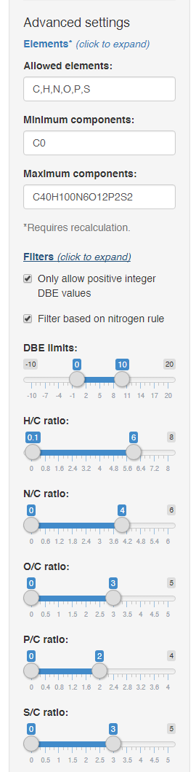
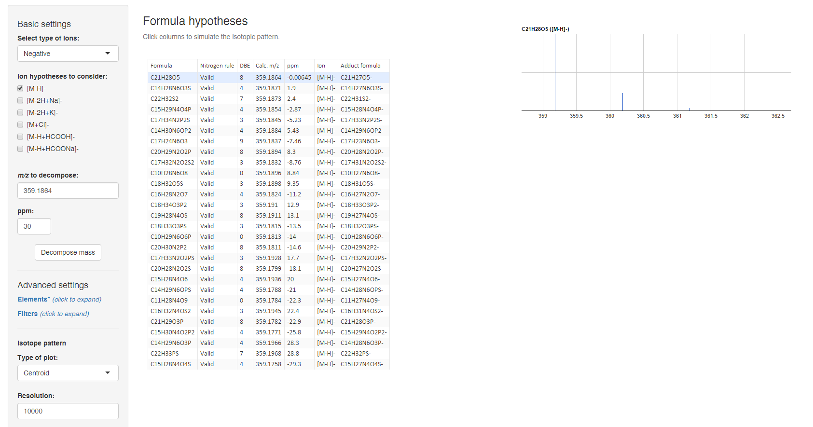

Molecular formula: Automatic decomposition
Kind T, Fiehn O. BMC Bioinformatics. 2007 Mar;8(1):105.
http://predret.org/tools/mass-decomposition/
Notes:
7 golden rules from Oliver Fiehn’s group. Must read paper.

Slide 12
Finding the pseudo-molecular ion
Notes:
Need to make sure that we are look at the so called pseudo-molecular ion
So let is take a look at what the problem is

Slide 13
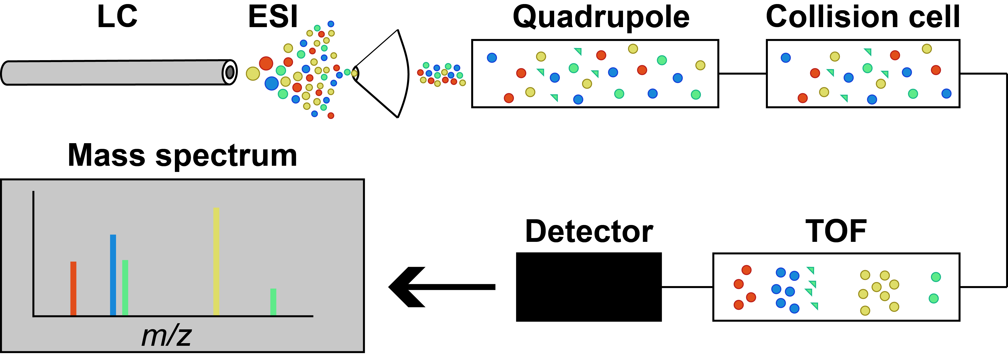
Additional info from fragmentation: MS¹ (Q-TOF)
Ionization in the ESI source. Some in-source fragmentation takes place (green here).
Everything passes the quadrupole
Collision cell is ”off”
TOF separates by m/z
Notes:
Only ionized by adding or removing a hydrogen.
There are other things than fragments that can cause additional peaks from the same compound → adducts

Slide 14
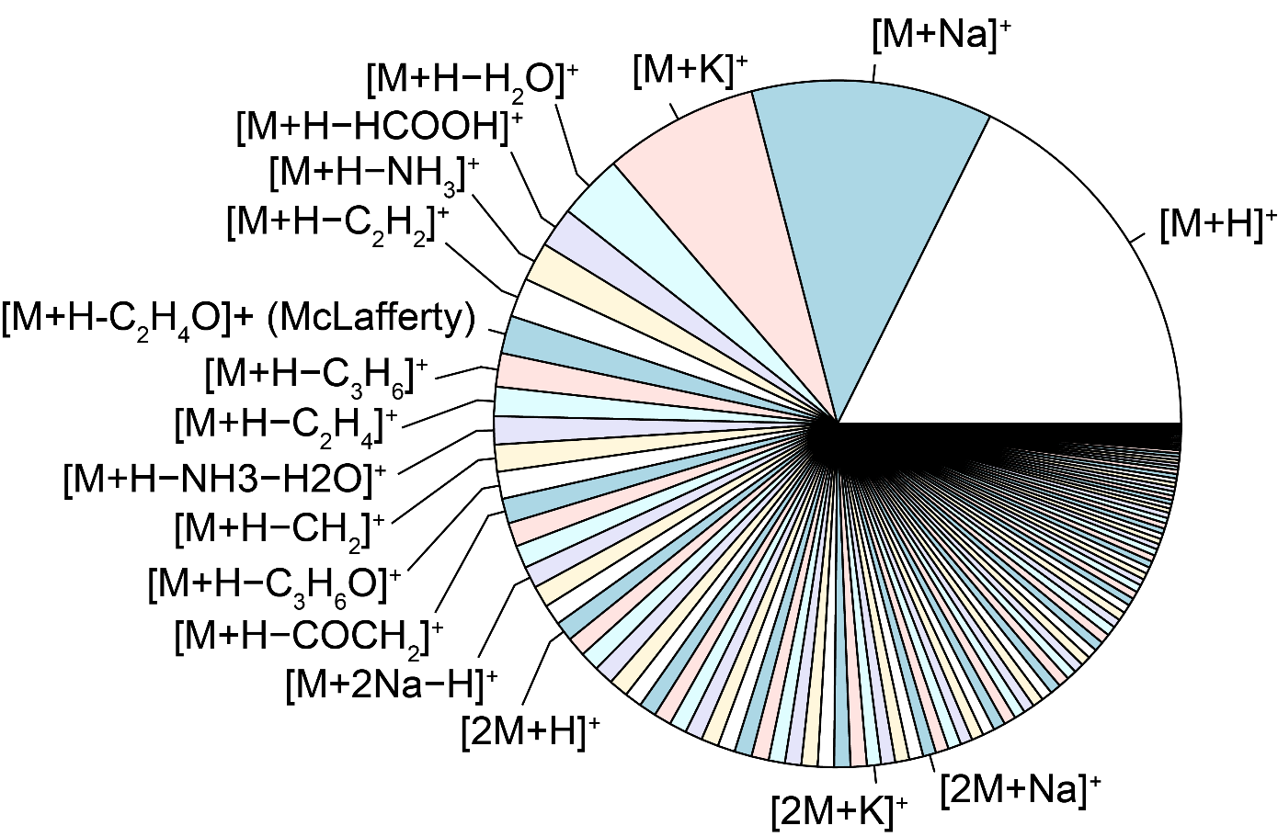
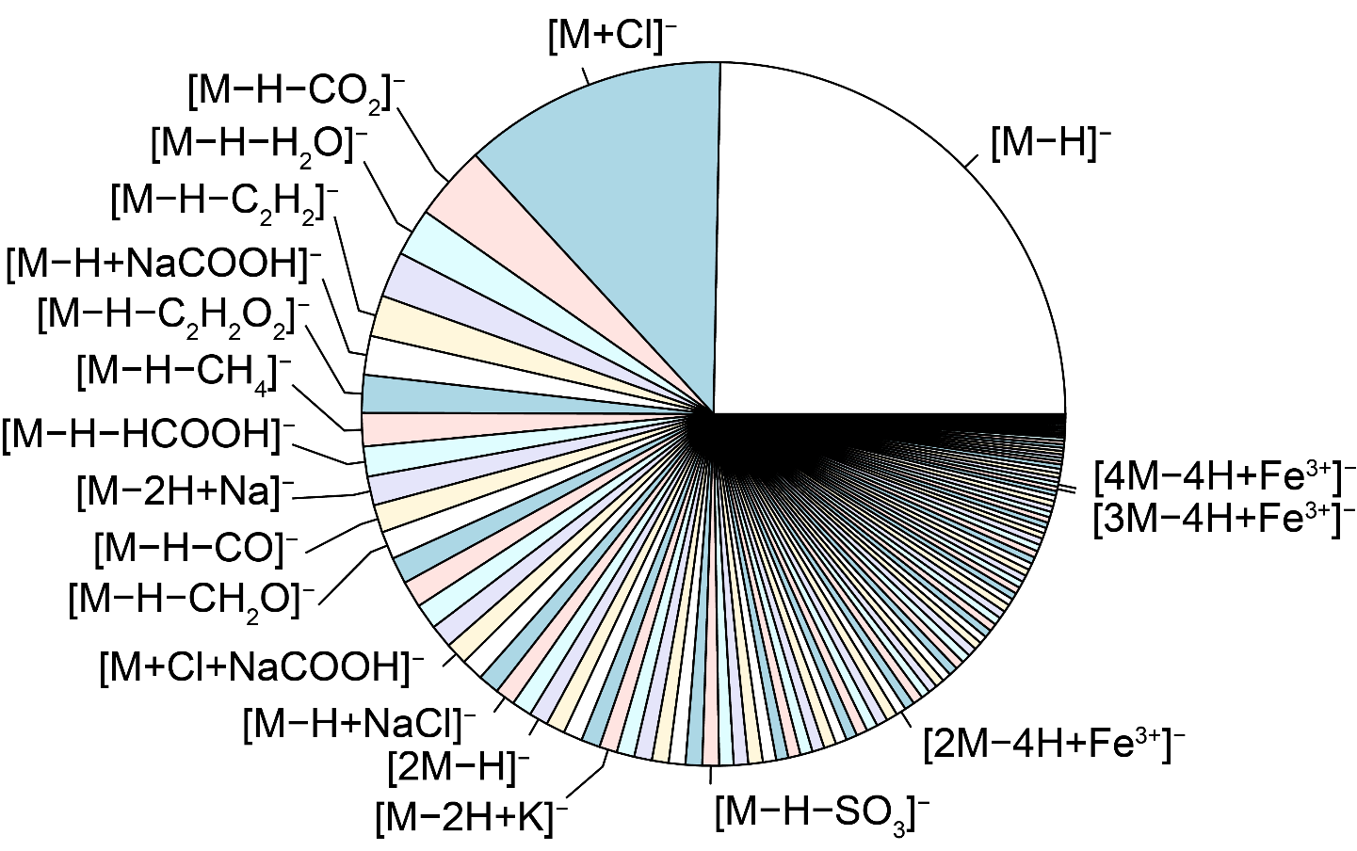
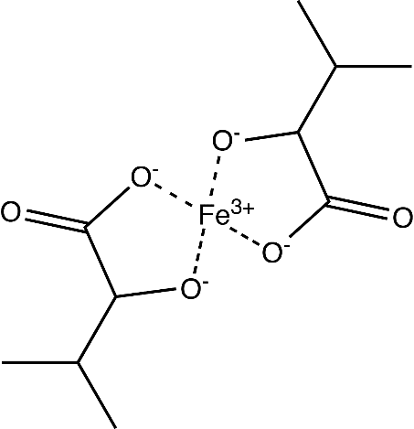
Finding the molecular ion: Adducts
Usually caused by molecules being charge by combining with a charged species other than H (e.g. Na⁺, K⁺, Cl⁻).
Neutral adducts also exist (e.g. formic acid, acetone, sodium formate, NaCl)

Slide 15
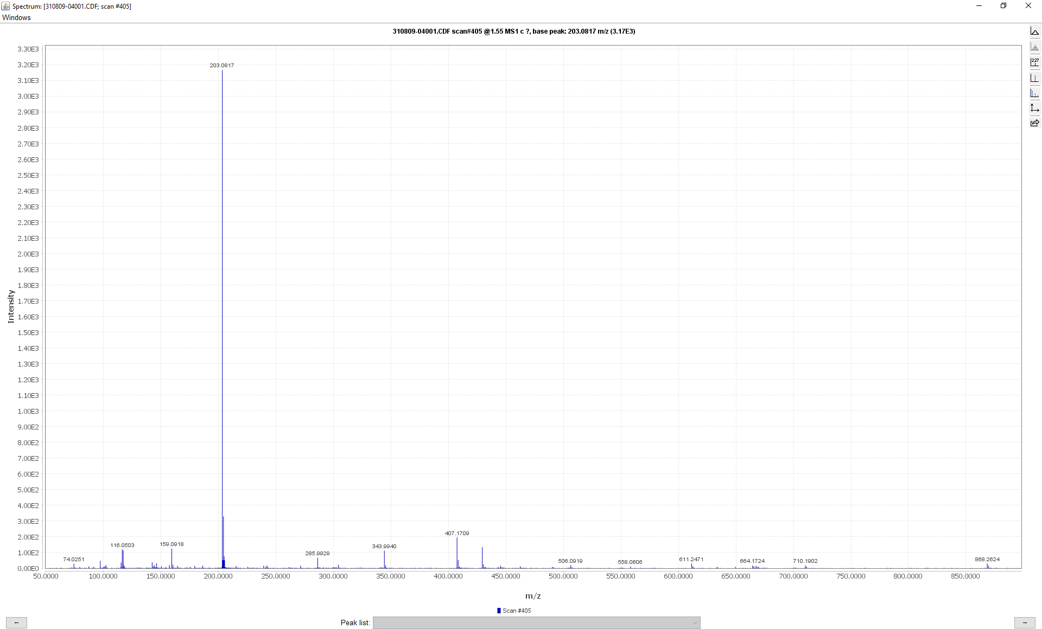
Finding the molecular ion: Adducts

Slide 16
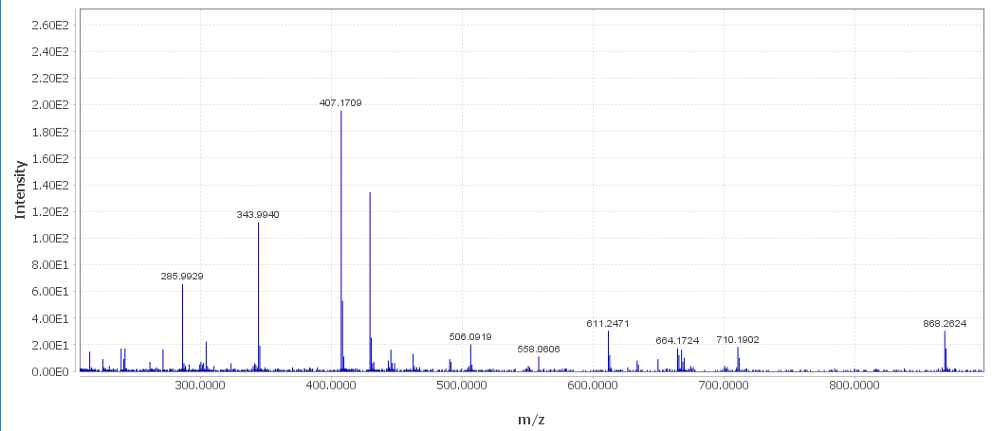
Finding the molecular ion: Adducts
[2M-H⁺]⁻
???
Contaminants
[2M+Na⁺-2H⁺]⁻
[4M+Fe³⁺-4H⁺]⁻
[3M-H⁺]⁻
[4M+Fe³⁺-4H⁺]⁻
Notes:
There is not the most common adducts that would be chloride - or at least they are very small – but we see these other adducts… →
Remember this is MS1. so also coeluting compounds
Doing this manually is a very tedious process

Slide 17
Finding the molecular ion:
Adducts and fragments with CAMERA
mz | rt | isotopes | adduct | pcgroup
117.0545 | 1.38 |  |  | 878
144.1019 | 1.41 |  |  | 878
163.0604 | 1.35 |  | [M+H-Leu]+ 293.148 | 878
276.1444 | 1.45 |  | [M+H-H2O]+ 293.148 | 878
280.1393 | 1.41 |  | [M+H-CH2]+ 293.148 | 878
294.1550 | 1.41 |  | [M+H]+ 293.148 | 878
295.1582 | 1.41 |  |  | 878
119.0491 | 1.40 |  | [M+H-NH3-HCOOH]+ 181.074 | 879
123.0440 | 1.40 |  | [M+H-NH3-COCH2]+ 181.074 | 879
136.0756 | 1.40 | [29][M]+ | [M+H-HCOOH]+ 181.074 | 879
137.0790 | 1.40 | [29][M+1]+ |  | 879
147.0441 | 1.40 |  | [M+H-NH3-H2O]+ 181.074 | 879
165.0547 | 1.40 | [65][M]+ | [M+H-NH3]+ 181.074 | 879
166.0581 | 1.40 | [65][M+1]+ |  | 879
182.0812 | 1.40 | [85][M]+ | [M+H]+ 181.074 | 879
183.0841 | 1.40 | [85][M+1]+ |  | 879
184.0854 | 1.40 | [85][M+2]+ |  | 879
204.0633 | 1.40 |  | [M+Na]+ 181.074 | 879
363.1554 | 1.40 |  | [2M+H]+ 181.074 [4M+2H]2+ 181.074 | 879
120.0515 | 1.40 |  |  | 880
122.0792 | 1.40 |  |  | 881
123.0552 | 1.40 |  |  | 882
322.0772 | 1.40 |  |  | 882
348.0708 | 1.40 |  | [M+H-COCH2]+ 389.074 | 882
428.0367 | 1.34 |  | [M+K]+ 389.074 | 882
124.0448 | 1.40 |  |  | 883
126.0298 | 1.40 |  | [M+H-gluc-(H2O)2]+ 337.065 | 884
152.0097 | 1.40 |  | [M+H-NH3]+ 168.029 | 884
169.0357 | 1.40 | [73][M]+ | [M+H]+ 168.029 | 884
170.0390 | 1.40 | [73][M+1]+ |  | 884
171.0402 | 1.40 | [73][M+2]+ |  | 884
185.0308 | 1.42 |  |  | 884
338.0683 | 1.40 |  | [M+H]+ 337.065 | 884
CAMERA says this
is one compounds
Fragment lists @ https://github.com/stanstrup/chemhelper/tree/master/inst/extdata
mzmine2xcmsSet @ https://github.com/stanstrup/chemhelper
Notes:
So now help arrives

Slide 18
Finding plausible compound candidates from databases

Slide 19
Compound and spectral databases
Compound databases
Global
  Indiscriminant selection of compounds
  Large (tens of millions)
  Contains the structure of compounds. Little other info
Focused
  Biology specific
  Compound class specific
  Relatively small (tens of thousands)
  Can contain additional contextual information
Spectral databases
  Indiscriminant selection of compounds
  Relatively small (tens of thousands)
Contains authentic spectra of compounds
Notes:
Not because you should assume that a hit in the database means you have identified your compound but →
Easier to confirm a hypothesis than to generate one.
Be careful: spectra from different machines are not identical

Slide 20

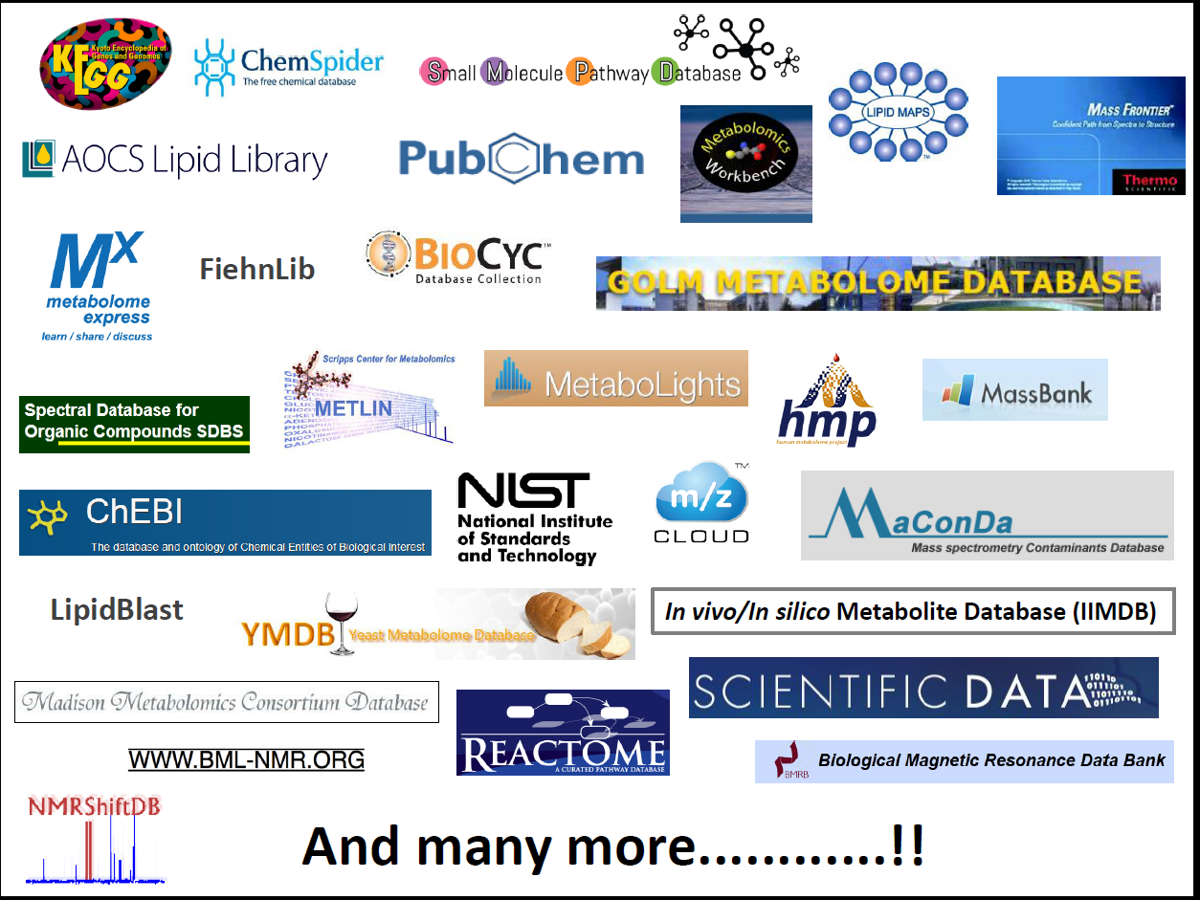
Compound and spectral databases
HMDB (hmdb.ca)
  My compound ID (www.mycompoundid.org)
METLIN (metlin.scripps.edu)
Lipidmaps (www.lipidmaps.org)
Phenol-explorer (phenol-explorer.eu)
ChEBI (www.ebi.ac.uk/chebi/)
Chemspider (www.chemspider.com)
PubChem (pubchem.ncbi.nlm.nih.gov)
MassBank (www.massbank.jp)
mzCloud (https://www.mzcloud.org)
More in: Medina S et al. Trends in Analytical Chemistry The effects of the intake of plant foods on the human metabolome. Trends Anal Chem. 2013;52:88–99. http://dx.doi.org/10.1016/j.trac.2013.08.002

Slide 21
Using the fragmentation pattern

Slide 22
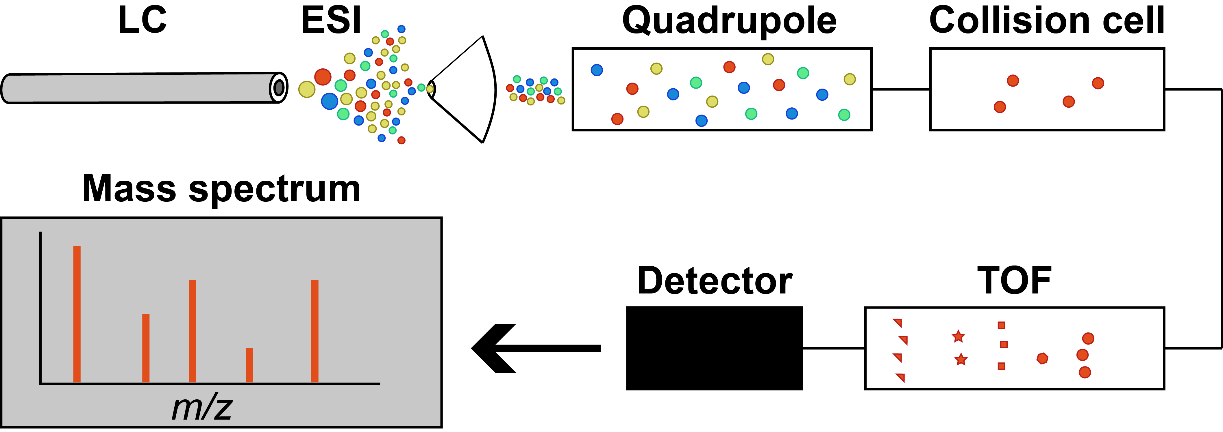
Additional info from fragmentation: MS² (Q-TOF)
Ionization in the ESI source. Some in-source fragmentation takes place (not shown).
Only selection ion passes the quadrupole (red). Careful: Isolation window is usually 1+ Da.
  MS^{n}-like spectra by fragmenting a known fragment (in-source fragmentation)
Fragmentation in the collision cell
TOF separates by m/z
Notes:
Different energies can give different fragments.
Orbitraps have several fragmentation modes

Slide 23
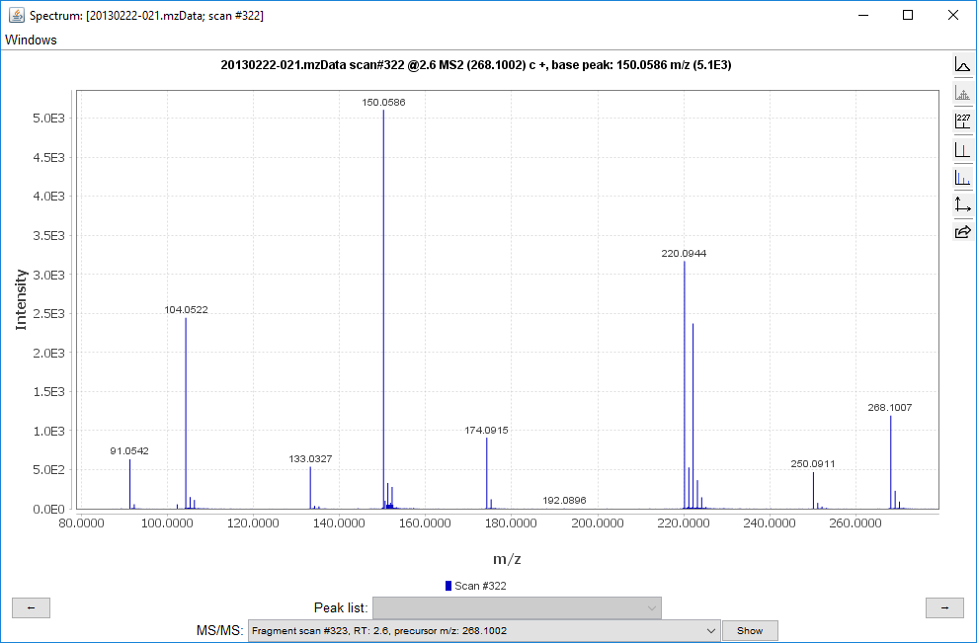
Interpreting fragmentation data: The manual way
-HCOOH
-CH₄S
-H₂O

Slide 24
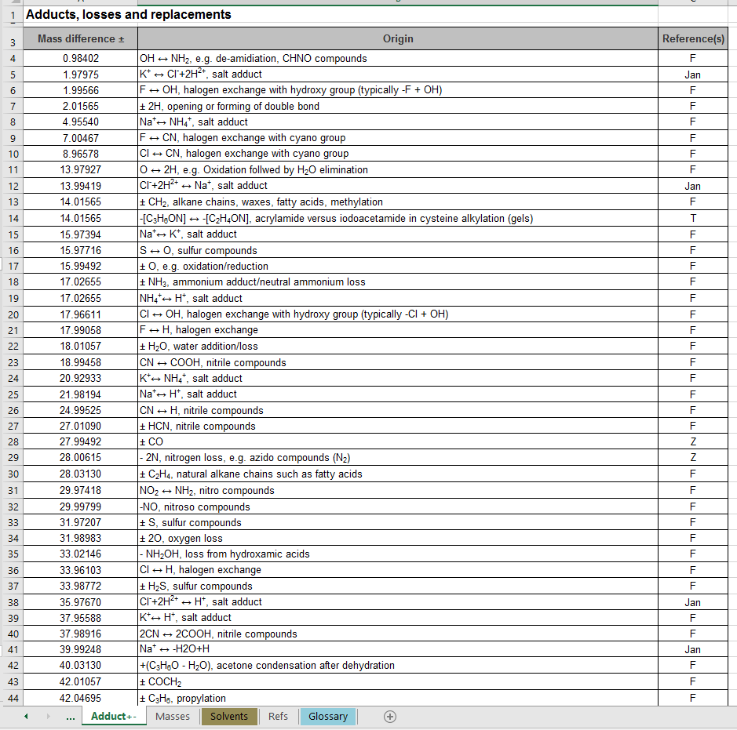
Interpreting fragmentation data: The manual way
Keller BO, Sui J, Young AB, Whittal RM. Anal Chim Acta. 2008;627(1):71–81.
Notes:
This is also the list you can look at when you are looking for adducts

Slide 25
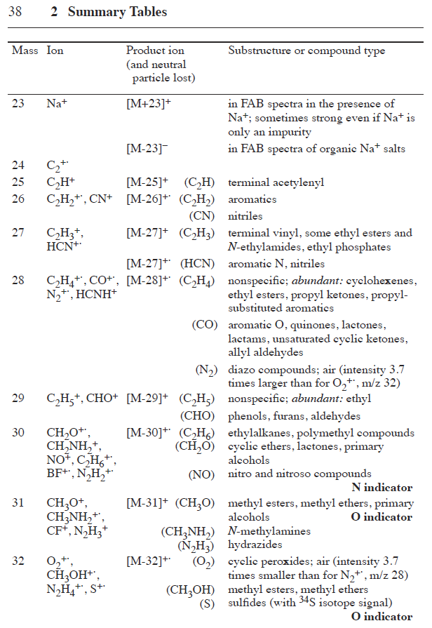
Interpreting fragmentation data: The manual way
Pretsch, Buļhlmann & Badertscher. Structure Determination of Organic Compounds: Tables of Spectral Data.

Slide 26
Interpreting fragmentation data: The manual way
C₅H₁₁NO₂S
→ Methionine!
C₈H₆O
DBE = 6
-HCOOH
-CH₄S
-HCOOH
-H₂O
-NH₃

Slide 27
Interpreting fragmentation data: The manual way
– the good
(
)
-NH₃
-HCOOH
-phenylacetyl
-H₂O
-CH₄S
-CO
-HCOOH
Notes:
This is where biology and identification intersects
Probably this compound was created by a reaction between methionine and Phenyl acetate.
So there used to be an acid group here which made this reaction possible.

Slide 28
Interpreting fragmentation data: The manual way
– the bad
-NH₃
J. Phys. Chem. A, 2004, 108 (17), pp 3844–3853

Slide 29
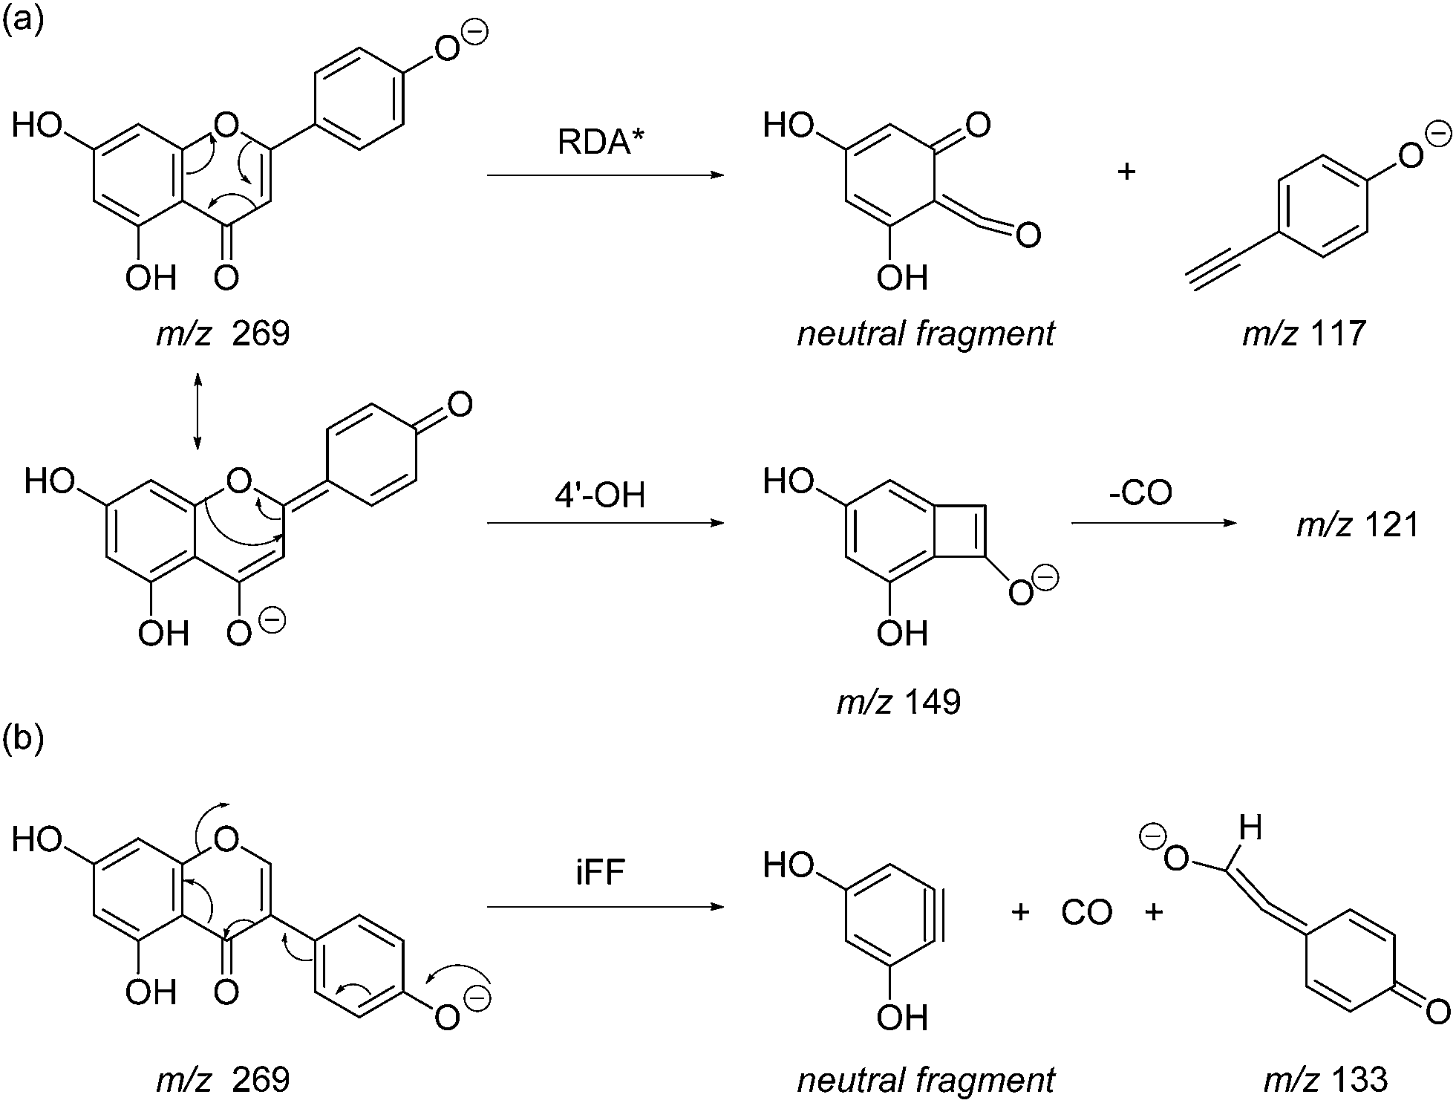
Interpreting fragmentation data: The manual way
– the ugly
Anal. Methods, 2014, 6, 8915-8923

Slide 30
In silico prediction: Mass spectra
In silico fragmentation
MetFrag (msbi.ipb-halle.de/MetFrag)
MetFusion (msbi.ipb-halle.de/MetFusion)
MAGMa (http://www.emetabolomics.org/magma)
CFM-ID (cfmid.wishartlab.com) – “smarter” than MetFrag. Searches only HMDB/KEGG.
CSI:FingerID (www.csi-fingerid.org) – State of the art. Outperforms others.
ATM only positive mode.
In silico mass spectra
LipidBlast (fiehnlab.ucdavis.edu/projects/LipidBlast)

Slide 31
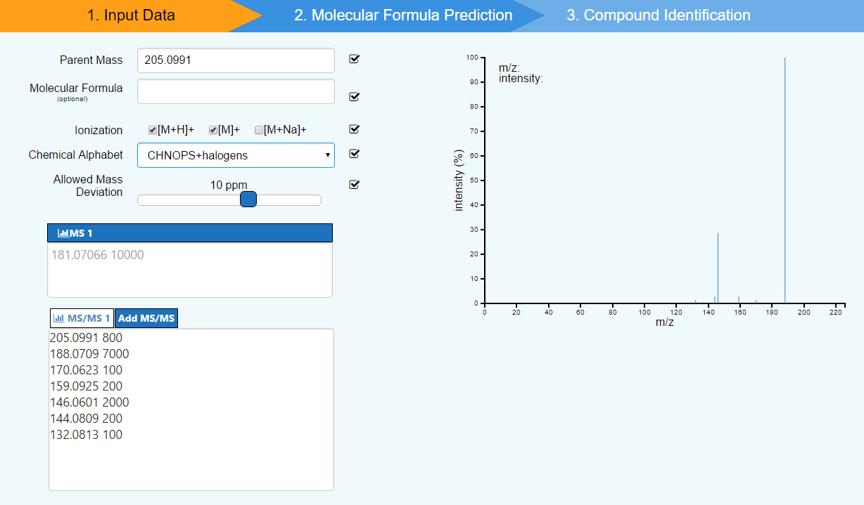
Interpreting fragmentation data: CSI:FingerID

Slide 32
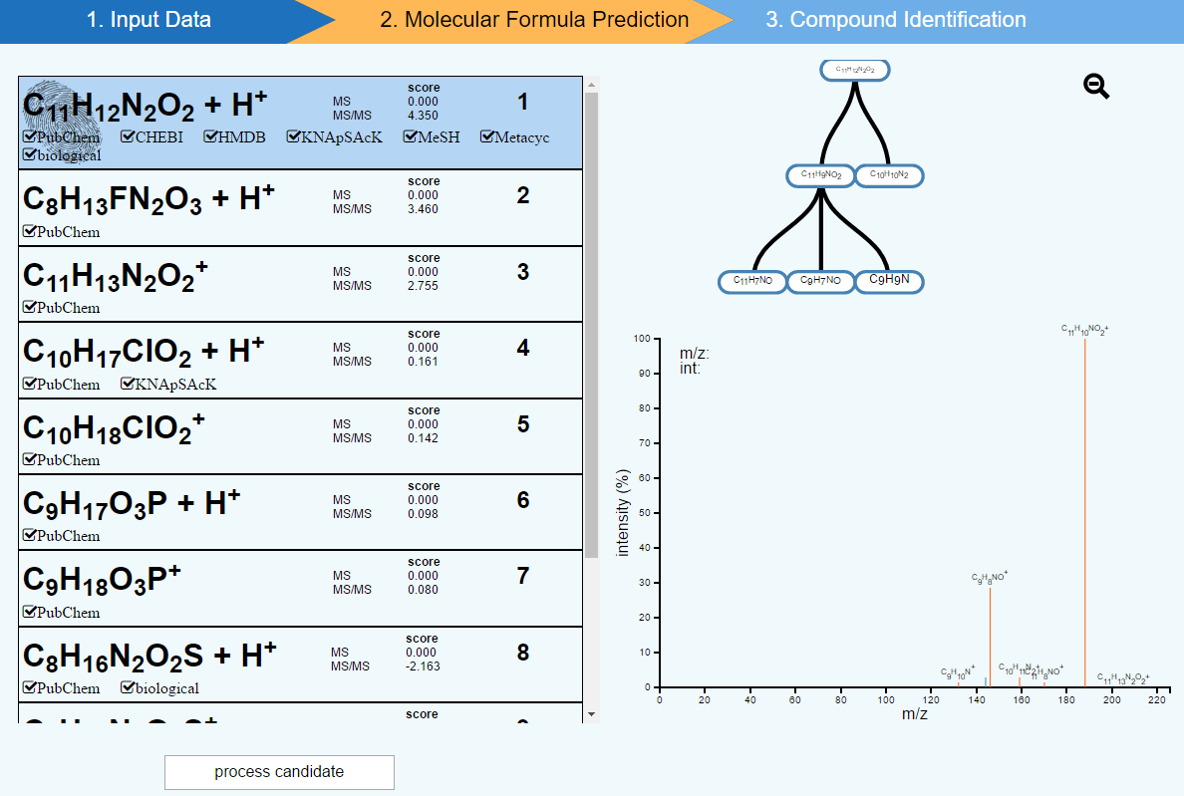
Interpreting fragmentation data: CSI:FingerID

Slide 33
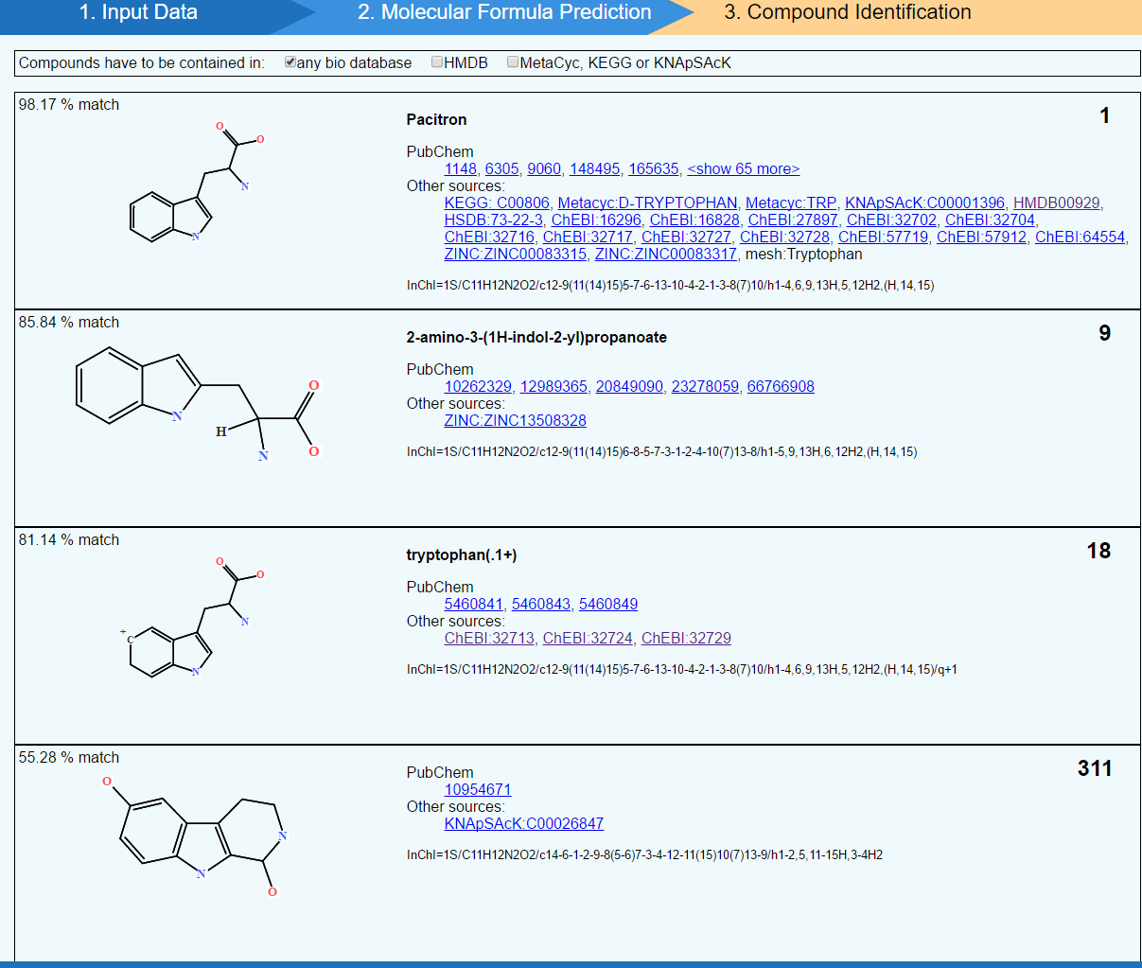
Interpreting fragmentation data: CSI:FingerID
Notes:
You can also do with MS1
Give you a hypothesis earlier in the game

Slide 34
Fragmentation is not everything

Slide 35
In silico prediction: Retention time
STANDARDS STANDARDS STANDARDS
Retention time prediction/mapping
Quantitative Structure Retention Relationship (QSRR) models ->
  Based on modelling a large number of structural descriptors to the retention time
  Many many system specific models have been published.
Notes:
You cannot have databases like for mass spectra

Slide 36
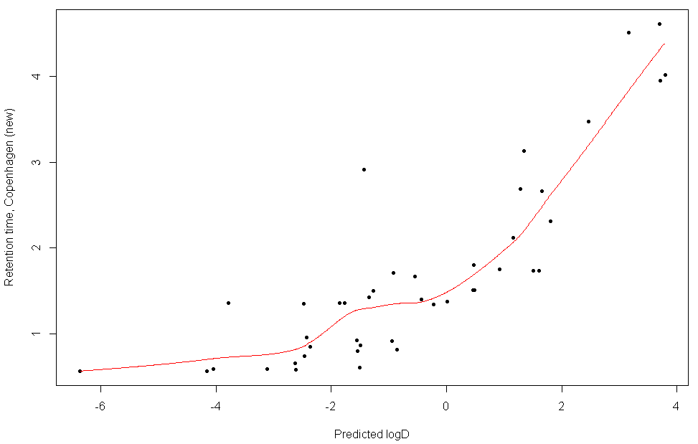
In silico prediction: Simple QSRR model
Stanstrup, J., Gerlich, M., Dragsted, L. O., & Neumann, S. (2013). Metabolite profiling and beyond: Approaches for the rapid processing and annotation of human blood serum mass spectrometry data Metabolomics and Metabolite Profiling. Anal. Bioanal. Chem., 405(15), 5037–5048.

Slide 37
In silico prediction: Retention time
STANDARDS STANDARDS STANDARDS
Retention time prediction/mapping
Quantitative Structure Retention Relationship (QSRR) models ->
  Based on modelling a large number of structural descriptors to the retention time
  Many many system specific models have been published.
www.retentionprediction.org
PredRet (predret.org)

Slide 38
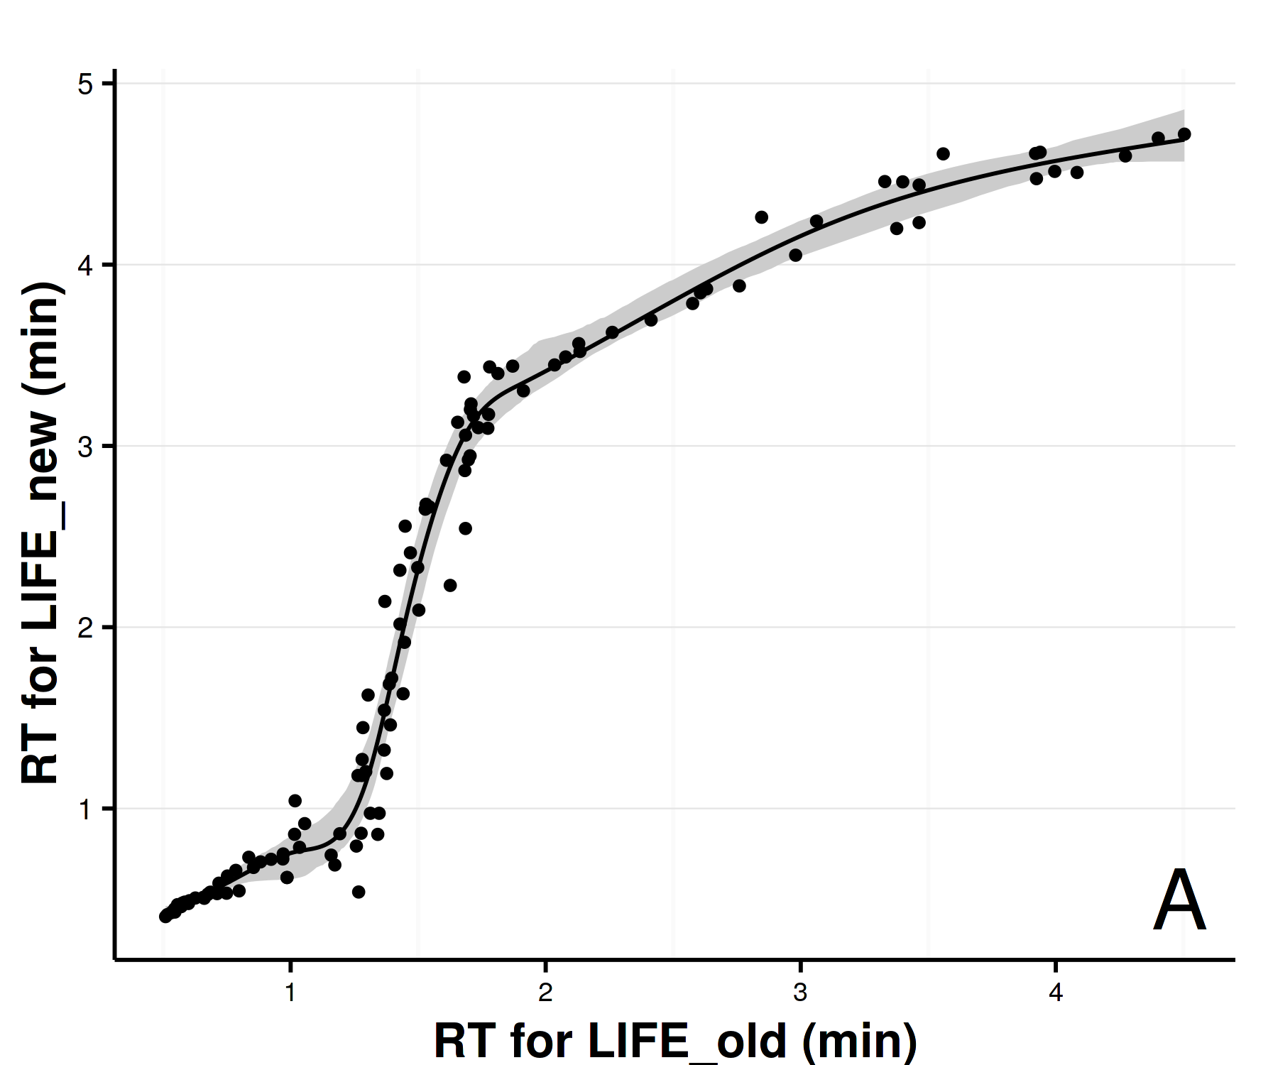
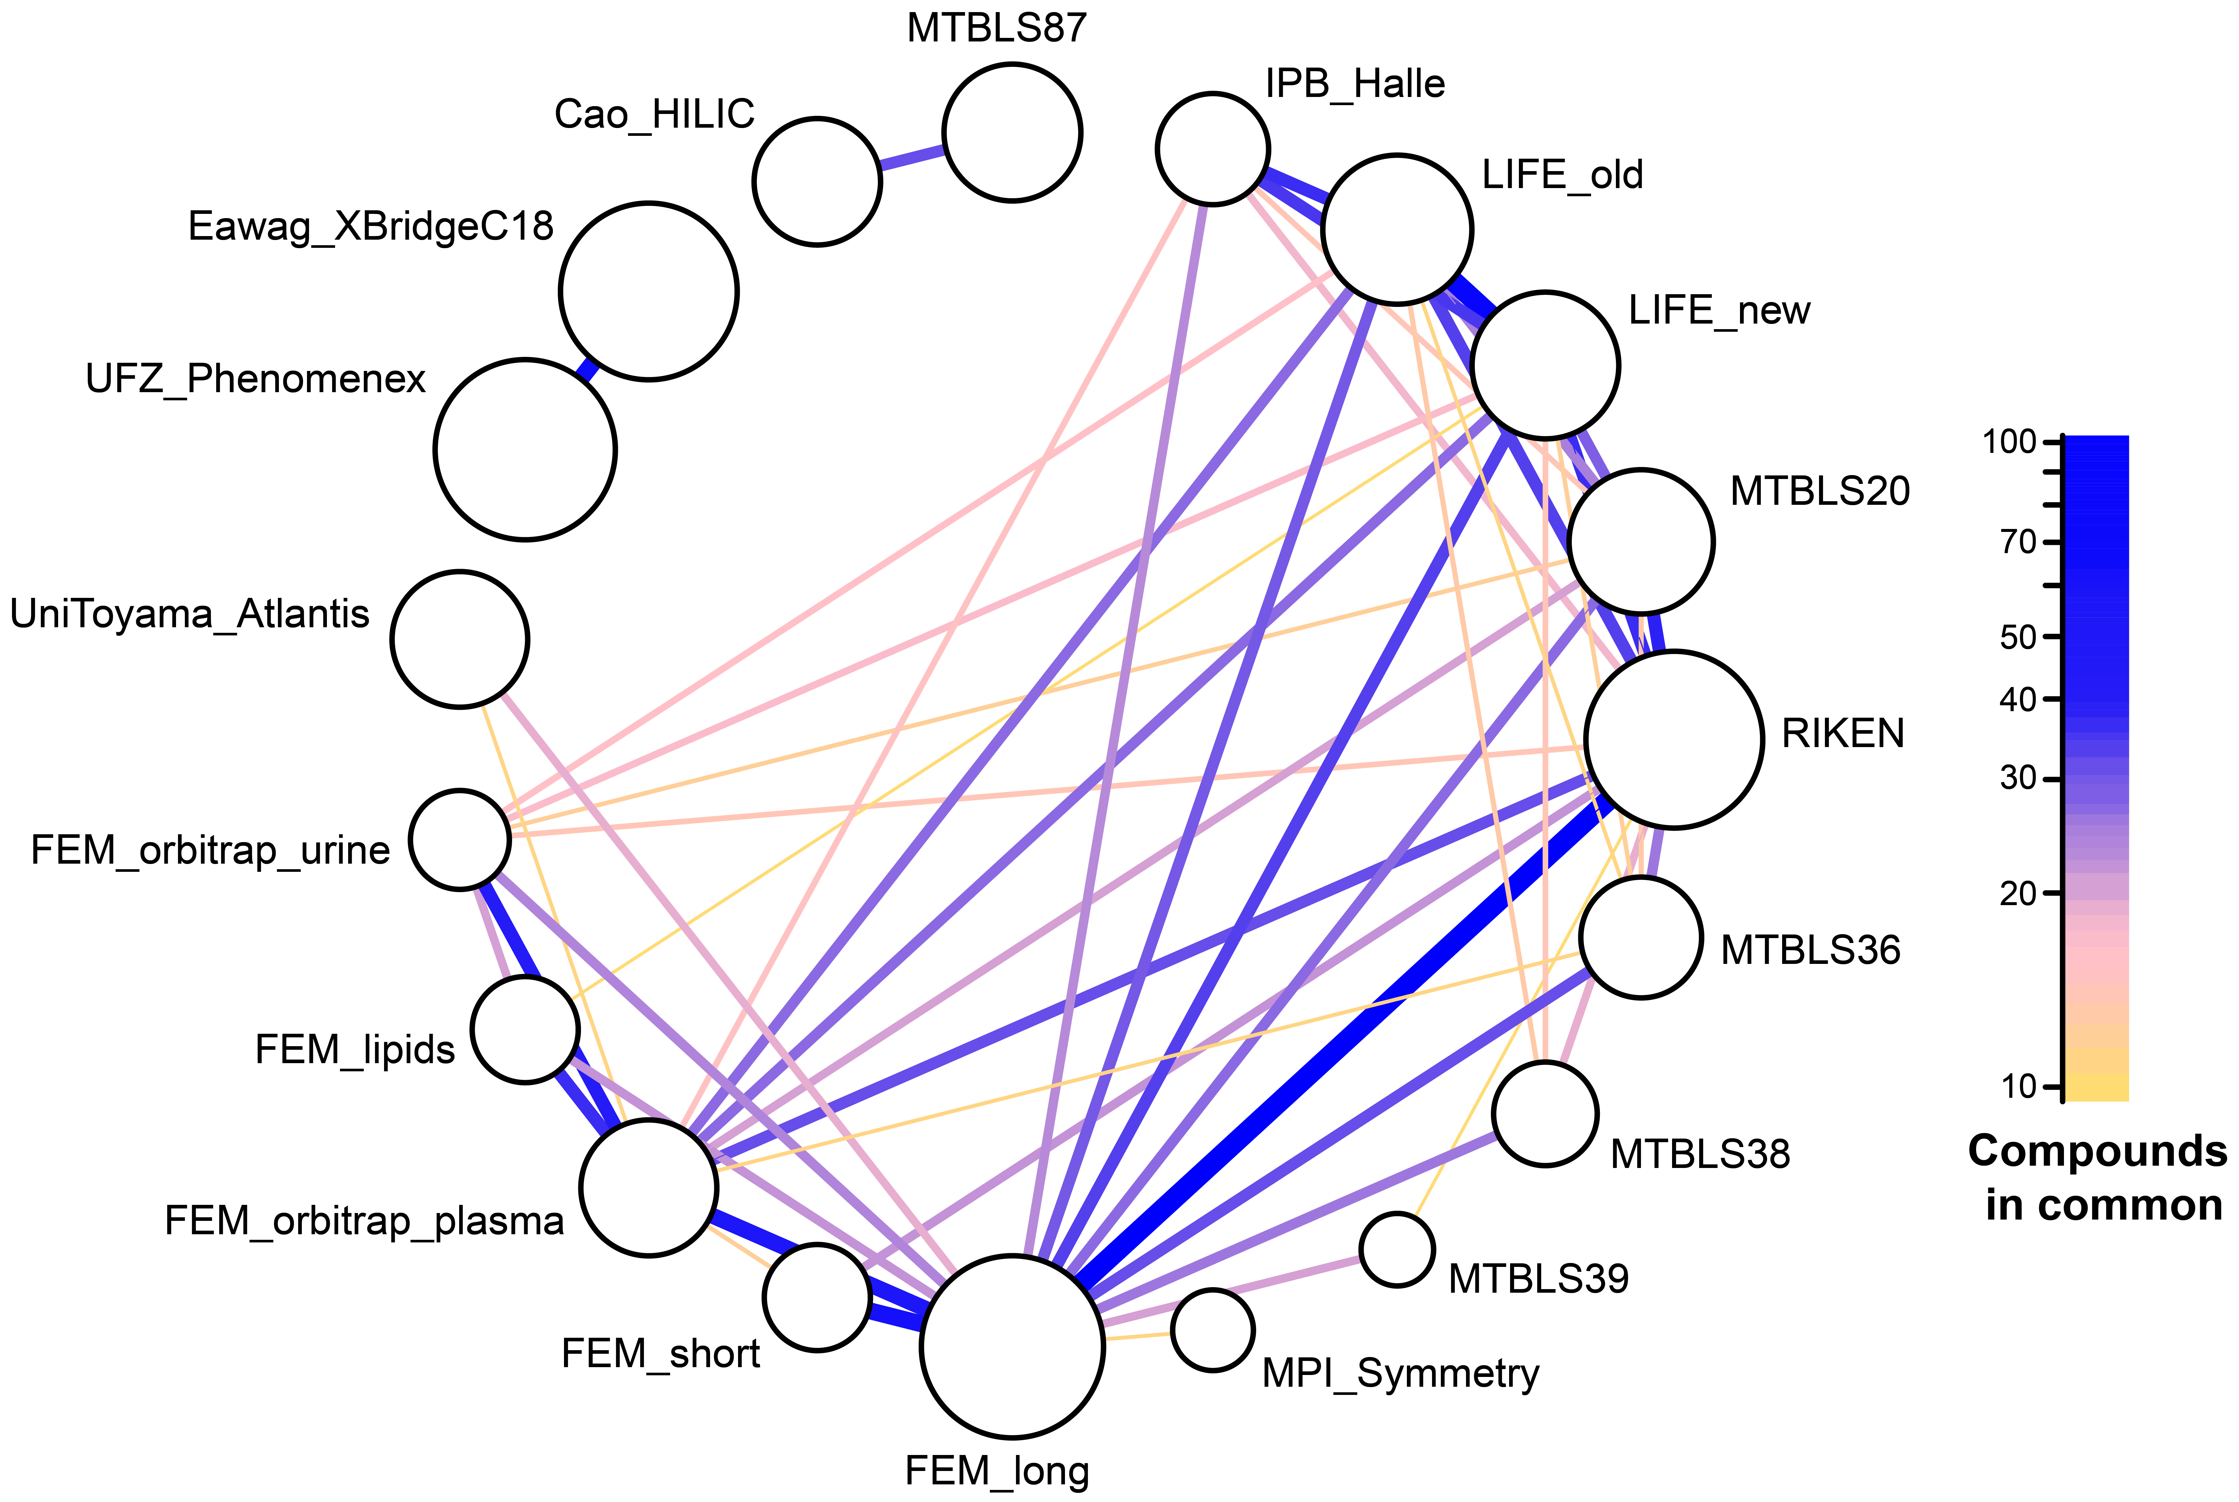
In silico prediction: Retention time with PredRet
Stanstrup, J., Neumann, S., & Vrhovsek, U. (2015). PredRet: Prediction of Retention Time by Direct Mapping between Multiple Chromatographic Systems. Analytical Chemistry.

Slide 39
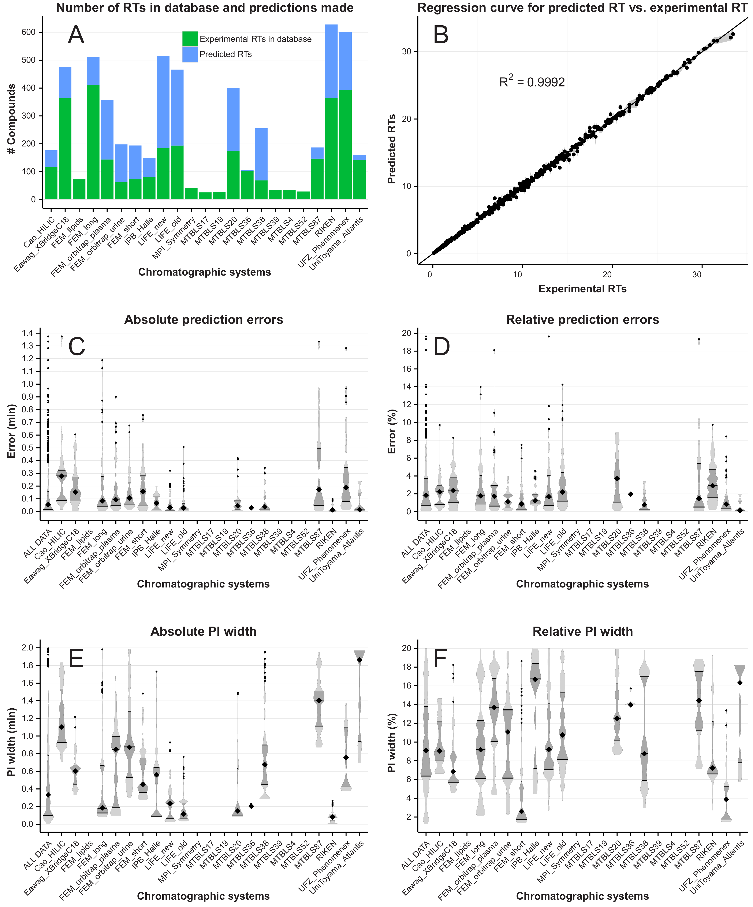
In silico prediction: Retention time with PredRet

Slide 40
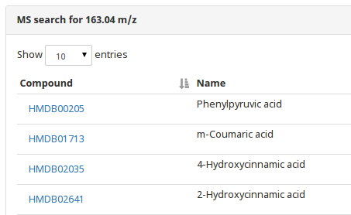
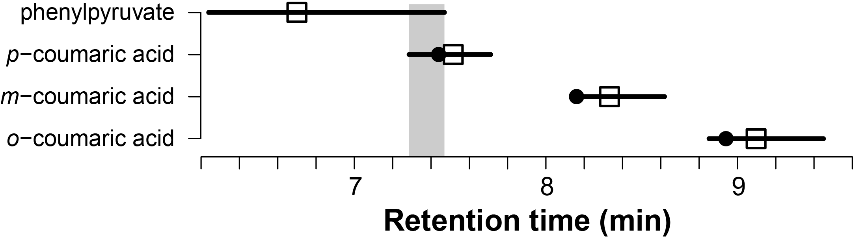
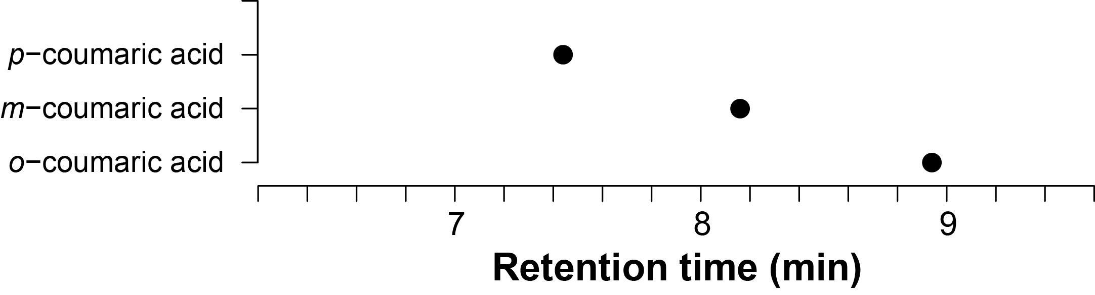
In silico prediction: Retention time

Slide 41
So are you really really sure or just a little sure?

Slide 42
Identification levels (MSI): AKA how sure are you?
Standard for reporting of identifications proposed by the Metabolomics Standards Initiative (MSI)
LEVEL I: Identified compounds
Two independent measures (eg. RT and m/z)
compared to an authentic standard
LEVEL II: Putatively annotated compounds
Physicochemical properties and/or spectral similarity with public/commercial spectral libraries
LEVEL III: Putatively characterized compound classes
physicochemical properties of a chemical class of compounds, or by spectral similarity to known compounds of a chemical class
LEVEL IV: Unknown compounds
Metabolomics. 2007;3(3):211–21.

Slide 43
Identification levels (MSI): AKA how sure are you?
Does MSI level I == 100 % sure ID?
  Other compounds could also have ~same RT and ~same spectra
Could ”100 % sure ID” mean different things to different people?
  Positional isomers (especially lipids)
  Cis/trans
  Stereoisomers
Notes:
So these levels are very good and you SHOULD use them when publishing your findings
Try to get all relevant isomers
Double bond → position → even if you think only one position makes sense biologically

Slide 44
Summary

Slide 45
Summary: From features to compounds
The mass and isotope pattern help you find the molecular formula
Molecular formula of fragments and losses are also informative
Not all possible formula are valid compounds (nitrogen rule, DBE)
Adducts can help (or make it more difficult to) find the pseudo-molecular ion
Fragments give info on the structure of the compound
Compound databases show us what compounds are known
Spectral databases give us spectra of real compounds
In silico tools can help us when no real spectrum is available
It is crucial to report the level of certainly unambiguously

Slide 46
Recommendations
Start with low hanging fruits.
  Search databases first.
  Give up fast if not enough data or get more data (MS^{n}) if possible/important.
  Accept that you won’t ID everything.
Find the pseudo-molecular ion before you try to ID.
Always check EIC before trying to ID a feature/fragment/adduct.
Don’t use the MSI levels blindly.
Use good chemical sense and report uncertainty meticulously.
Remember: There is no substitute for authentic standard compounds.
But they might not be enough!

Slide 47
Suggested future reading
Overview
These slides and more teaching material: http://stanstrup.github.io/
Kind T, Fiehn O. Seven Golden Rules for heuristic filtering of molecular formulas obtained by accurate mass spectrometry. BMC Bioinformatics. 2007 Mar;8(1):105.
Sumner L et al. Proposed minimum reporting standards for chemical analysis. Metabolomics. 2007;3(3):211–21.
Dunn WB et al. Mass appeal: Metabolite identification in mass spectrometry-focused untargeted metabolomics. Metabolomics. 2013 Mar;9(SUPPL.1):44–66.
Stanstrup J, Gerlich M, Dragsted LO, Neumann S. Metabolite profiling and beyond: Approaches for the rapid processing and annotation of human blood serum mass spectrometry data Metabolomics and Metabolite Profiling. Anal Bioanal Chem. 2013 Jun;405(15):5037–48.
In silico methods
Kuhl C, Tautenhahn R, Böttcher C, Larson TR, Neumann S. CAMERA: An integrated strategy for compound spectra extraction and annotation of liquid chromatography/mass spectrometry data sets. Anal Chem. 2012 Jan;84(1):283–9.
Wolf S, Schmidt S, Müller-Hannemann M, Neumann S. In silico fragmentation for computer assisted identification of metabolite mass spectra. BMC Bioinformatics. 2010 Mar;11(1):148.
Gerlich M, Neumann S. MetFusion: Integration of compound identification strategies. J Mass Spectrom. 2013;48(3):291–8.
Dührkop K, Shen H, Meusel M, Rousu J, Böcker S. Searching molecular structure databases with tandem mass spectra using CSI:FingerID. PNAS. 2015;112(41):12580-5.
Notes:
Additional reading material, links to my website.

