Slide 1

Automated Real-Time Quality Control of LC-MS Metabolomics Data:
QC4Metabolomics
Systems Medicine
Jan Stanstrup
jan.stanstrup@regionh.dk
stanstrup@gmail.com
stanstrup.github.io
@JanStanstrup

Slide 2

QC in Metabolomics – Many facets
Sample prep
Reproducibility
Recovery
(Storage)
Analytical
Linearity
Response to concentration
Repeatability/Reproducibility
Carry over
Identification
Specificity
Coverage
Relevance
==
IN
OUT
Notes:
When you speak about QC in metabolomics we can of course consider different step of the analyses
Sample prep for example where at lot of attention have already been devoted to…
Or the identification step that I would also claim have QC aspects
For the analytical part a lot of attention is typically devoted to creating a robust method when the method is developed.
But what is often not considered very systematically is making sure that the quality is *kept* good and consistent.
To achieve this you need to monitor your analysis as it is happening.
If things slip in any of these steps your downstream analysis will be compromised and you end up putting garbage in so you can only get garbage out at the end of your data analysis.
My talk today will therefore be about QC in the analytical part with a focus on reproducibility
https://pixabay.com/en/trash-can-garbage-can-waste-basket-23653/

Slide 3
QC in Metabolomics – Many facets
Sample prep
Reproducibility
Recovery
(Storage)
Analytical
Linearity
Response to concentration
Repeatability/Reproducibility
Carry over
Identification
Specificity
Coverage
Relevance
Notes:
My talk today will therefore be about QC in the analytical part with a focus on reproducibility

Slide 4
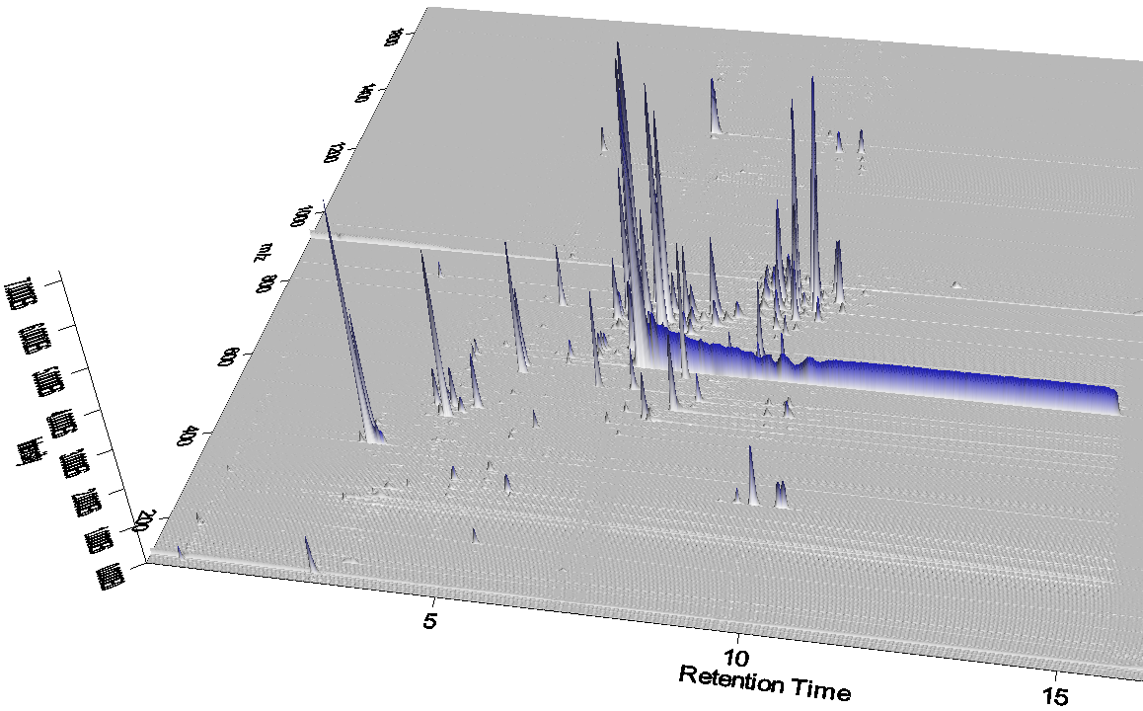
QC in Metabolomics – Is different and difficult
Complex data
Too many peaks to inspect manually
No internal standards for all compounds
Noise/contaminants
Dynamic range

Slide 5

QC in Metabolomics – Current typical practice
Spot checking during analysis
  Impossible to do comprehensively
  Not all problems apparent to the eye
  Minor peaks covered by major peaks
  Requires experienced operators
Notes:
https://pixabay.com/en/inspector-man-detective-male-160143/
http://thebusinessweave.tumblr.com/post/71126943901/when-i-get-to-my-roommates-leftover-pizza-before

Slide 6
QC in Metabolomics – Current typical practice
Spot checking during analysis
  Impossible to do comprehensively
  Not all problems apparent to the eye
  Minor peaks covered by major peaks
  Requires experienced operators
Checking systematic changes during data analysis, e.g. by PCA analysis
  Only statistical corrections can be done
  Some problems too large to correct
  Detrimental problems require full instrumental analysis
Notes:
https://pixabay.com/en/inspector-man-detective-male-160143/
http://thebusinessweave.tumblr.com/post/71126943901/when-i-get-to-my-roommates-leftover-pizza-before

Slide 7

QC in Metabolomics – Current typical practice
Spot checking during analysis
  Impossible to do comprehensively
  Not all problems apparent to the eye
  Minor peaks covered by major peaks
  Requires experienced operators
Checking systematic changes during data analysis, e.g. by PCA analysis
  Only statistical corrections can be done
  Some problems too large to correct
  Detrimental problems require full instrumental analysis
Notes:
https://pixabay.com/en/inspector-man-detective-male-160143/
http://thebusinessweave.tumblr.com/post/71126943901/when-i-get-to-my-roommates-leftover-pizza-before

Slide 8
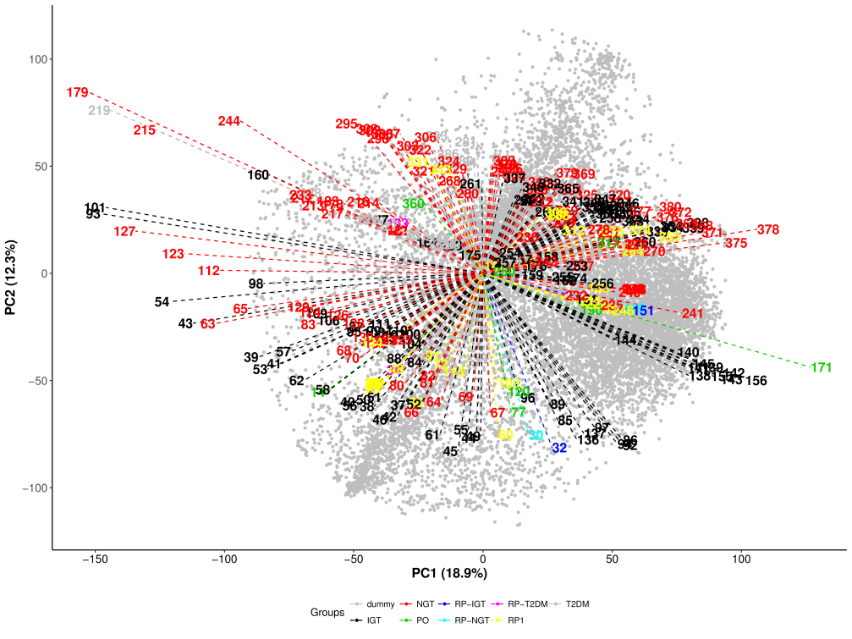
QC in Metabolomics – Is different and difficult
Batch effects and intensity drift
Subtle instrumental issues
(loss of calibration, etc.)
No consensus
Documentation/tracking
Notes:
As an example… colored by diabetes

Slide 9
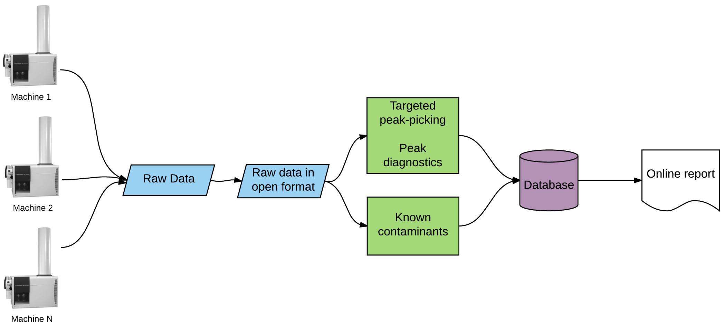
QC in Metabolomics – How can we do it better?

Slide 10
QC in Metabolomics – How can we do it better?
Real-time tracking of standards or common compounds
  Retention time stable?
  m/z constant and accurate?
  Intensity drops?
Contamination level changes?
Room conditions ok?

Slide 11
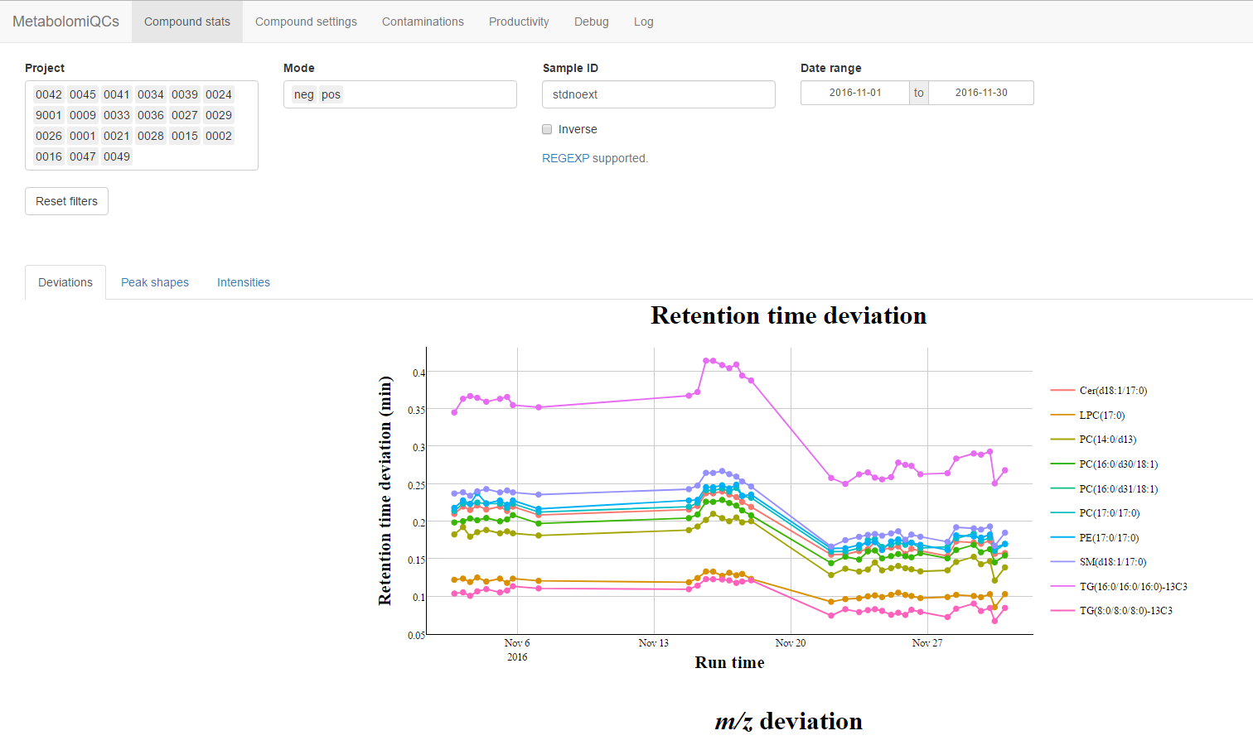
QC4Metabolomics GUI
Notes:
Sample type, search, zoom

Slide 12
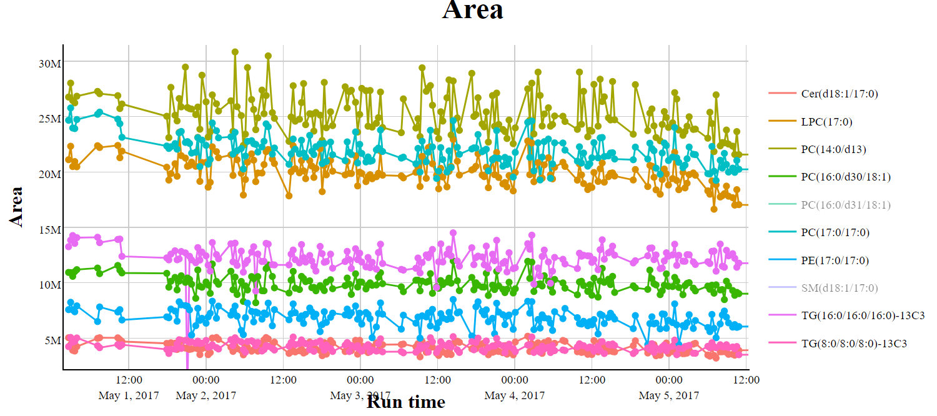
Tracking standards - Intensity

Slide 13
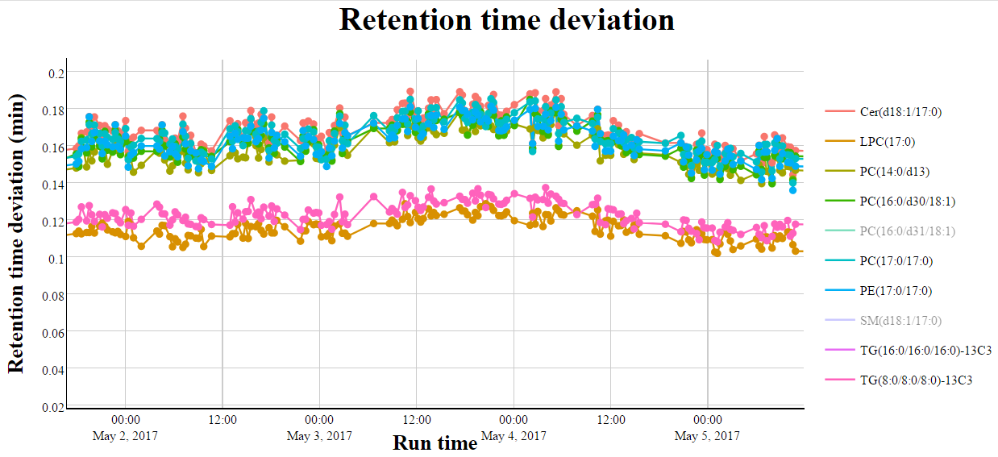
Tracking standards - Chromatography

Slide 14
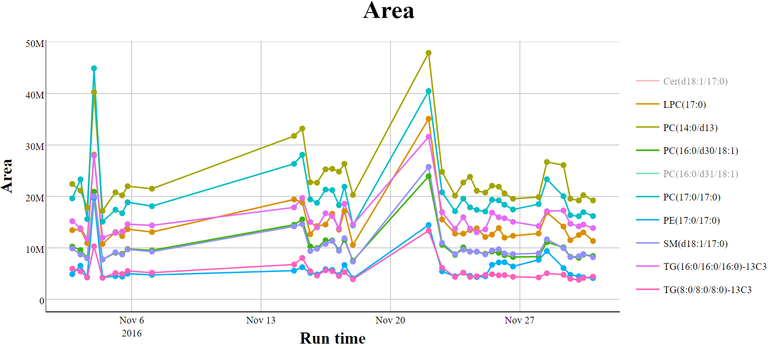
Tracking standards - Intensity
Now go find out why!
Reanalyze now?

Slide 15
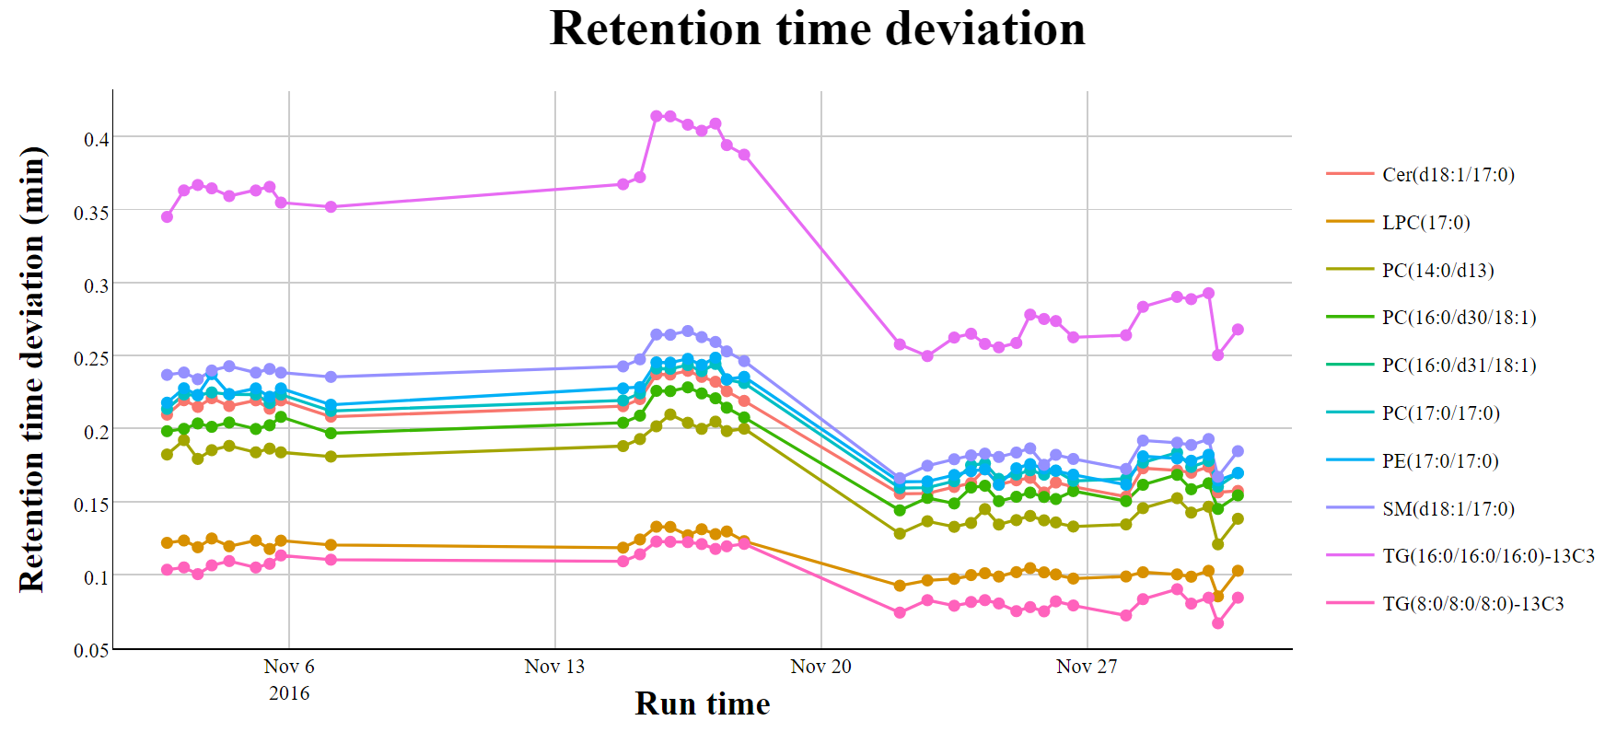
Tracking standards - Chromatography
New column?
New solvent?

Slide 16
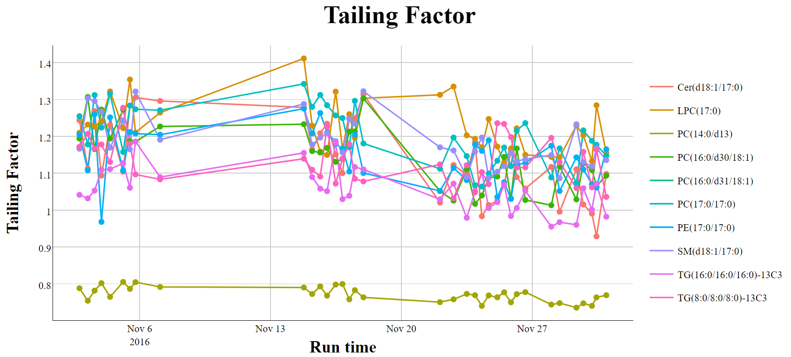
Tracking standards - Chromatography

Slide 17
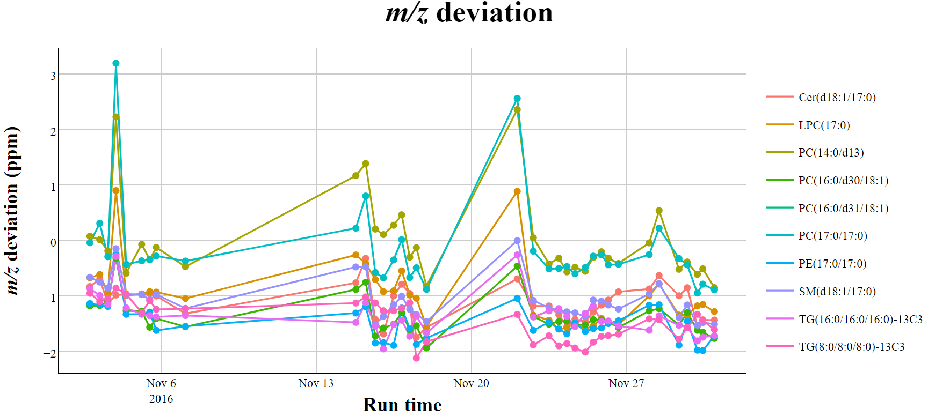
Tracking standards – Mass accuracy

Slide 18
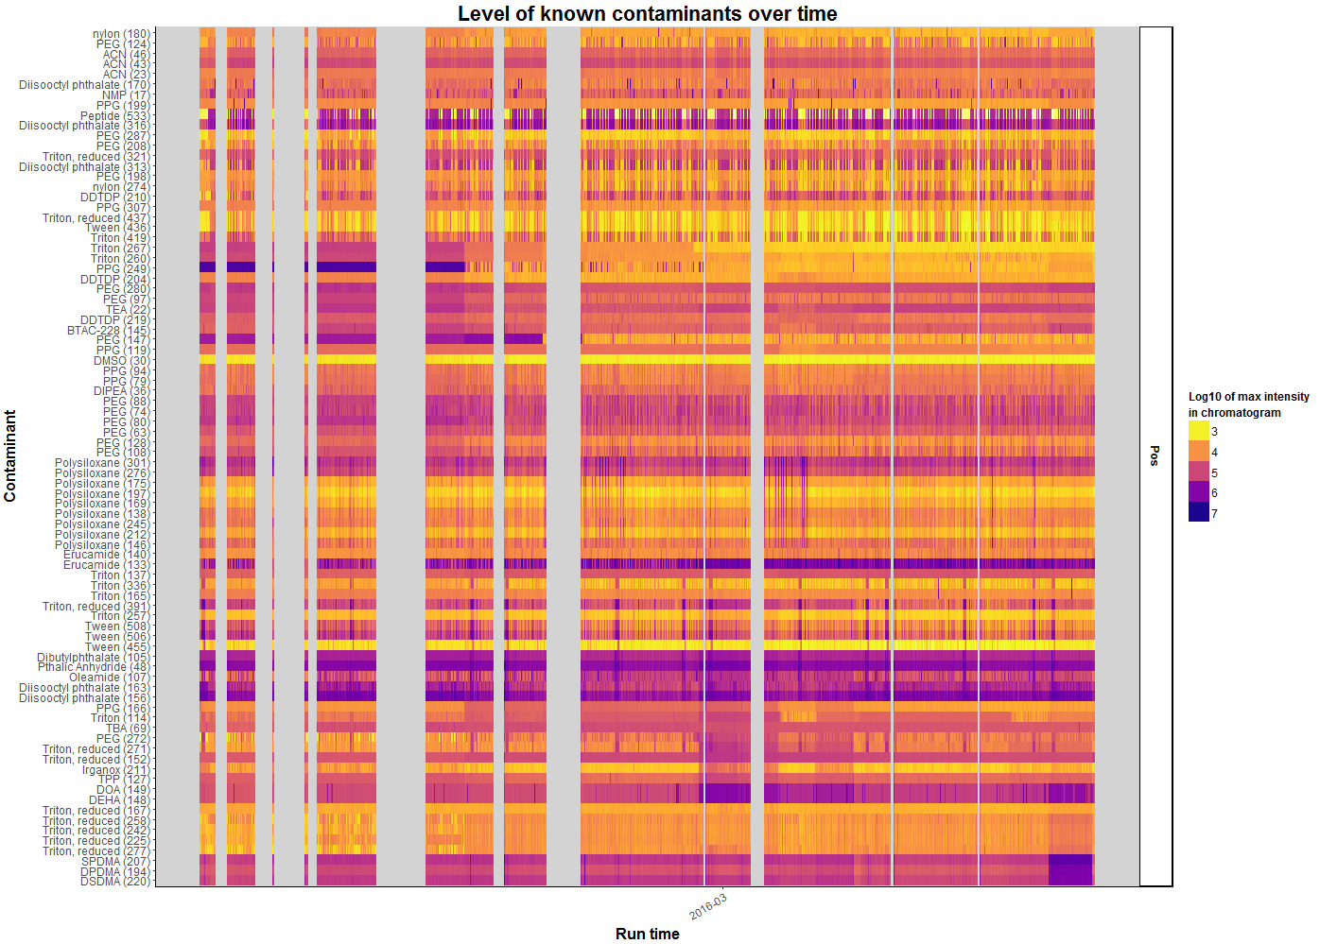
Contaminants – Overview

Slide 19
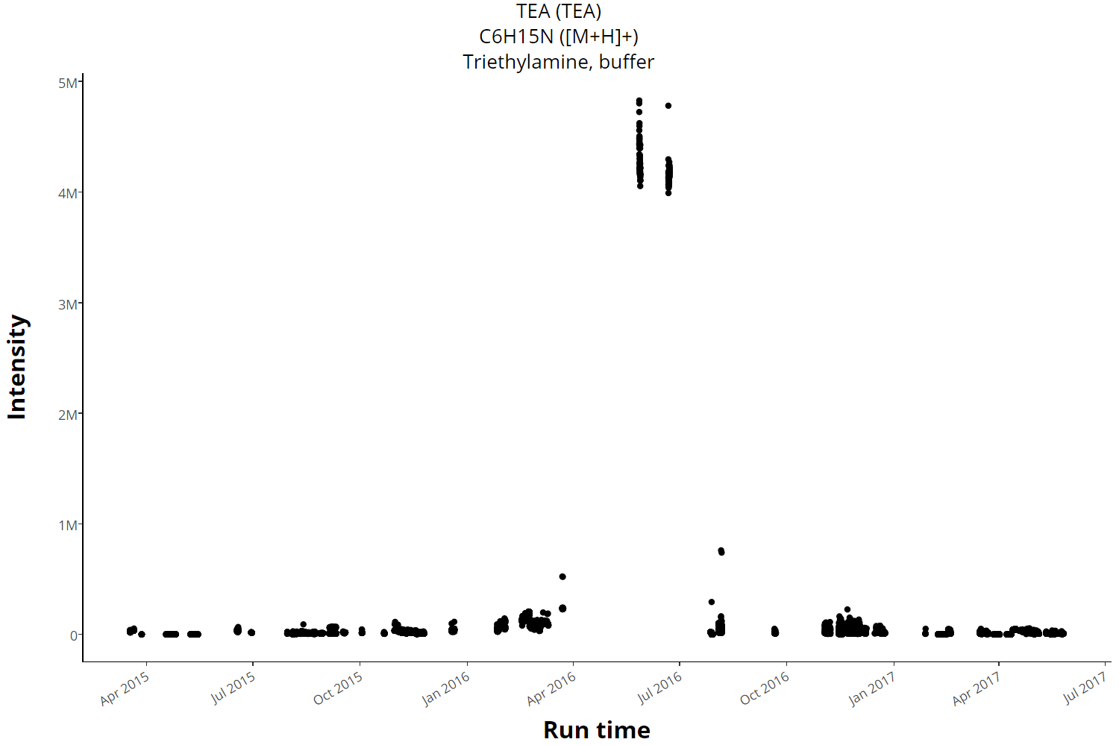
Contaminants – Over time

Slide 20
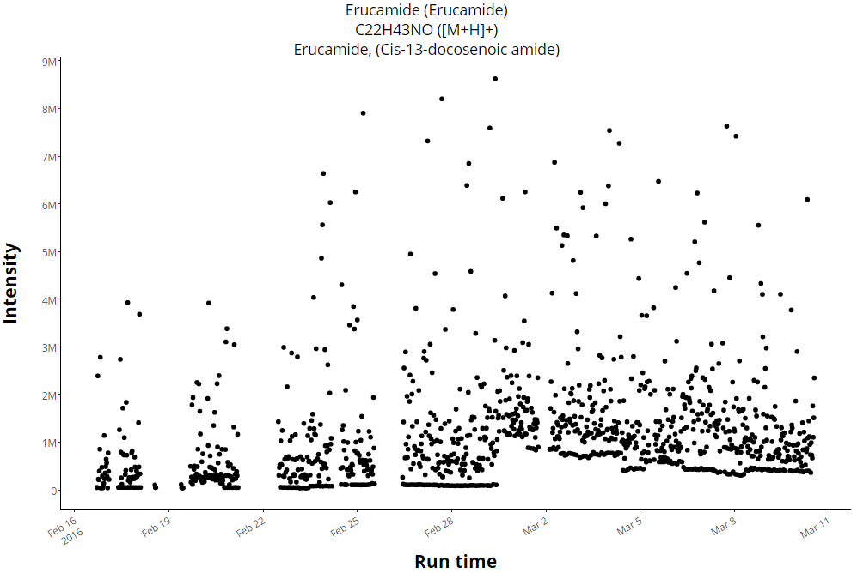
Contaminants – Over time
These are solvent →
this contaminant
is from sample prep

Slide 21
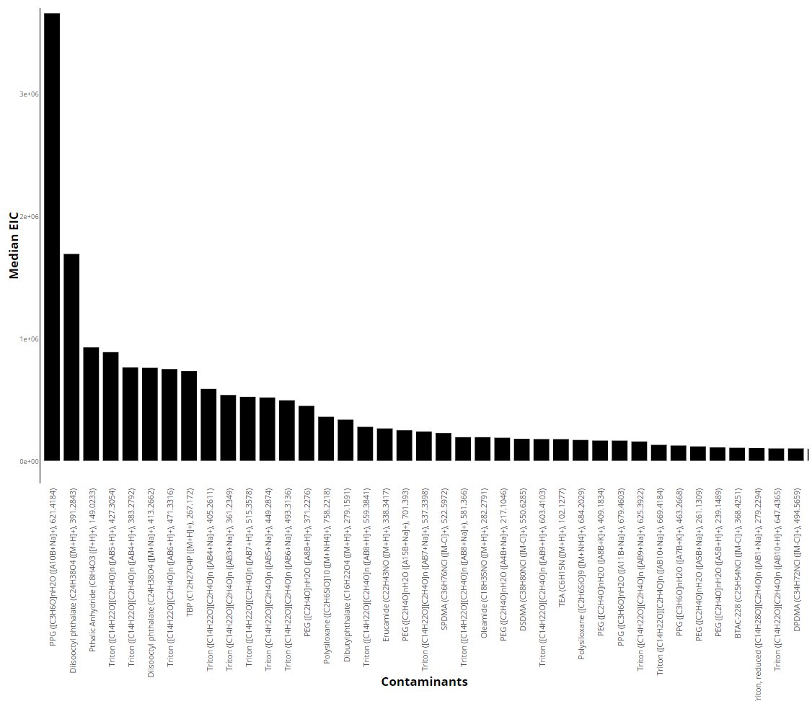
Contaminants – Single samples screening

Slide 22
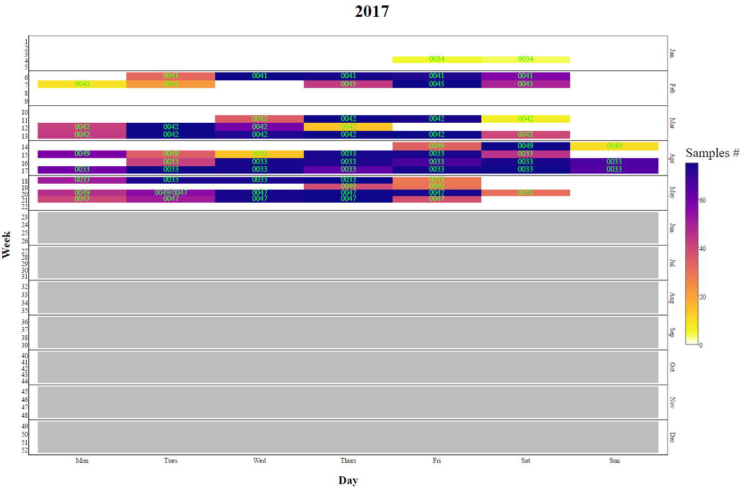
Productivity

Slide 23
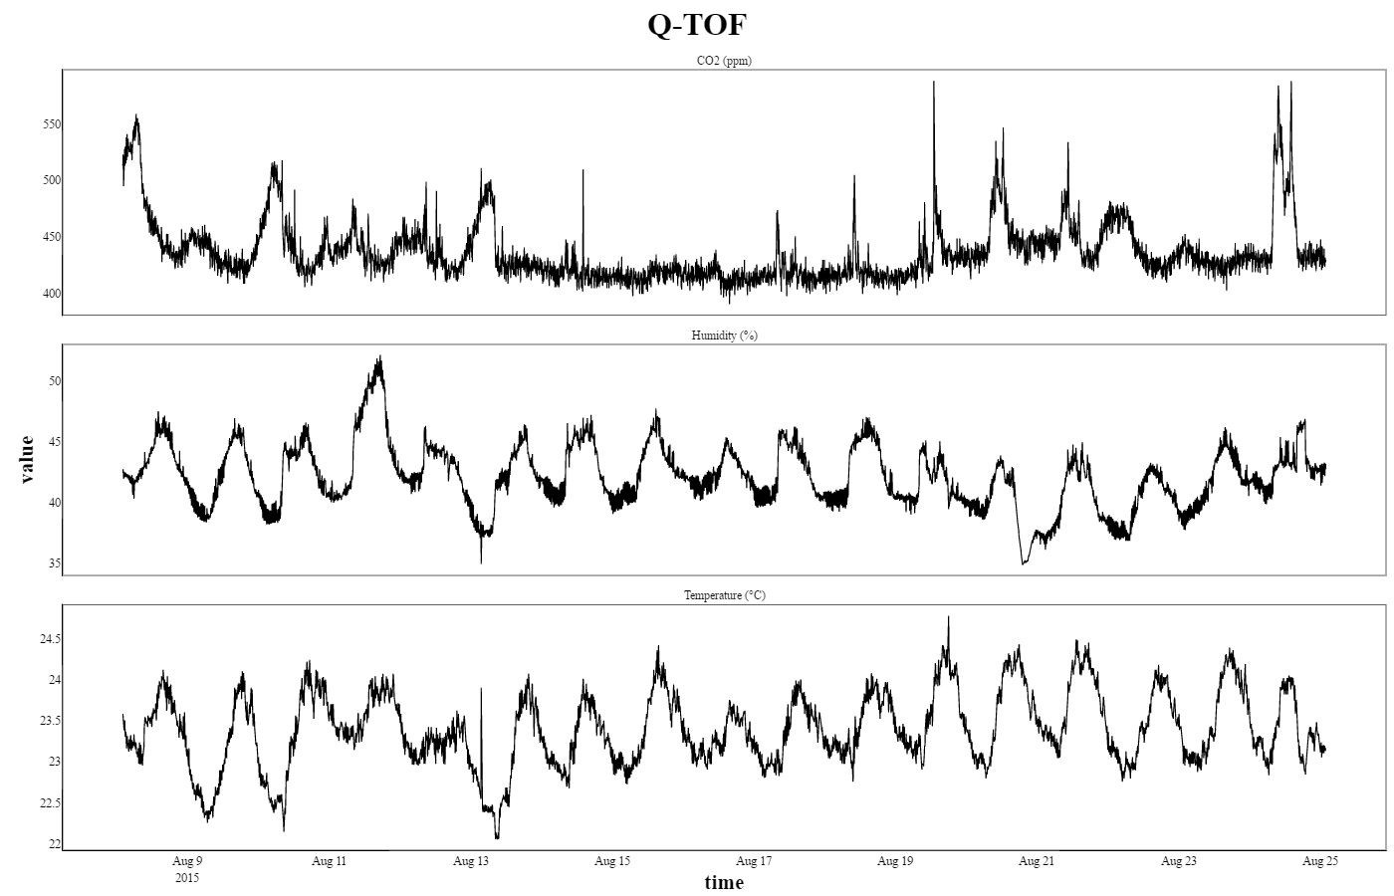
Room conditions

Slide 24
Real-time warnings
m/z accuracy outside parameters
Retention time outside parameters
Line broadening
Extreme loss of sensitivity
Contaminants increasing compared to historic past

Slide 25
Other features of QC4Metabolomics
Dataset reports
Flexible: e.g. compounds to track and peak-picking parameters can be customized
Modular: Modules can be enabled/disabled and modules can be written for a specific setup or new purpose
Data can be extracted from the database
Open-source
Written in R (XCMS) and shiny making it relatively accessible to bioinformaticians to expand

Slide 26
Perspective
Moving towards a clinical setting
Long term monitoring (storage)
Long term NIST samples stability/reproducibility
Inter-lab comparisons

Slide 27
Thank you for your attention

