Slide 1


Metabolomics pre-processing & Compound Annotation
6. September 2016
Gözde Gürdeniz & Jan Stanstrup
gozg@nexs.ku.dk
stanstrup@gmail.com
http://stanstrup.github.io
@JanStanstrup
Notes:
Publish slides? Slideshare, researchgate, my website?

Slide 2
Agenda
Why do we do metabolomics and what does the data look like?
LC-MS data pre-processing
Compound identification

Slide 3
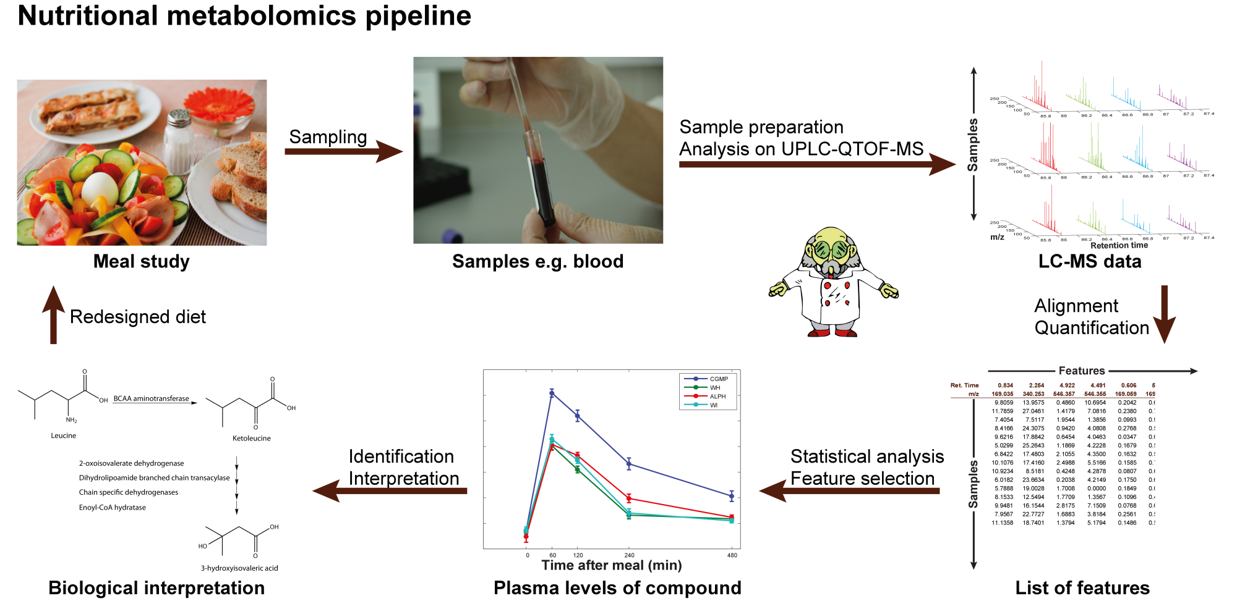
What is a metabolomics experiment?
Notes:
Normal analysis → specific measurement → jump right to interpretation
Sample contains so much more information
This is where metabolomics stand out and these and the steps we will be talking about today

Slide 4
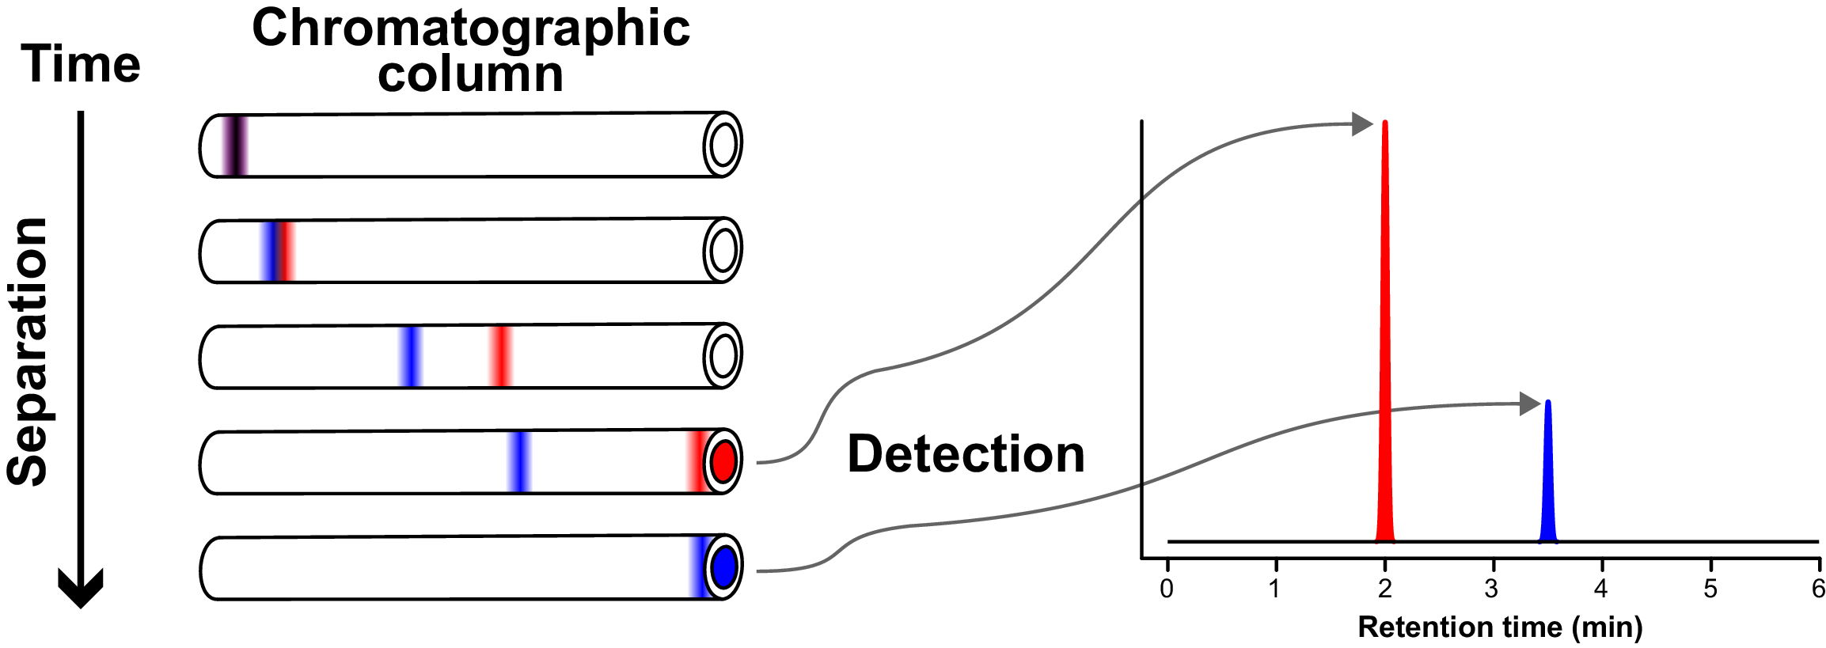
Separating the components
Notes:
Chromatogram

Slide 5
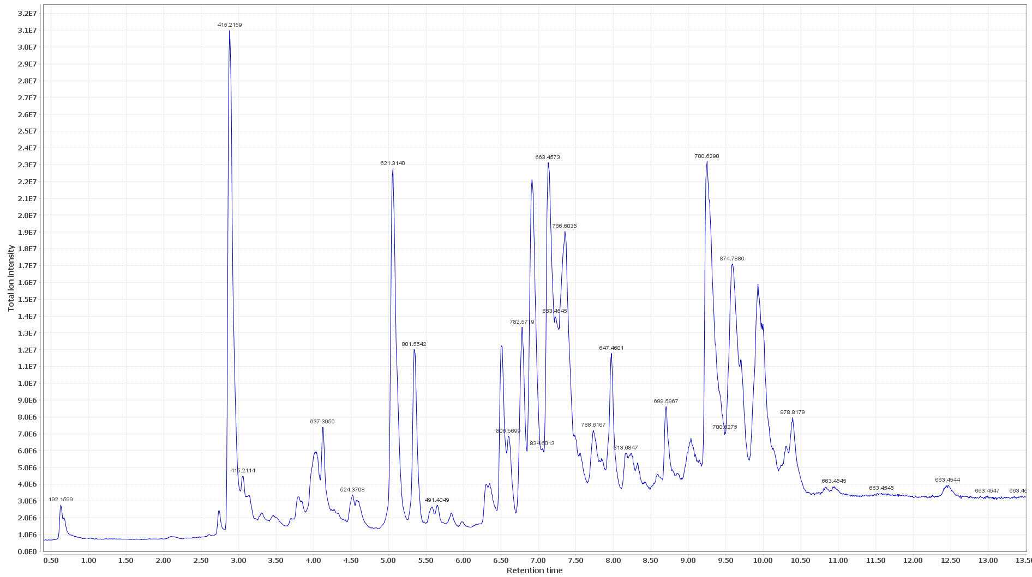
Separating the components
Notes:
Total Ion Chromatogram (TIC)

Slide 6
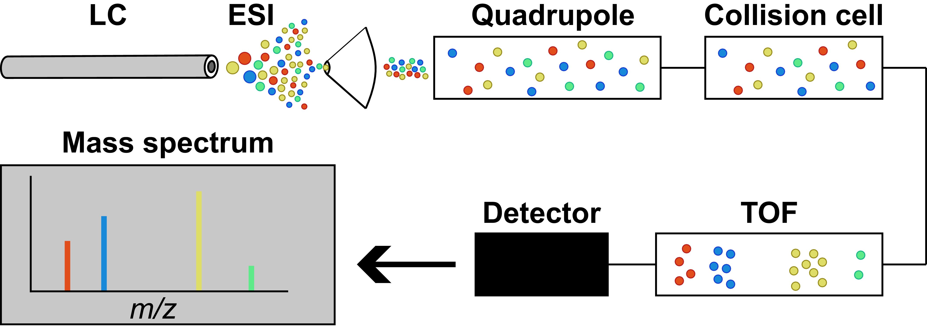
Scanning the compounds in complex samples
Notes:
Mass spectra

Slide 7
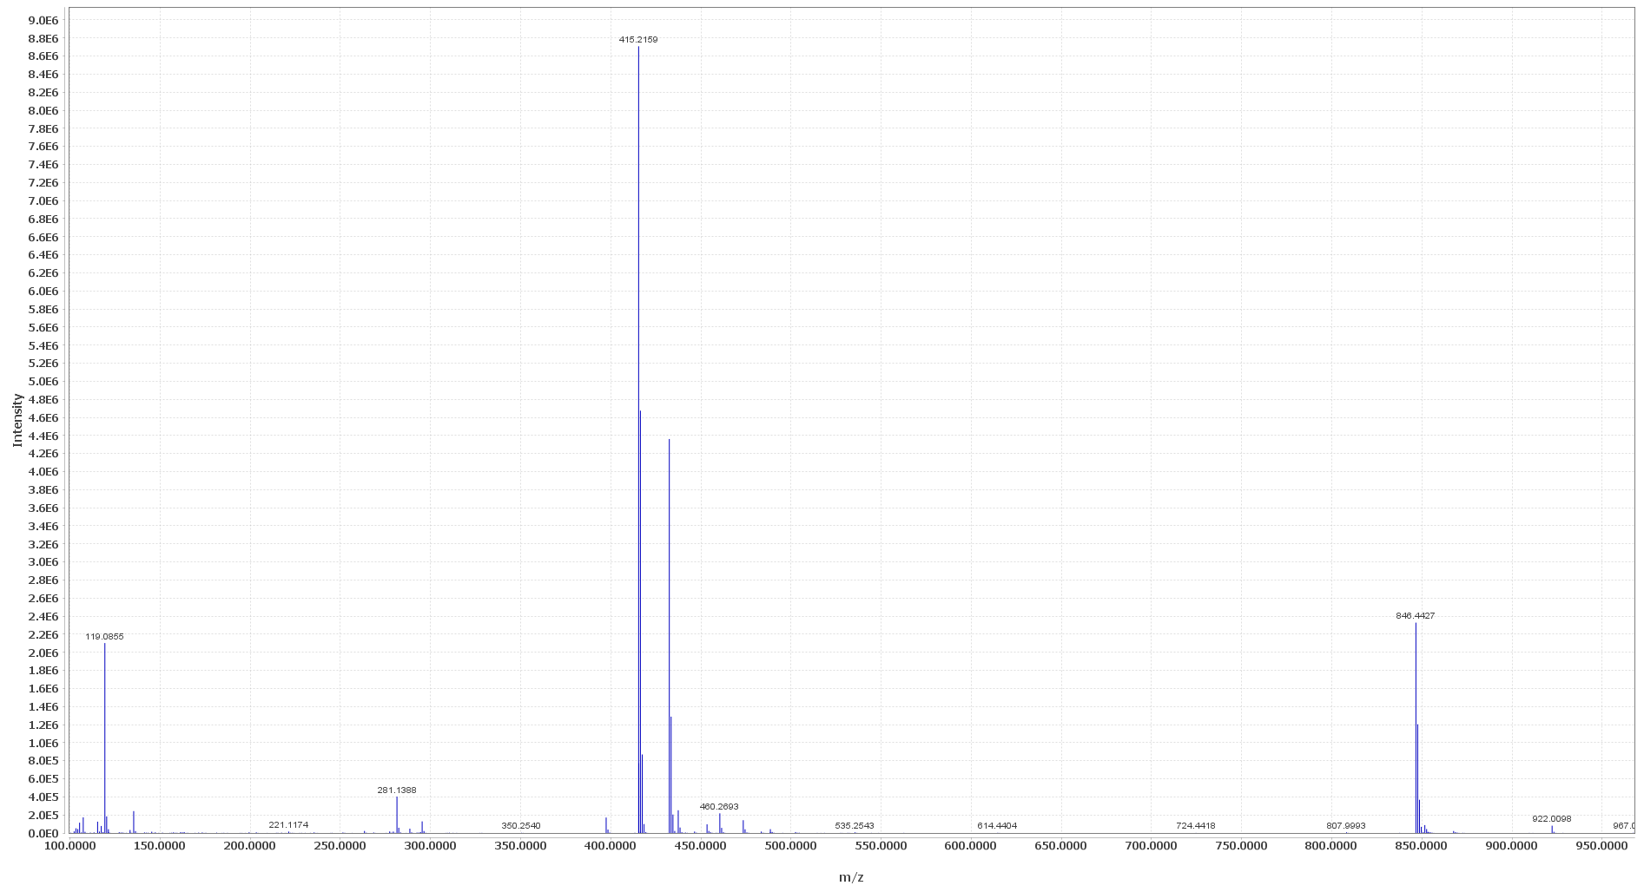
Scanning the compounds in complex samples
Notes:
For each time point →
Mass spectra

Slide 8
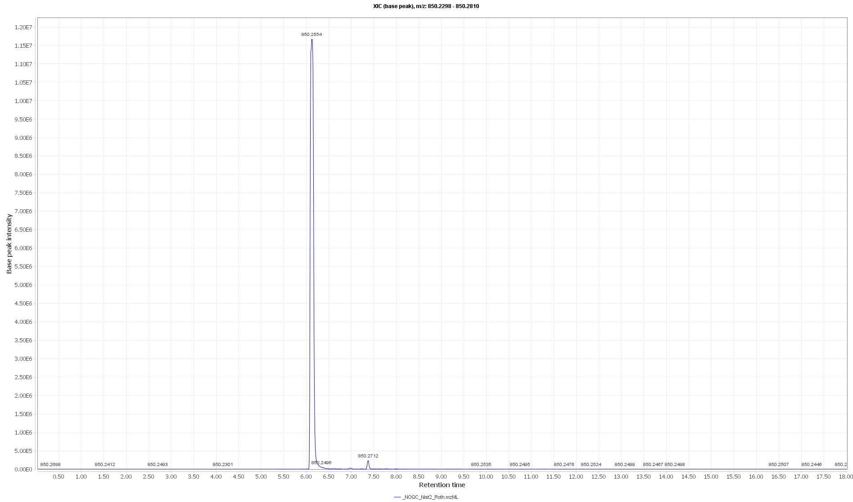
Scanning the compounds in complex samples
Notes:
Extracted Ion Chromatogram

Slide 9
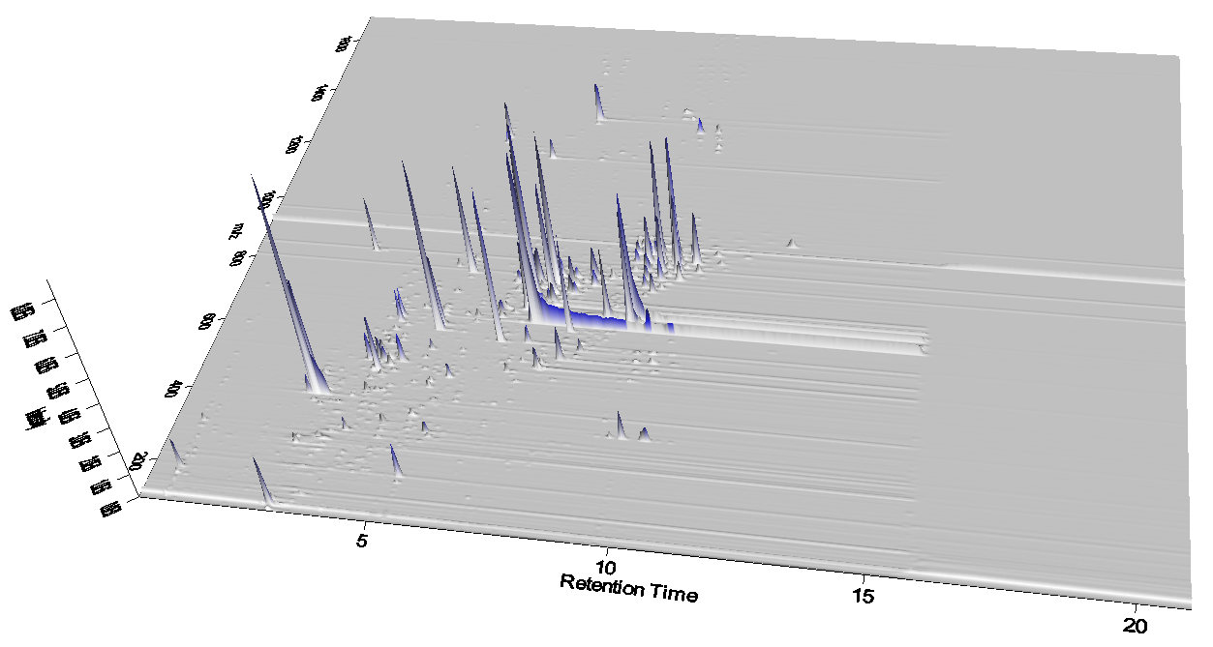
Complex 3D data

Slide 10
Complex 3D data
EIC

Slide 11
Complex 3D data
Mass spectrum

Slide 12
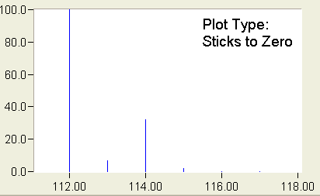
Molecular formula: Isotope pattern
C₆H₅Cl
monoisotopic mass
+1
+2
+3
Notes:
Pseudo-molecular Ion

Slide 13
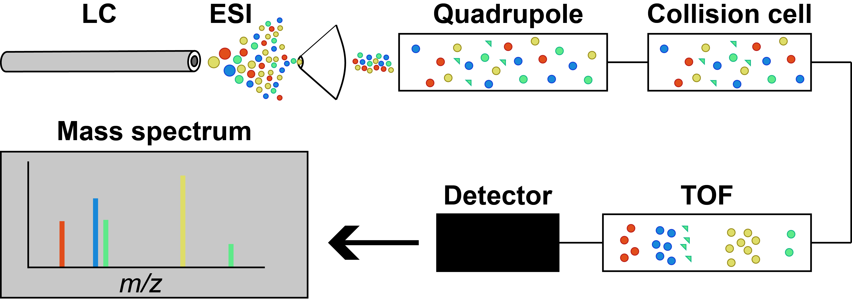
Fragmentation: MS¹ (Q-TOF)
Ionization in the ESI source. Some in-source fragmentation takes place (green here).
Everything passes the quadrupole
Collision cell is ”off”
TOF separates by m/z
Notes:
Pseudo-molecular ion
Only ionized by adding or removing a hydrogen.
There are other things than fragments that can cause additional peaks from the same compound → adducts

Slide 14
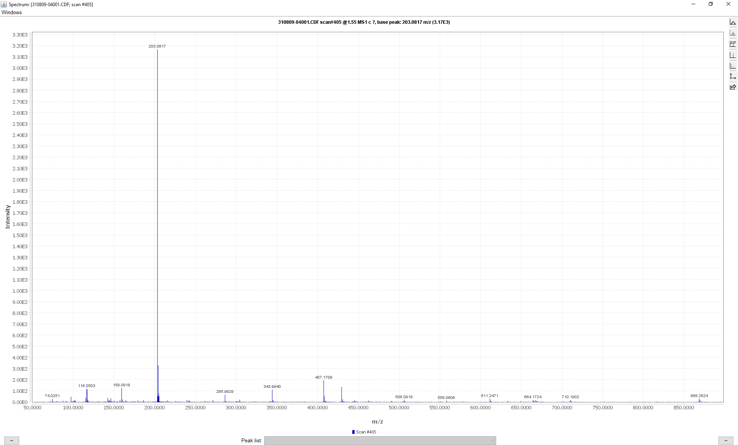
Adducts

Slide 15
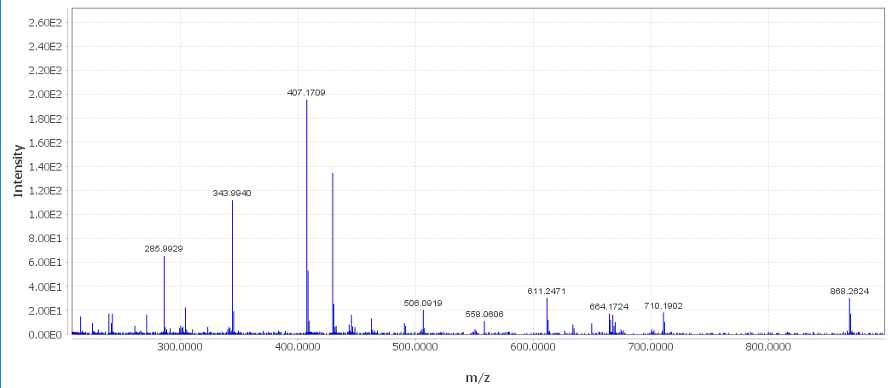
Adducts and polymers
[2M-H⁺]⁻
???
Contaminants
[2M+Na⁺-2H⁺]⁻
[4M+Fe³⁺-4H⁺]⁻
[3M-H⁺]⁻
[4M+Fe³⁺-4H⁺]⁻
Notes:
There is not the most common adducts that would be chloride - or at least they are very small – but we see these other adducts… →
Remember this is MS1. so also coeluting compounds
Doing this manually is a very tedious process

Slide 16
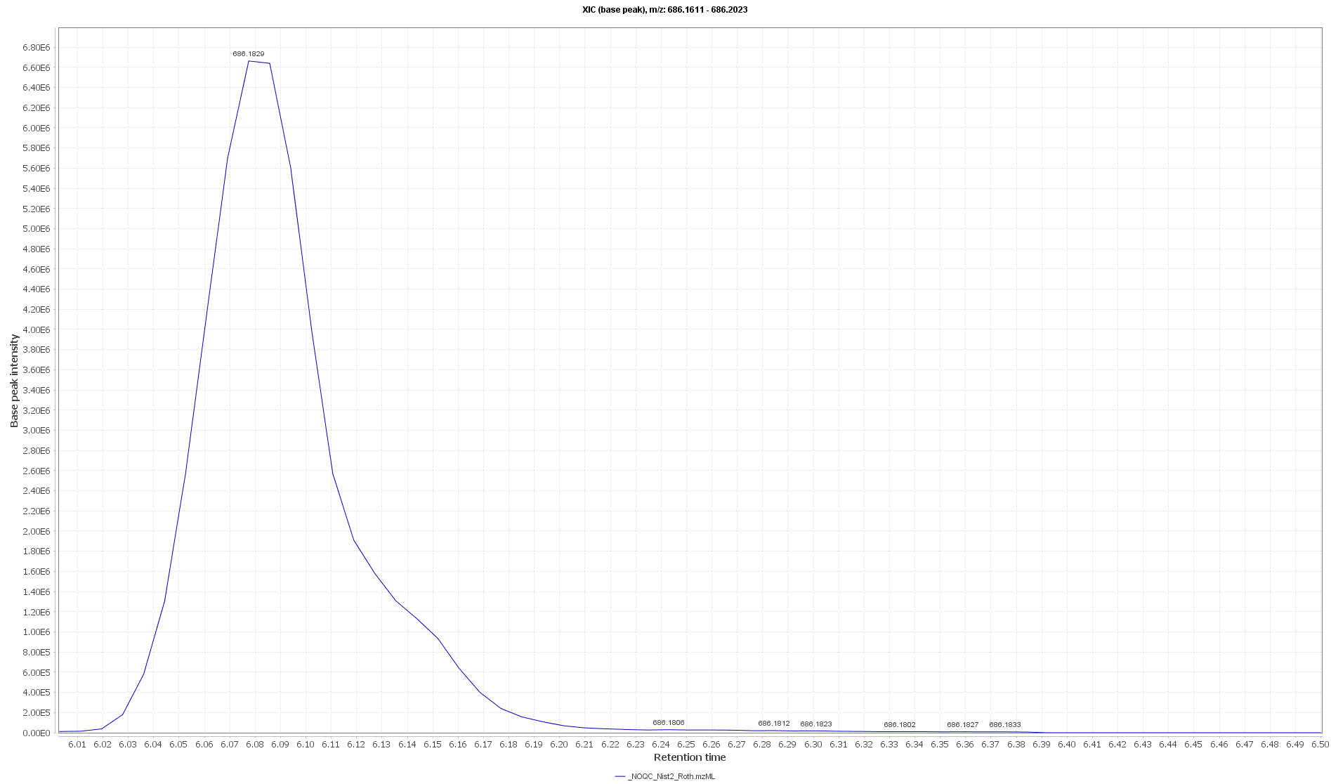
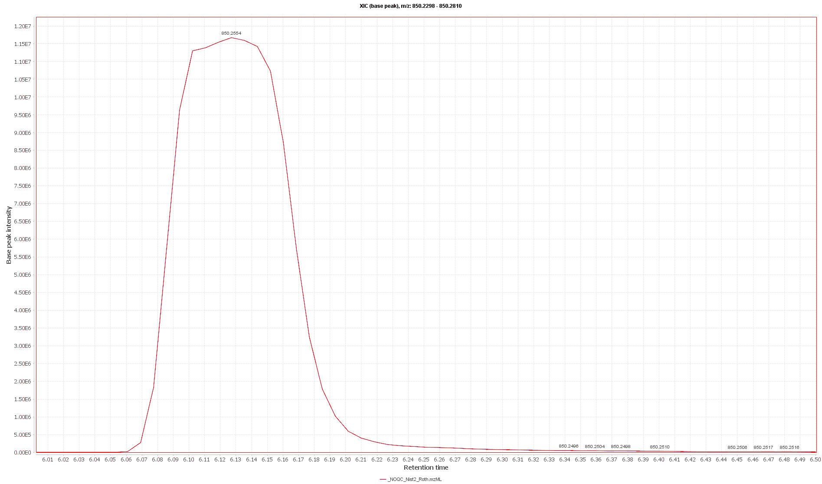
Related or not?

Slide 17
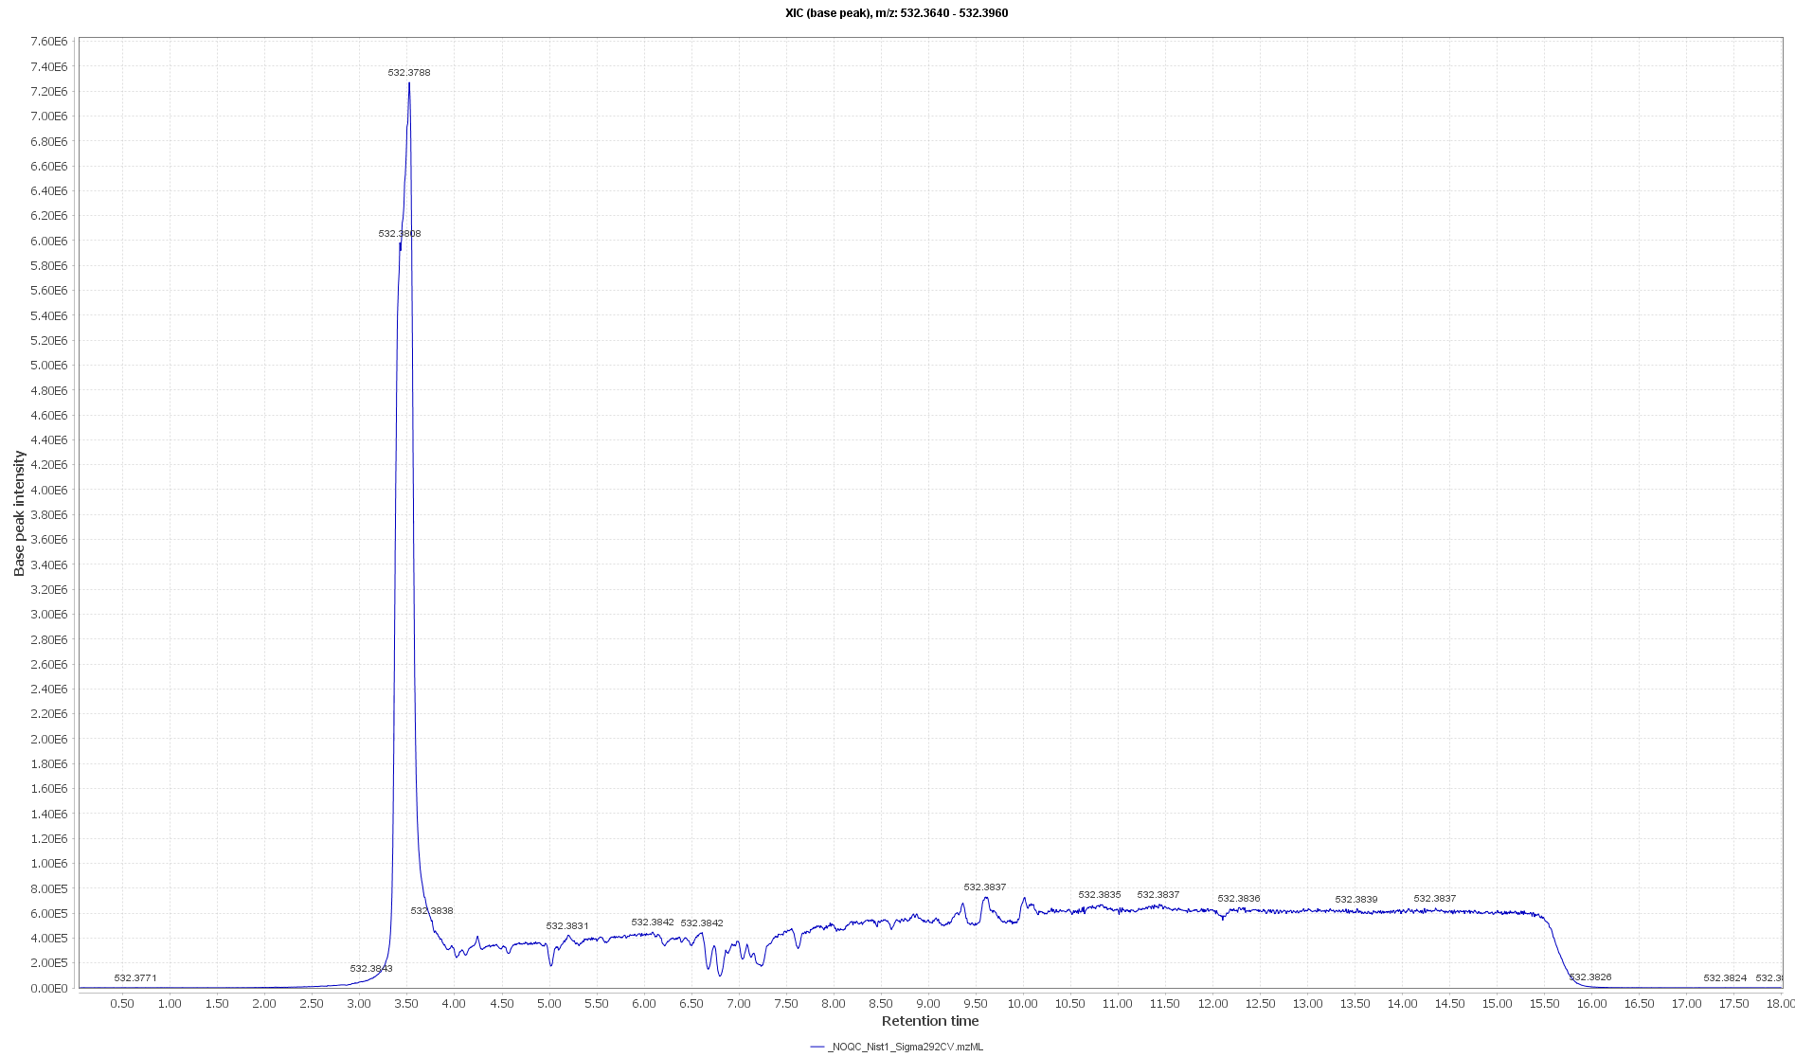
Unrelated and probably contaminant

Slide 18
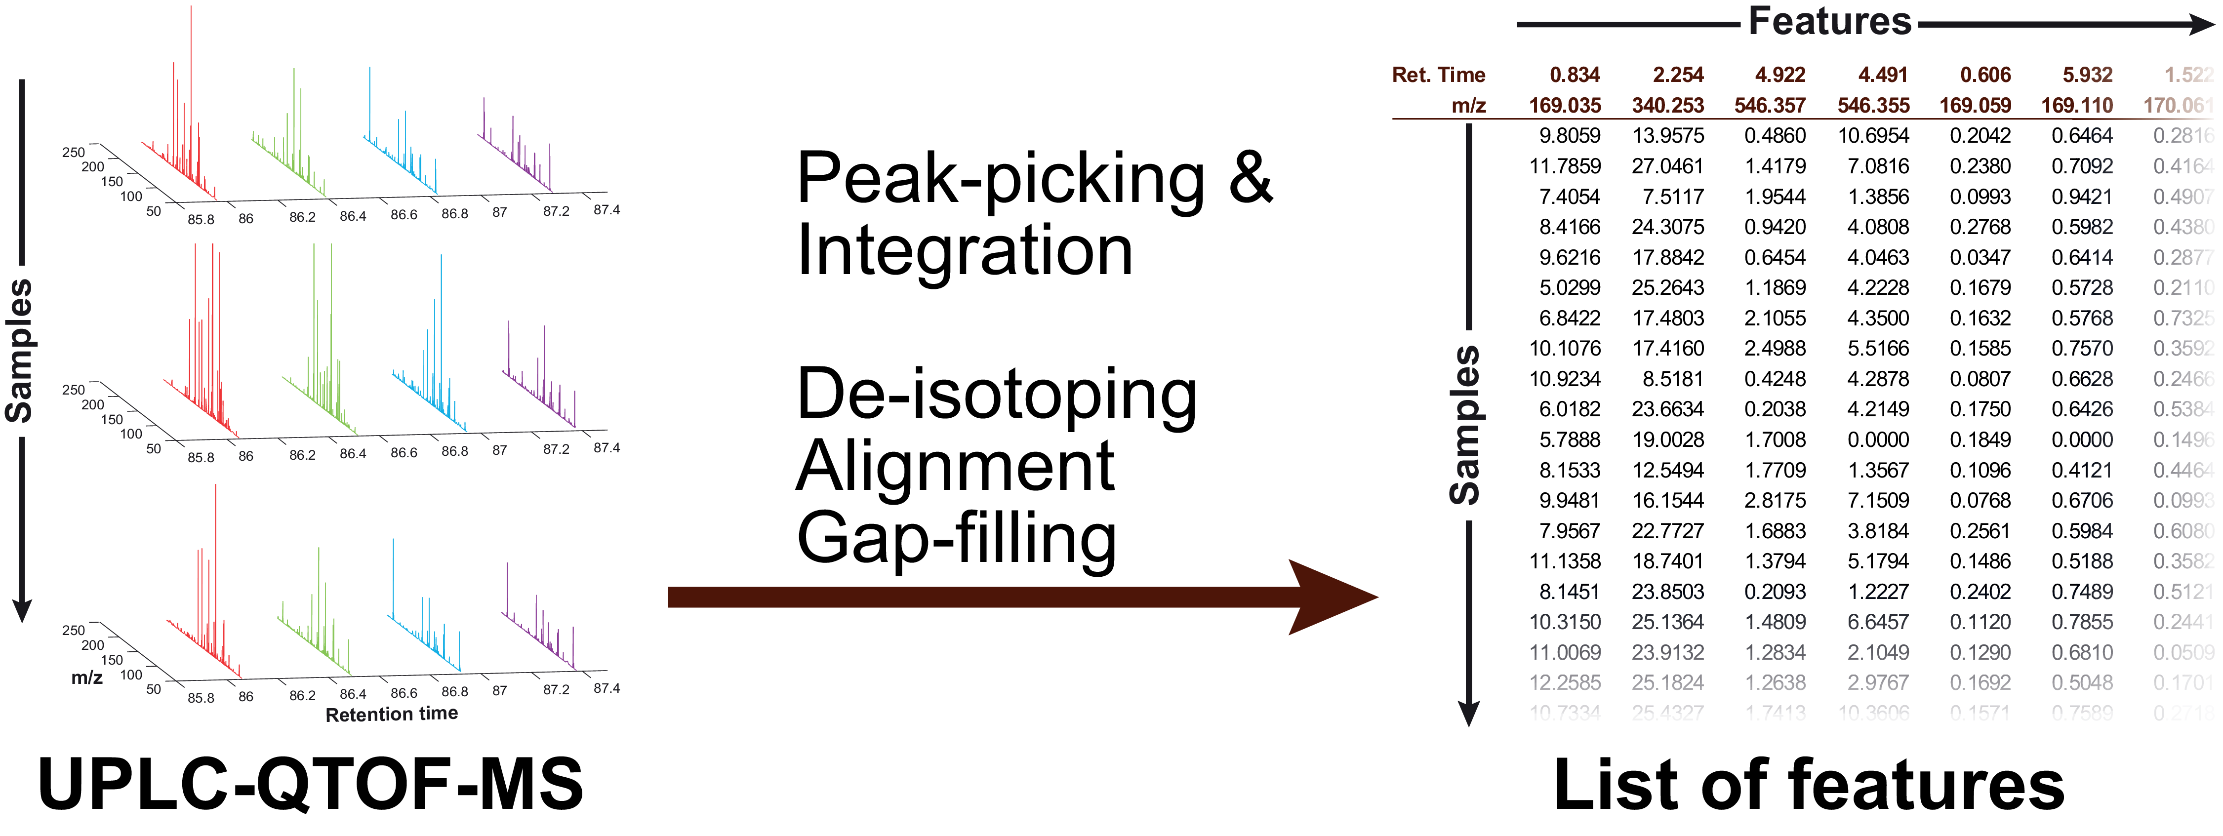
Why we need pre-processing

Slide 19
Why we need pre-processing

Slide 20
Converting data to open formats
Converters
ProteoWizard for most formats
Some vendor converters
Some (old) format specific converters
Formats
netCDF: Obsolete, limited, well-supported
mzXML: Obsolete, well-supported
mzData: Obsolete, limited support
mzML: Current standard
Vendor | Formats | Converter
Agilent | .d | ProteoWizard
Bruker | .d, YEP, BAF, FID | CompassXport (Bruker) ProteoWizard (registry trick required!)
Thermo Fisher | RAW | ProteoWizard
Waters | .raw | DataBridge (Waters, only netCDF) ProteoWizard (only new version with lockmassRefiner filter) Masswolf: Intertwines lockmass scans

