Slide 1
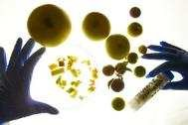

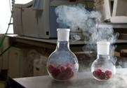

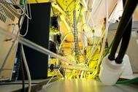

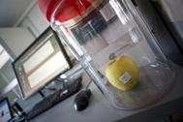



Compound identification in MS metabolomics NEXS, University of Copenhagen, 11th February 2016
Jan Stanstrup
Department of Food Quality and Nutrition, Research and Innovation Centre, Fondazione Edmund Mach (FEM), San Michele all’Adige (TN), Italy
Find me here
stanstrup.github.io
stanstrup@gmail.com
@JanStanstrup

Slide 2
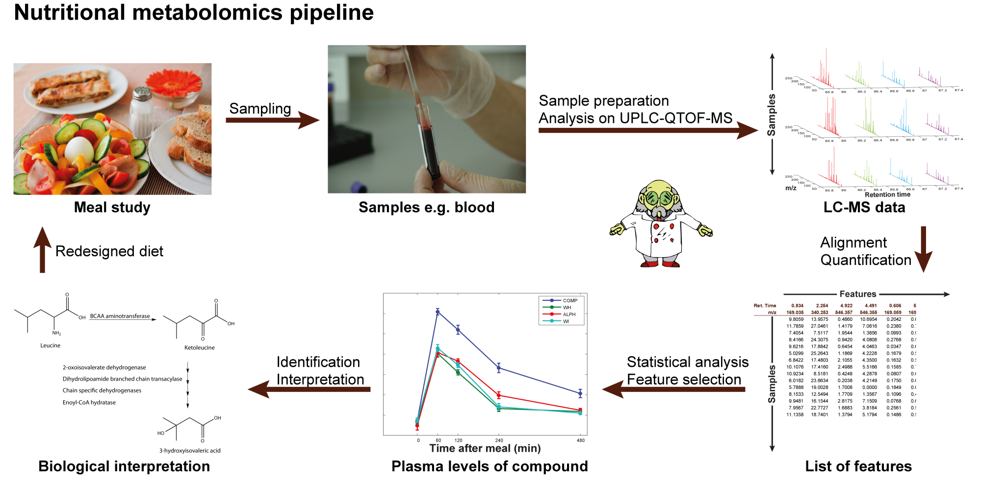
Identification of compounds in MS metabolomics
No ID → no biological context
Most time-consuming part of the whole pipeline

Slide 3
Identification of compounds in MS metabolomics
Molecular formula the old-fashioned way
Ex. 1: Decomposing a mass
Isotopic pattern
“low res” isotopic pattern
Isotopic fine pattern
Ion charge
Rules for valid molecular formula
Nitrogen rule
Double bond equivalent
Decomposing a mass
Exercise 2: Isotope fine pattern

Slide 4
Identification of compounds in MS metabolomics
Fragmentation and adducts
Fragmentation
Adducts
Ex. 3: Identification of a compound
CAMERA: Automatic annotation
Databases and tools
Compound databases
Spectral databases
In-silico fragmentation
Level of certainty
Identification levels
Ex. 3: Identification of a compound – revisited

Slide 5
Ex. 1.: Decomposing a molecular mass
 | Mass # | Rel. abundance
H | 1.0078 | 0.999885
 |  | 0.000115
C | 12.0000 | 0.9893
 |  | 0.0107
N | 14.0031 | 0.99636
 |  | 0.00364
O | 15.9949 | 0.99757
 |  | 0.00038
 |  | 0.00205
S | 31.9721 | 0.9499
 |  | 0.0075
 |  | 0.0425
Cl | 34.9689 | 0.7576
 | 36.9659 | 0.2424
Mass = 46. What can it be?
Formula | Nitrogen rule | DBE | Calc. m/z
NS | Invalid | 1.5 | 45.9751
CH2S | Valid | 1 | 45.9877
NO2 | Invalid | 1.5 | 45.9929
CH2O2 | Valid | 1 | 46.0055
H2N2O | Valid | 1 | 46.0167
CH4NO | Invalid | 0.5 | 46.0293
H4N3 | Invalid | 0.5 | 46.0405
C2H6O | Valid | 0 | 46.0419
CH6N2 | Valid | 0 | 46.0531
C2H8N | Invalid | -0.5 | 46.0657
C3H10 | Valid | -1 | 46.0783
H14S | Valid | -6 | 46.0816
H14O2 | Valid | -6 | 46.0994
H16NO | Invalid | -6.5 | 46.1232
H18N2 | Valid | -7 | 46.1470
Nitrogen dioxide
Formic acid
Ethanol

Slide 6
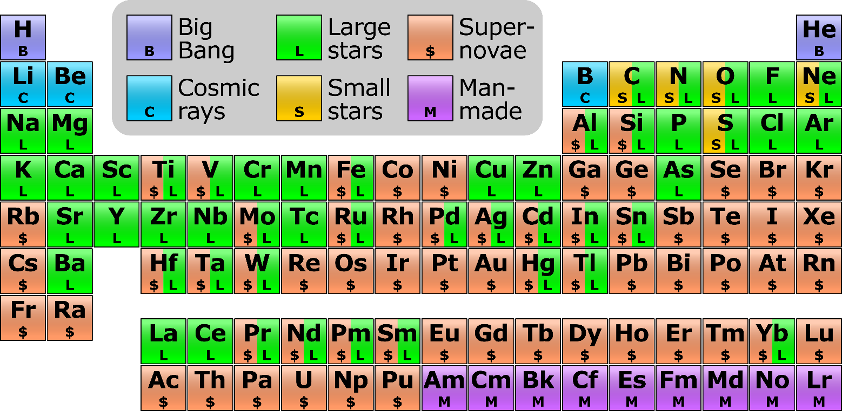
Isotopic pattern
Isotopes: atom with same number of protons and electrons, but different number of neutrons.
The mass of an atom is less than the sum of the parts (up to iron). Think E=mc². This 'missing mass' is known as the mass defect, and represents the energy that was released when the nucleus was formed
The change in mass defect caused by adding neutrons is different for each atom.
On earth the abundance of isotopes are more or less fixed. → Can be exploited for identification.
https://commons.wikimedia.org/wiki/File:Nucleosynthesis_periodic_table.svg

Slide 7
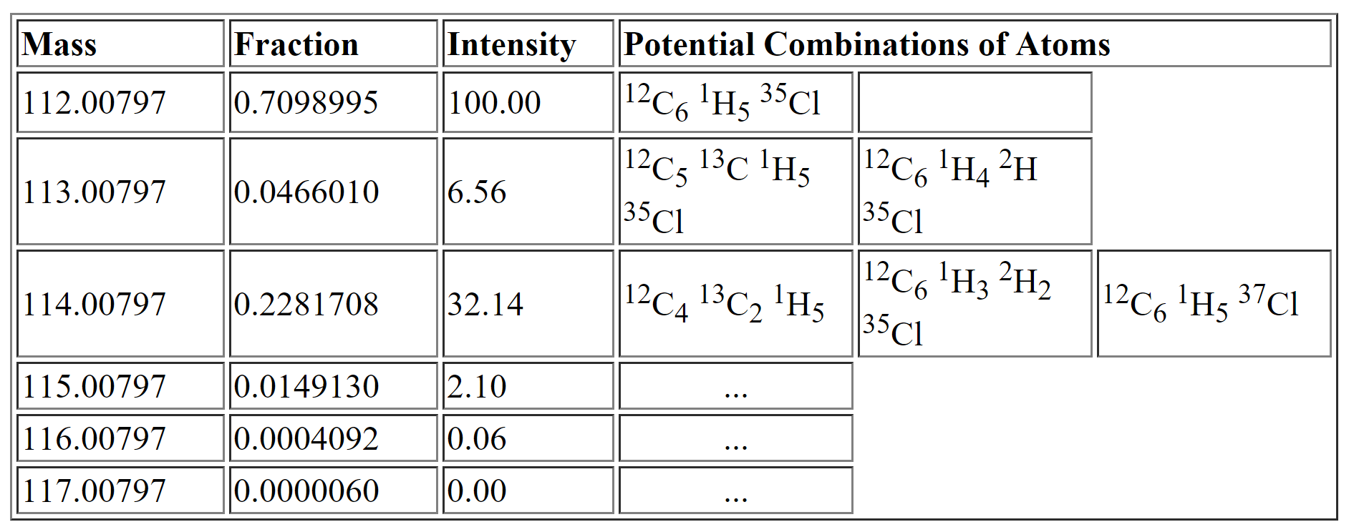
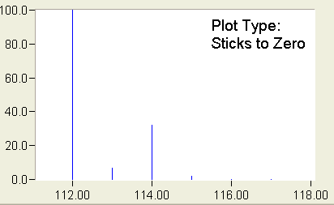
Isotopic pattern
 | Mass # | Rel. abundance
H | 1.0078 | 0.999885
 | 2.0141 | 0.000115
C | 12.0000 | 0.9893
 | 13.0033 | 0.0107
N | 14.0031 | 0.99636
 | 15.0001 | 0.00364
O | 15.9949 | 0.99757
 | 16.9991 | 0.00038
 | 17.9992 | 0.00205
S | 31.9721 | 0.9499
 | 32.9715 | 0.0075
 | 33.9679 | 0.0425
Cl | 34.9689 | 0.7576
 | 36.9659 | 0.2424
C₆H₅Cl
0.9893⁶ * 0.999885⁵ * 0.7576 = 0.7098364
6 * (0.9893⁵ * 0.0107 * 0.999885⁵ * 0.7576) +
5 * (0.9893⁶ * 0.999885⁴ * 0.000115 * 0.7576)
= 0.04647259
(difference to table due to differences in abundances in sources)
http://www.alchemistmatt.com/mwthelp/isotopicdistribution.htm
http://www.chem.uoa.gr/applets/AppletMS/Appl_Ms2.html

Slide 8
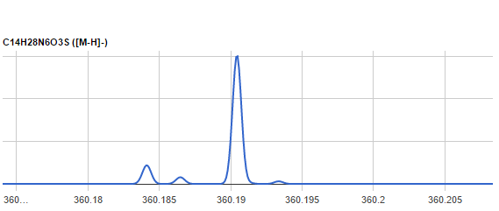

Isotopic fine pattern
Use first_iso.xlsx or first_iso_diff.xlsx
Use second_iso.xlsx or second_iso_diff.xlsx
360.1842-360.1905 = -0.0063
→ ¹⁵N
¹³C
+1 Isotope
+2 Isotope

Slide 9
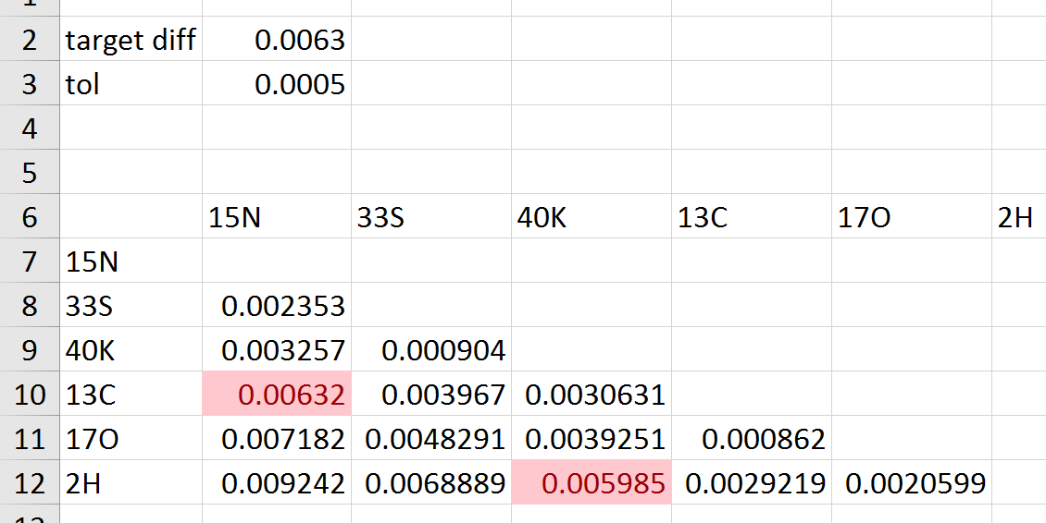
Isotopic fine pattern
Use first_iso.xlsx or first_iso_diff.xlsx
360.1842-360.1905 = -0.0063
→ ¹⁵N

Slide 10
Isotopic fine pattern
¹³C,¹⁵N
¹³C
³⁴S
¹³C,³³S
¹⁸O
¹⁵N
¹³C, ¹³C
³³S
²H
+1 Isotope
+2 Isotope

Slide 11
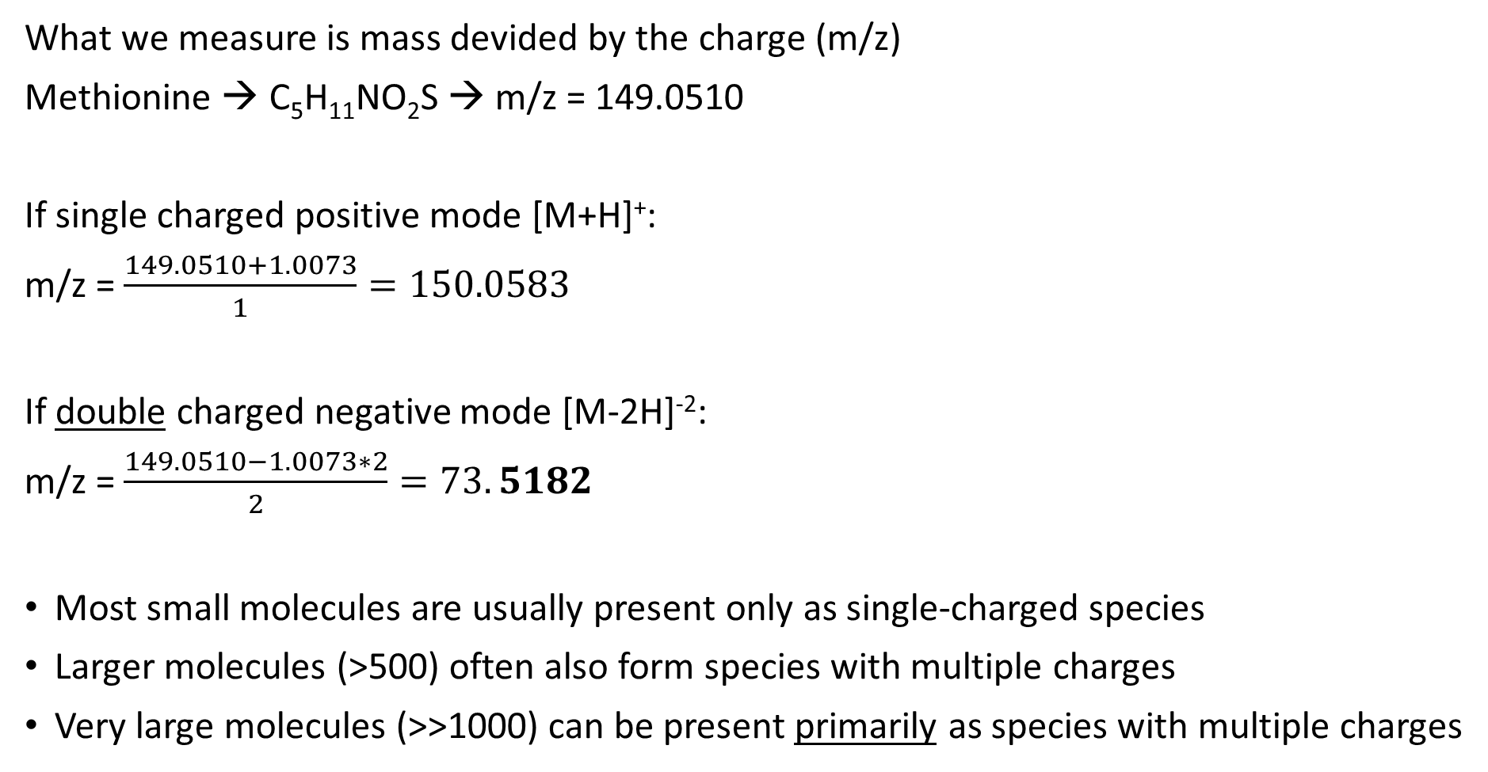
Ion charge
What we measure is mass devided by the charge (m/z)
Methionine → C₅H₁₁NO₂S → m/z = 149.0510
If single charged positive mode [M+H]⁺:
m/z = $\frac{149.0510+1.0073}{1}=150.0583$
If double charged negative mode [M-2H]⁻²:
m/z = $\frac{149.0510−1.0073∗2}{2}=73.5182$
Most small molecules are usually present only as single-charged species
Larger molecules (>500) often also form species with multiple charges
Very large molecules (>>1000) can be present primarily as species with multiple charges
Mass of a proton (H⁺)

Slide 12
Ion charge
The isotopic pattern can tell us the charge
Methionine single-charge isotopes peaks:
Ion Species | Isotope | Calculation of m/z
[M+H]⁺ | [M]⁺ | (149.0510 + 1.0073)/1 = 150.0583
[M+H]⁺ | [M+1]⁺ | (149.0510 + 1.0073 + 1.0033)/1 = 151.0616
[M+H]⁺ | [M+2]⁺ | (149.0510 + 1.0073 + 1.0033*2)/1 = 152.0649
Difference ∼ 1 Da
= 12C and 13C difference.
Estimation only! Real mass is an ”average” of the contributing isotopes.

Slide 13
Ion charge
The isotopic pattern can tell us the charge
Methionine double-charged isotopes peaks:
Ion Species | Isotope | Calculation of m/z
[M+2H]²⁺ | [M]⁺ | (149.0510 + 1.0073*2)/2 = 75.5328
[M+2H] ²⁺ | [M+1]⁺ | (149.0510 + 1.0073*2 + 1.0033)/2 = 76.0345
[M+2H] ²⁺ | [M+2]⁺ | (149.0510 + 1.0073*2 + 1.0033*2)/2 = 76.5361
Difference ∼ 0.5 Da

Slide 14
Nitrogen rule
For organic compounds containing exclusively H, C, N, O, Si, P, S, and the halogens:
odd nominal mass → odd number of N atoms
even nominal mass → zero or even number of N atoms
N.B.:
Reverses for +H and –H charged compounds!
Does NOT reverse for electron impact (i.e. classical GC since only an electon is lost/added)
Only works for small molecules (the non-integer part of masses will add up)
http://fiehnlab.ucdavis.edu/projects/Seven_Golden_Rules/Nitrogen_Rule

Slide 15

Double bond equivalent
Double bond equivalent (DBE) == Ring Double Bond Equivalents (RDBE) ==
Degree of unsaturation (UN, DoU) == Pi Bonds or Rings (PBoR)
For molecules containing only carbon, hydrogen, monovalent halogens, nitrogen, and oxygen:
$$DBE=C−\frac{H}{2}−\frac{X}{2}+\frac{N}{2}+1$$
C = number of carbons, H = number of hydrogens, X= number of halogens and N = number of nitrogens. All other atoms are ignored.
Rings → +1 DBE
Double bonds → +1 DBE
Triple bonds → +2 DBE
Benzene rings → +4 DBE
DBE = 1 !
Fiehn’s rant about why DBE is useless: http://fiehnlab.ucdavis.edu/projects/Seven_Golden_Rules/Ring-Double-Bonds

Slide 16
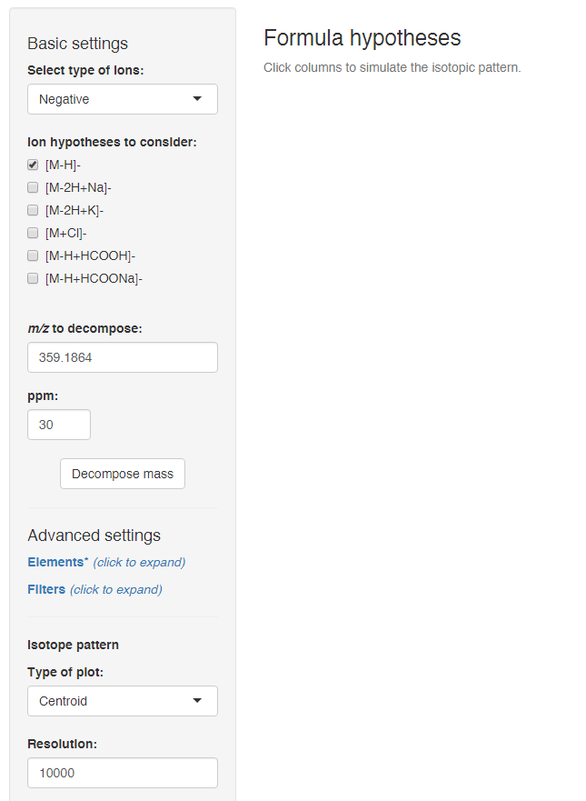
Decomposing a mass
http://predret.org/tools/mass-decomposition/

Slide 17
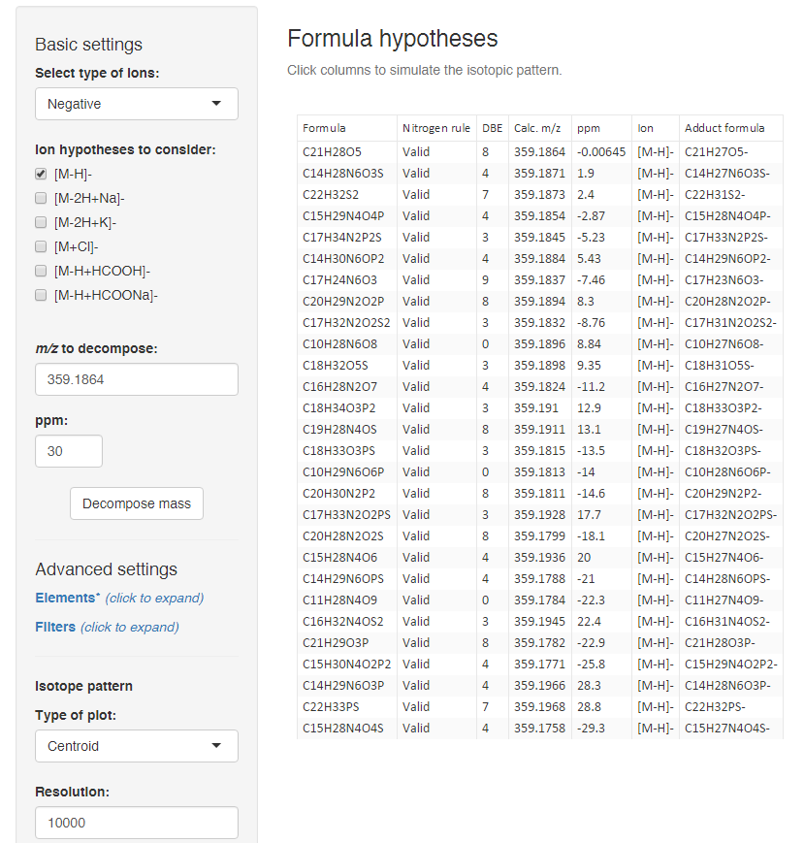
Decomposing a mass

Slide 18
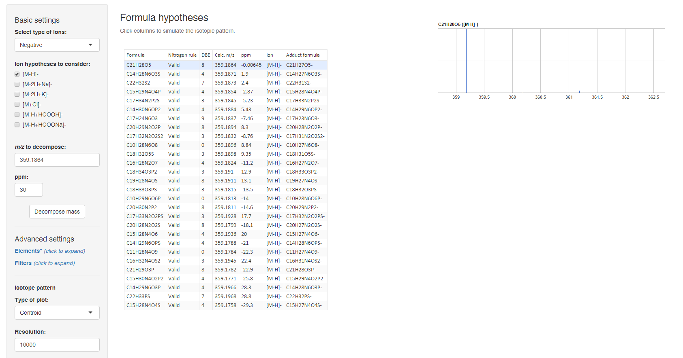
Decomposing a mass

Slide 19
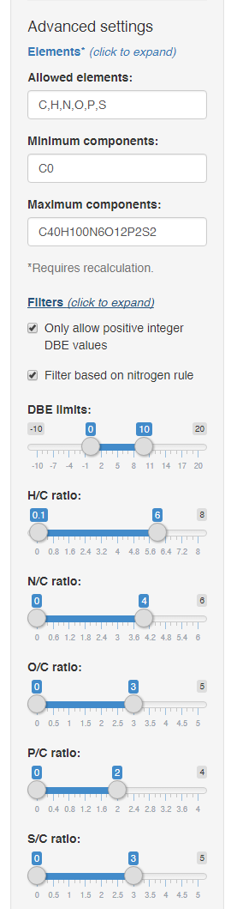
Decomposing a mass

Slide 20
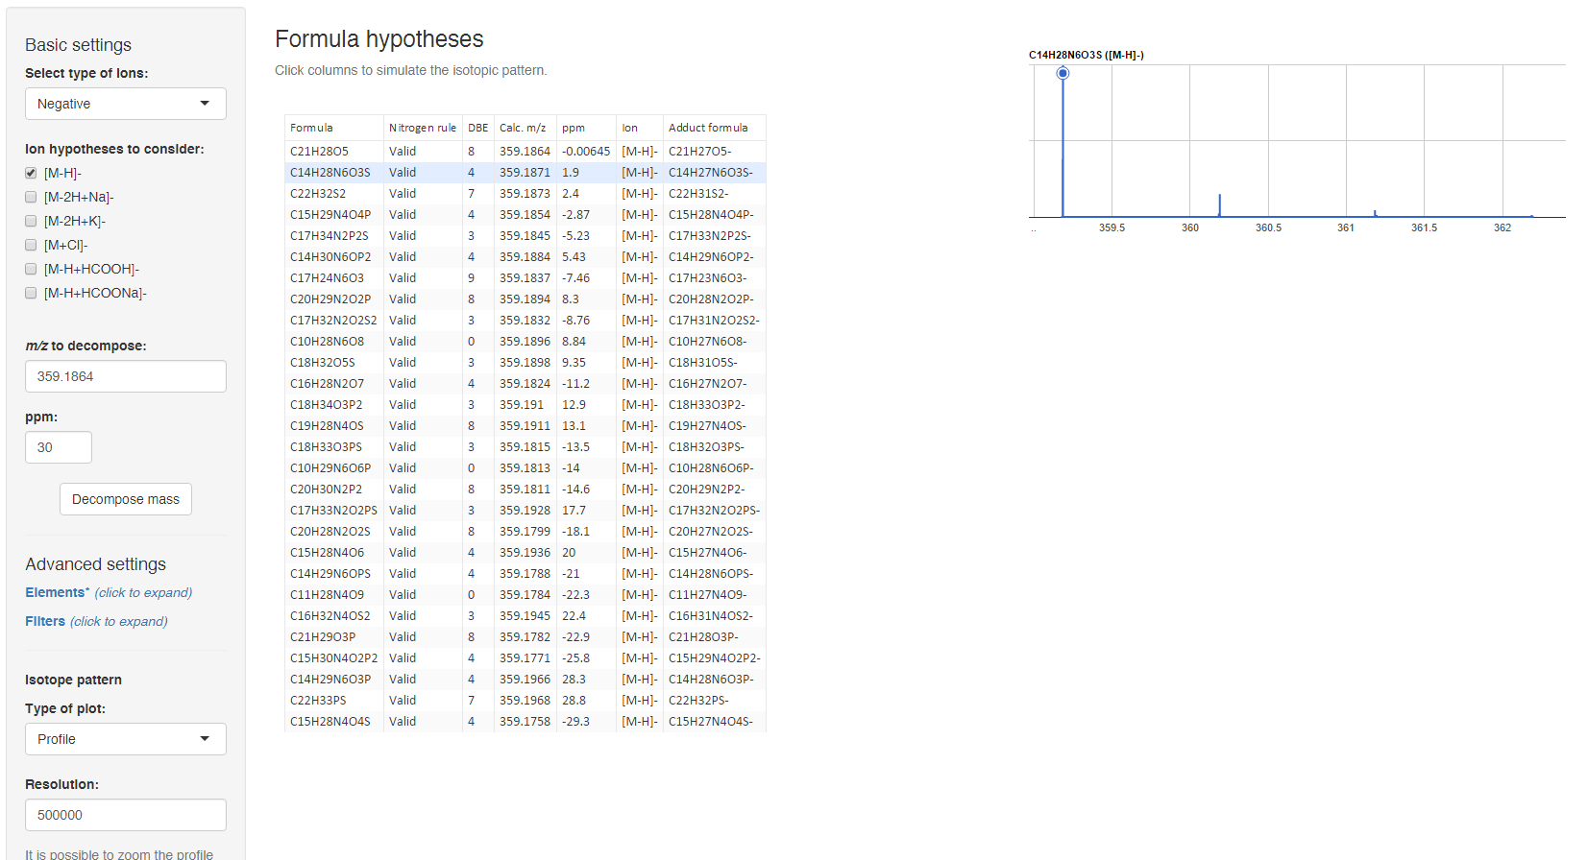
Decomposing a mass

Slide 21
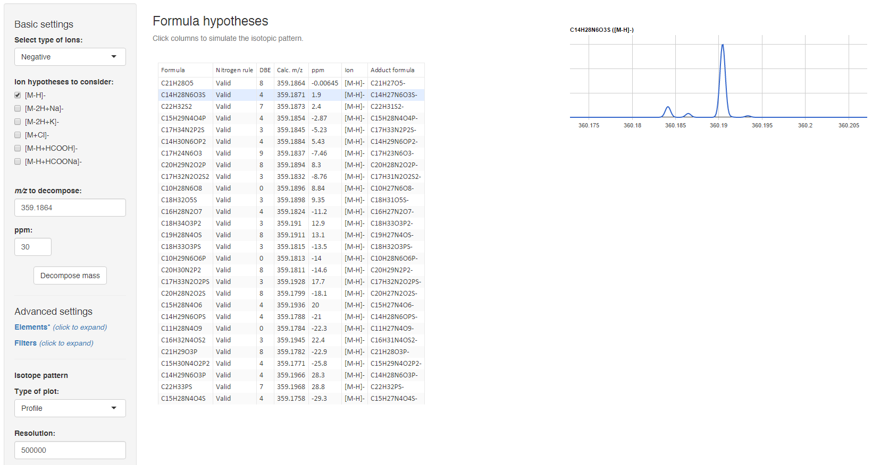
Decomposing a mass

Slide 22
Ex. 2: Isotope fine pattern
Open ex2_fine_isotope.html (you can zoom)
Use the excel files for isotopic fine pattern
Which elements are there for sure?
Which elements are NOT there?
What is the formula? Assume [M+H⁺]⁺.

Slide 23
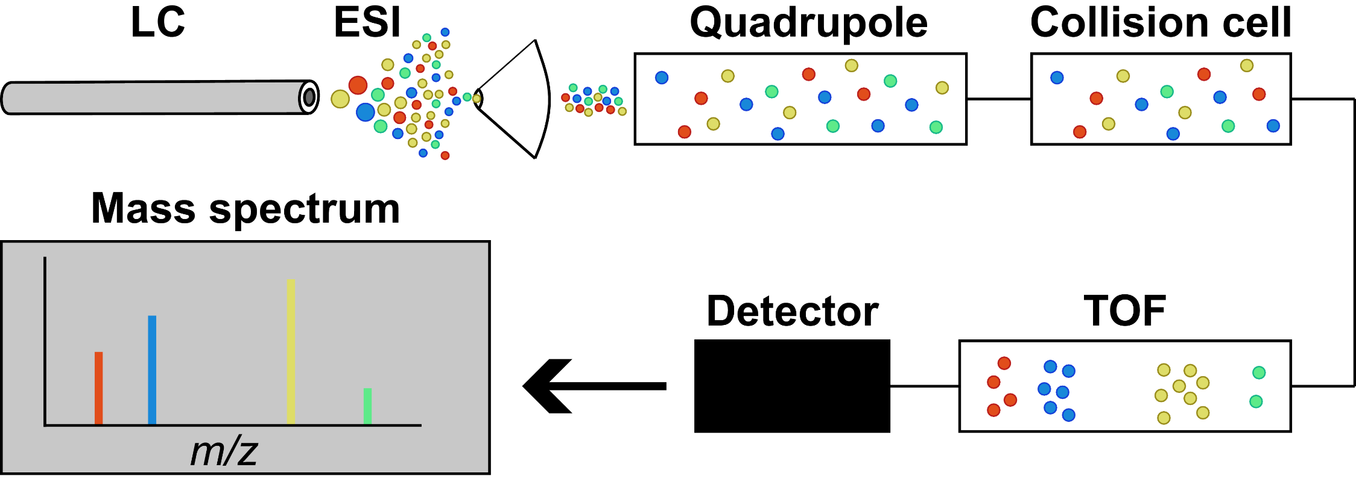
MS¹ vs MS/MS (MS²) vs MS^{n}
MS1: Let everything through the quadrupole
MS2: Select an ion in the quadrupole and fragment in collision cell
MS^{n}: Multiple steps of selection. MS^{n}-like spectra by fragmenting a known fragment (in-source fragmentation)

Slide 24
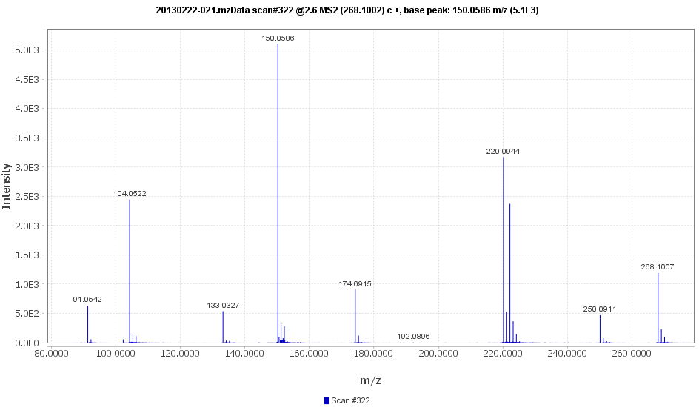
Fragmentation
-HCOOH
-CH₄S
-H₂O

Slide 25
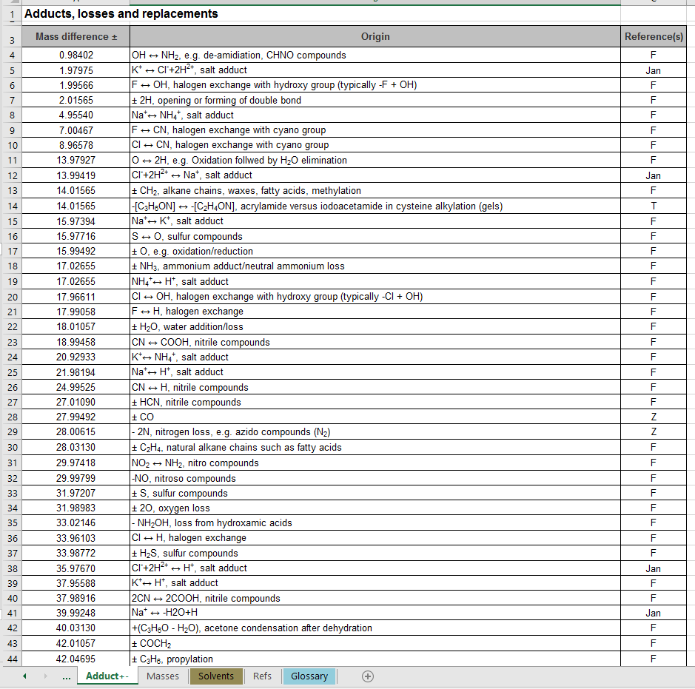
Fragmentation

Slide 26
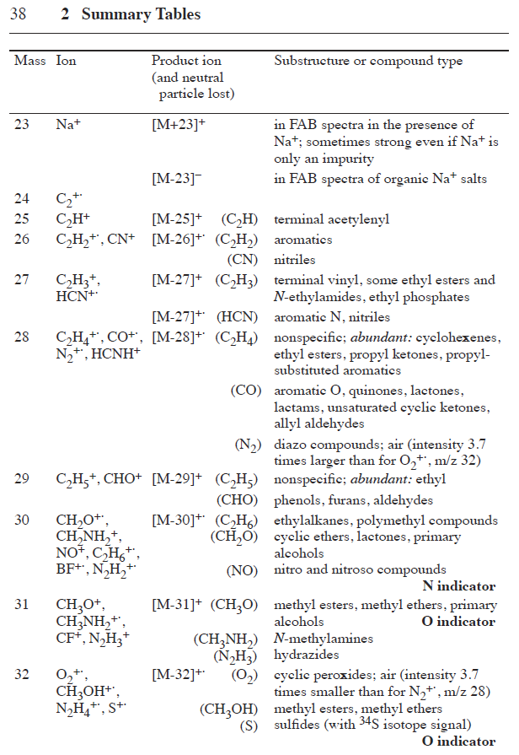
Fragmentation
Pretsch, Buļhlmann & Badertscher. Structure Determination of Organic Compounds: Tables of Spectral Data.

Slide 27
Fragmentation
-NH₃
C₅H₁₁NO₂S
→ Methionine!
C₈H₆O
DBE = 6
-HCOOH
-CH₄S
-H₂O

Slide 28
Fragmentation
(
)
-NH₃
-HCOOH
-phenylacetyl
-H₂O
-CH₄S
-CO
-HCOOH

Slide 29
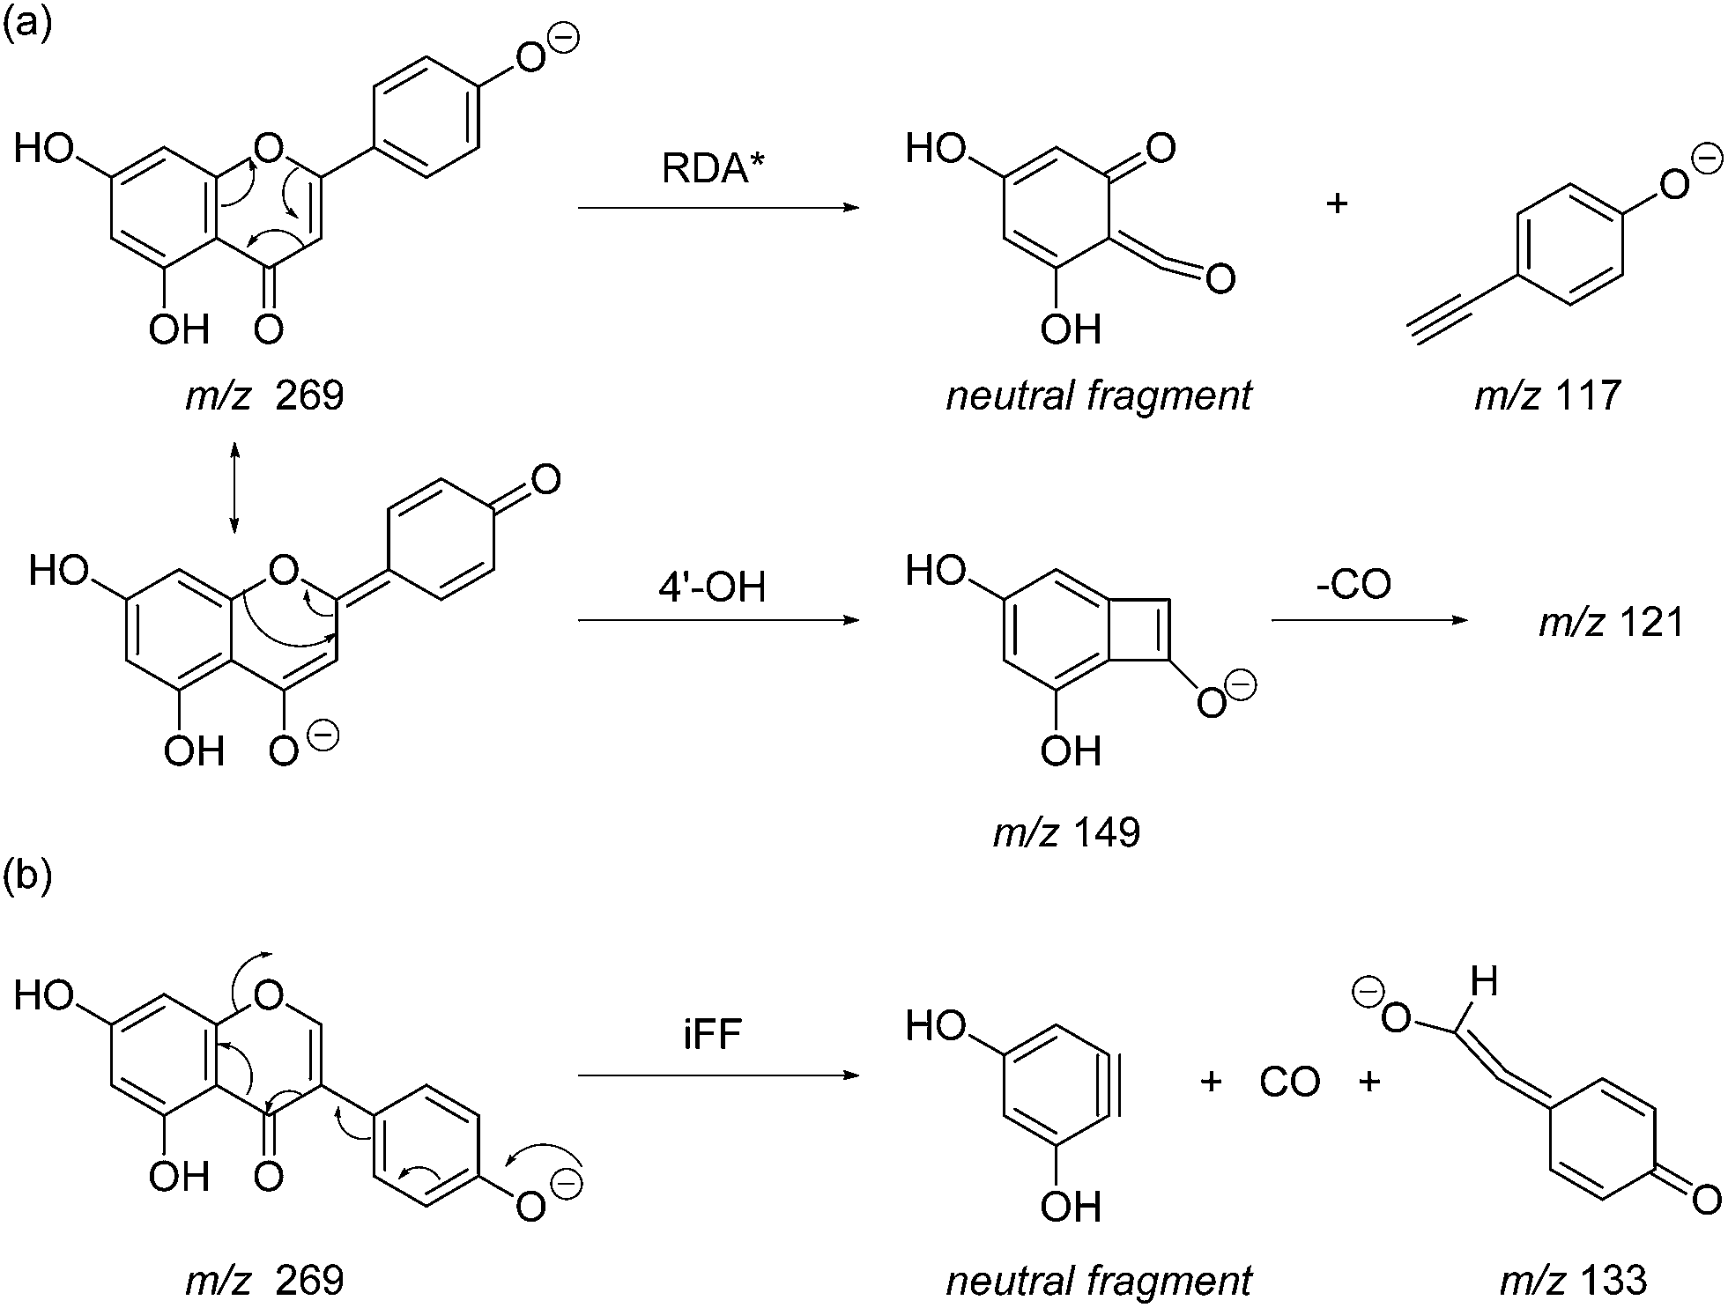
Fragmentation
Anal. Methods, 2014, 6, 8915-8923

Slide 30
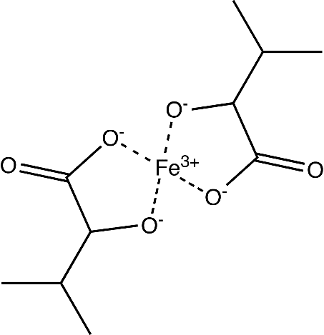
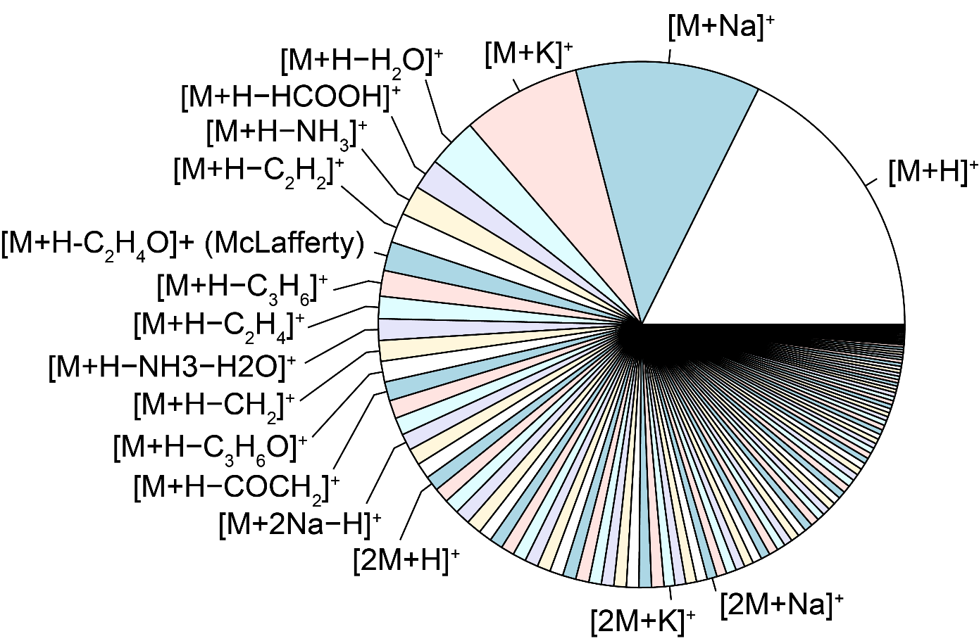
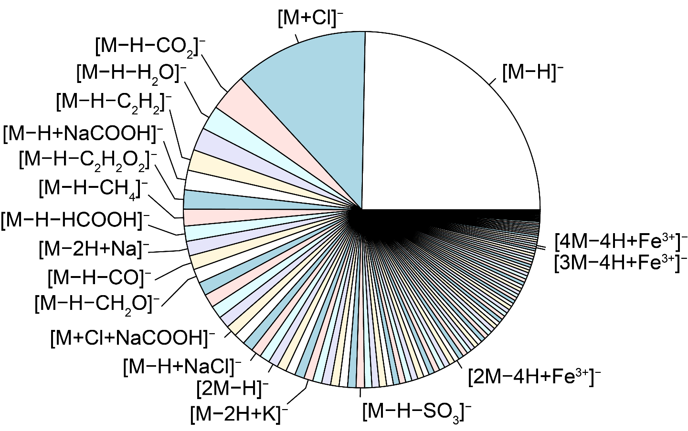
Adducts
Usually caused by molecules being charge by combining with a charged species other than H (e.g. Na⁺, K⁺, Cl⁻).
Neutral adducts also exist (e.g. formic acid, acetone, sodium formate, NaCl)

Slide 31
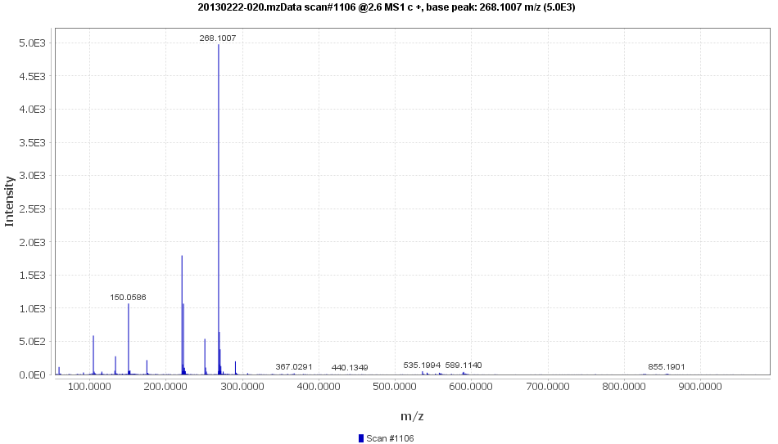
Adducts

Slide 32
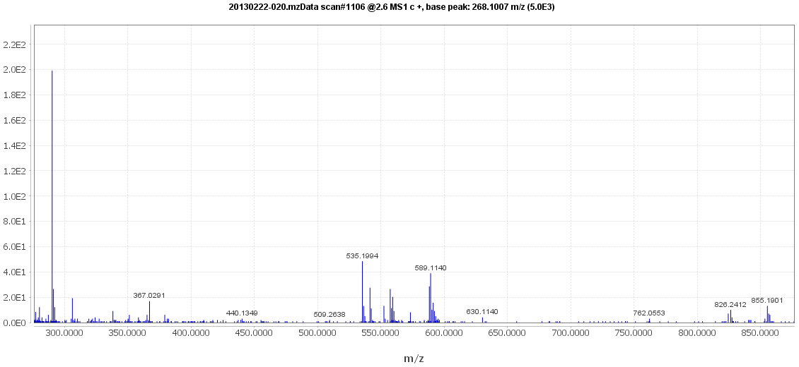
Adducts
[M+Na⁺]⁺
[2M+NH₄⁺]⁺
[2M+Na⁺]⁺
[2M+K⁺]⁺
[2M+Fe³⁺-2H⁻]⁺
[2M+H⁺]⁺
[M+K⁺]⁺

Slide 33
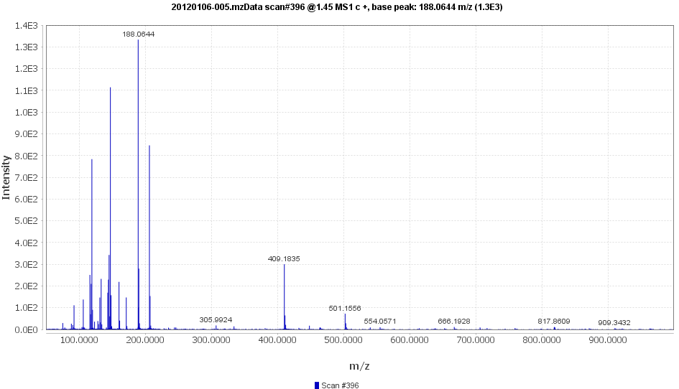
Exercise 3 – part 1
Open ”Exercise (20120106-005).mzData” in MzMine
Go to spectra 396 @ ~1.45 min. This is MS1. Not MS2.
What is the pseudo-molecular ion [M+H⁺]⁺?
What is the charge?
What is the possible/reasonable molecular formula at this point?

Slide 34
Exercise 3 – part 2
Open ”Exercise (20120106-005).mzData” in MzMine
Go to spectra 396 @ ~1.45 min. This is MS1. Not MS2.
What is the pseudo-molecular ion [M+H⁺]⁺?
What is the charge?
What is the possible/reasonable molecular formula at this point?
Annotate as many ions as possible
What is the molecular fomula?
What is the compound?

Slide 35
Automatic annotation: CAMERA
mz | rt | isotopes | adduct | pcgroup
117.0545 | 1.38 |  |  | 878
144.1019 | 1.41 |  |  | 878
163.0604 | 1.35 |  | [M+H-Leu]+ 293.148 | 878
276.1444 | 1.45 |  | [M+H-H2O]+ 293.148 | 878
280.1393 | 1.41 |  | [M+H-CH2]+ 293.148 | 878
294.1550 | 1.41 |  | [M+H]+ 293.148 | 878
295.1582 | 1.41 |  |  | 878
119.0491 | 1.40 |  | [M+H-NH3-HCOOH]+ 181.074 | 879
123.0440 | 1.40 |  | [M+H-NH3-COCH2]+ 181.074 | 879
136.0756 | 1.40 | [29][M]+ | [M+H-HCOOH]+ 181.074 | 879
137.0790 | 1.40 | [29][M+1]+ |  | 879
147.0441 | 1.40 |  | [M+H-NH3-H2O]+ 181.074 | 879
165.0547 | 1.40 | [65][M]+ | [M+H-NH3]+ 181.074 | 879
166.0581 | 1.40 | [65][M+1]+ |  | 879
182.0812 | 1.40 | [85][M]+ | [M+H]+ 181.074 | 879
183.0841 | 1.40 | [85][M+1]+ |  | 879
184.0854 | 1.40 | [85][M+2]+ |  | 879
204.0633 | 1.40 |  | [M+Na]+ 181.074 | 879
363.1554 | 1.40 |  | [2M+H]+ 181.074 [4M+2H]2+ 181.074 | 879
120.0515 | 1.40 |  |  | 880
122.0792 | 1.40 |  |  | 881
123.0552 | 1.40 |  |  | 882
322.0772 | 1.40 |  |  | 882
348.0708 | 1.40 |  | [M+H-COCH2]+ 389.074 | 882
428.0367 | 1.34 |  | [M+K]+ 389.074 | 882
124.0448 | 1.40 |  |  | 883
126.0298 | 1.40 |  | [M+H-gluc-(H2O)2]+ 337.065 | 884
152.0097 | 1.40 |  | [M+H-NH3]+ 168.029 | 884
169.0357 | 1.40 | [73][M]+ | [M+H]+ 168.029 | 884
170.0390 | 1.40 | [73][M+1]+ |  | 884
171.0402 | 1.40 | [73][M+2]+ |  | 884
185.0308 | 1.42 |  |  | 884
338.0683 | 1.40 |  | [M+H]+ 337.065 | 884
Fragment lists @ https://github.com/stanstrup/chemhelper/tree/master/inst/extdata

Slide 36
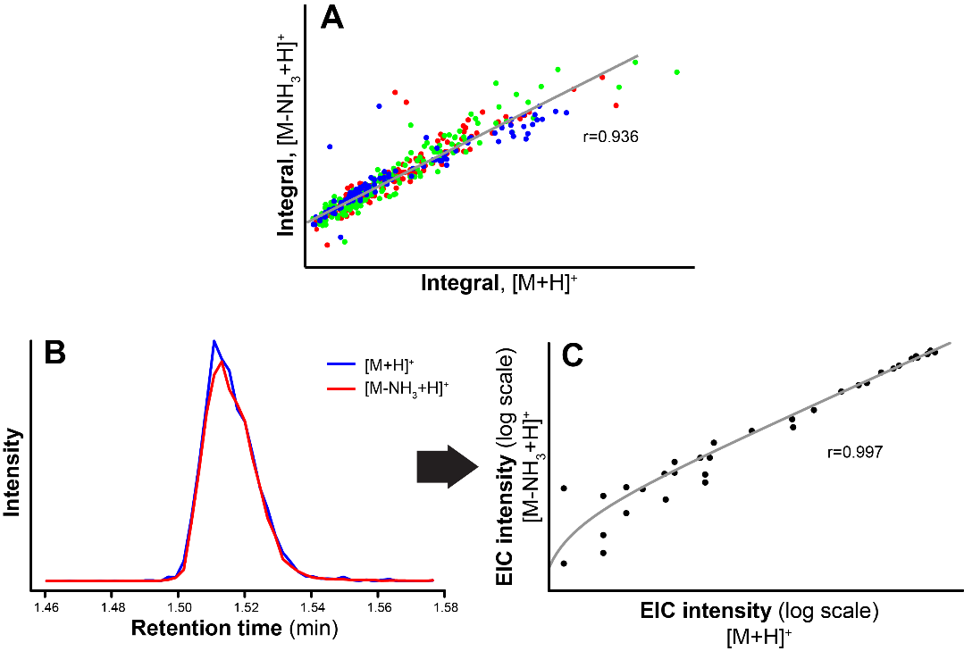
Automatic annotation: CAMERA

Slide 37
Automatic annotation: CAMERA

Slide 38
Automatic annotation: CAMERA

Slide 39
Databases and tools
Compound databases
Large
Contains the structure of compounds. Little other info.
Spectral databases
Relatively small
Contains authentic spectra of compounds.
In-silico fragmentation
Can be a database of in-silico predicted spectra.
Can be a tool that simulates spectra.
Can be a tool that tries to explain fragments in a given spectra and estimates if it is plausible for a given structure.

Slide 40
Compound databases
HMDB (hmdb.ca)
My compound ID (www.mycompoundid.org)
Metlin (metlin.scripps.edu)
Lipidmaps (www.lipidmaps.org/data/structure/LMSDSearch.php?Mode=SetupTextOntologySearch)
phenol-explorer (phenol-explorer.eu)
ChEBI (www.ebi.ac.uk/chebi/)
Chemspider (www.chemspider.com)
PubChem (pubchem.ncbi.nlm.nih.gov)
More in: Medina S et al. Trends in Analytical Chemistry The effects of the intake of plant foods on the human metabolome. Trends Anal Chem. 2013;52:88–99. http://dx.doi.org/10.1016/j.trac.2013.08.002

Slide 41
Human Metabolome Database (HMDB)
Small human metabolites (41.993 metabolite entries)
Searches
MS
MS/MS
compound
Metabocards
Description of metabolite
MS/MS spectra
links to other databases
Extended by MycompoundID.com
“Predicts” biological adducts
Predicts MS spectra for the predicted compounds
Huan T, Tang C, Li R, Shi Y, Lin G, Li L. MyCompoundID MS/MS Search: Metabolite Identification Using a Library of Predicted Fragment-Ion-Spectra of 383,830 Possible Human Metabolites. Anal Chem. 2015;87(20):10619–26.

Slide 42
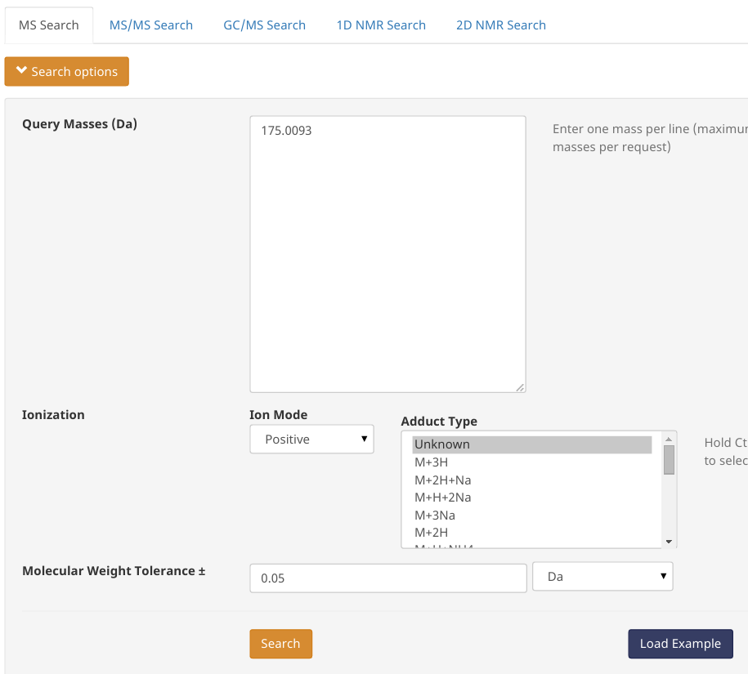
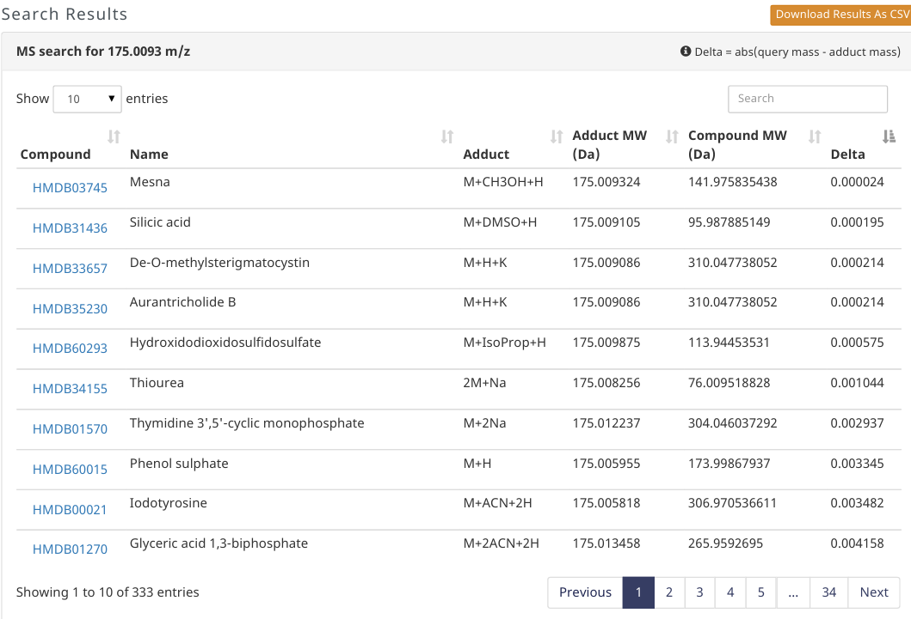
Human Metabolome Database (HMDB)

Slide 43
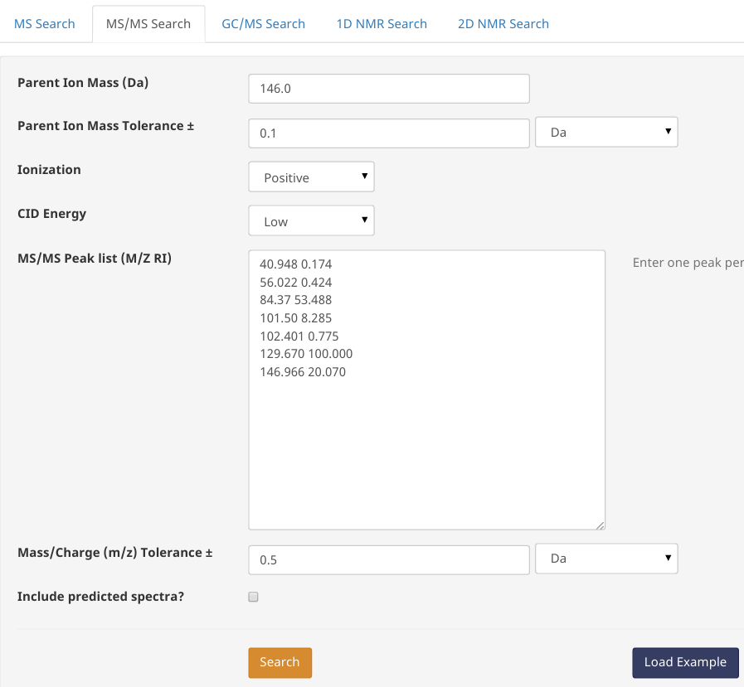
Human Metabolome Database (HMDB)

Slide 44
ChemSpider
Most known compounds (>40 million structures)
Searches
Name
Formula
Structure
Many name synonyms
An alternative is PubChem

Slide 45
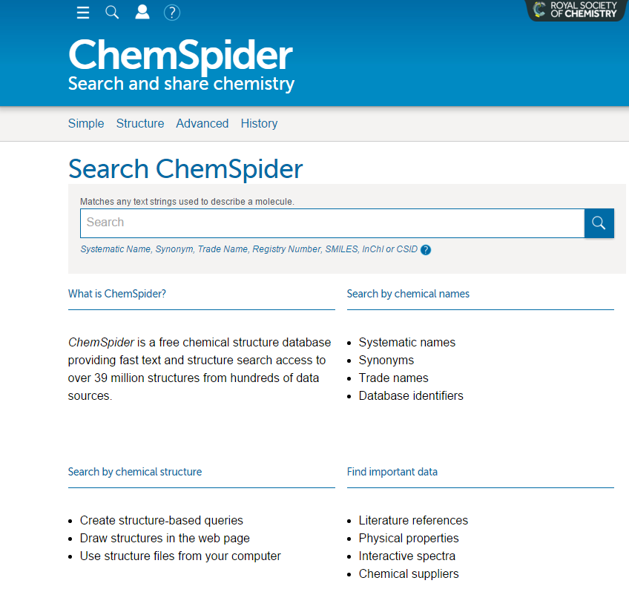
ChemSpider

Slide 46
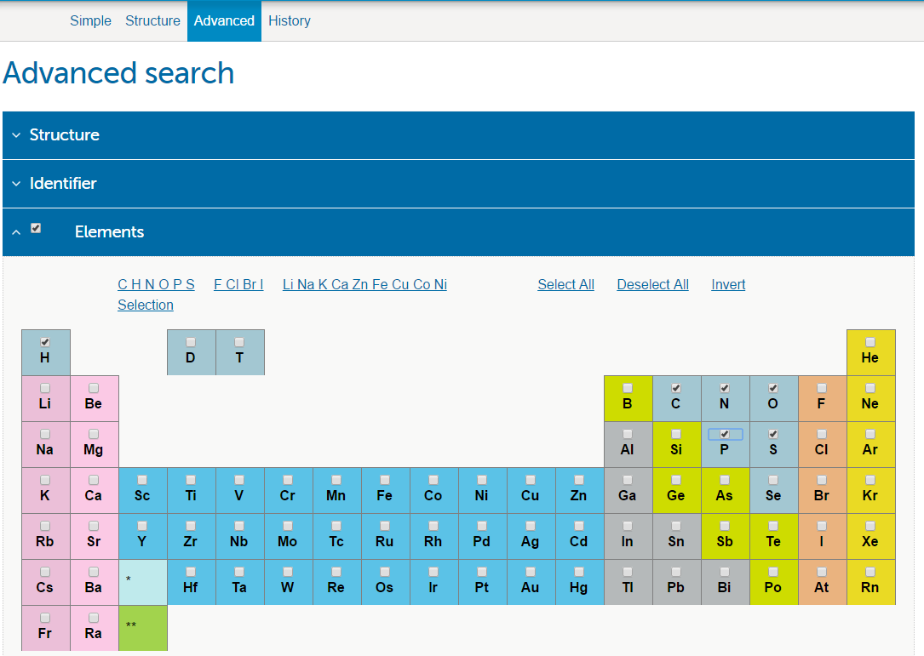
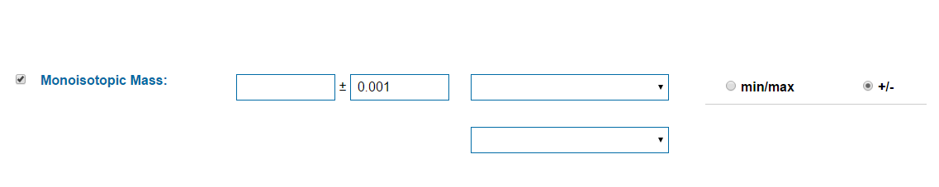
ChemSpider

Slide 47
Spectral databases
Metlin (metlin.scripps.edu)
HMDB (hmdb.ca)
MassBank (www.massbank.jp)
MzCloud (www.mzcloud.org)

Slide 48
METLIN
Searches
MS (possible to select adduct or parent ion)
MS/MS
Fragment
neutral loss
compound
Metabolites (242.766 metabolite entries)
MS/MS data high resolution
same instrument
many energies
11.676 metabolites

Slide 49
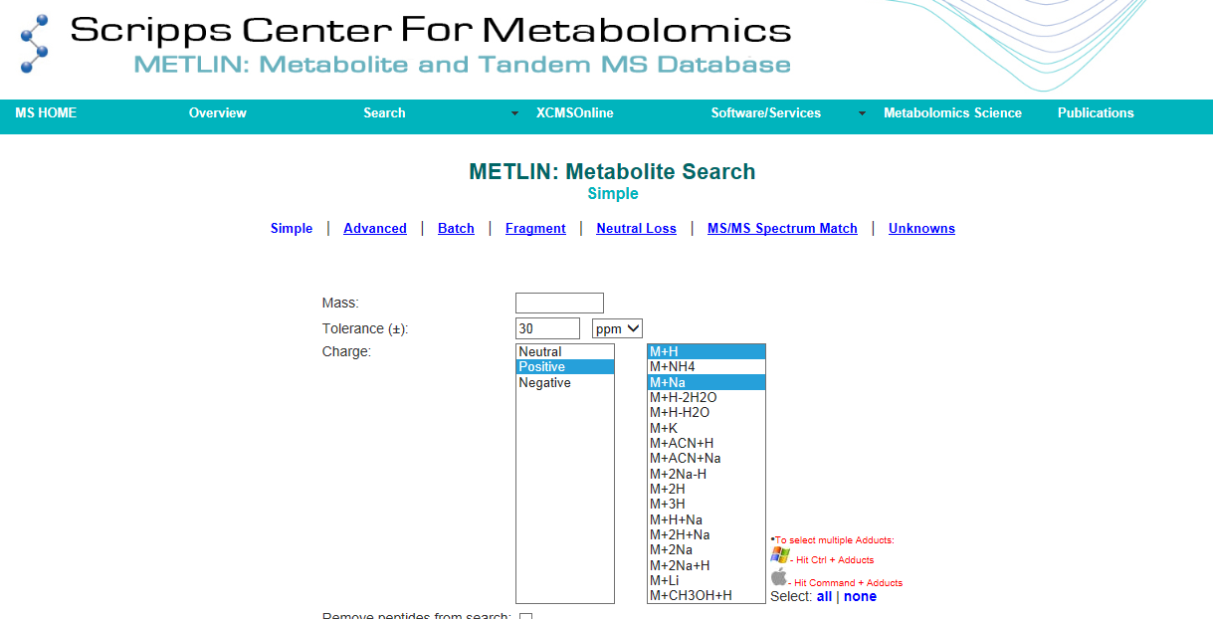
METLIN

Slide 50
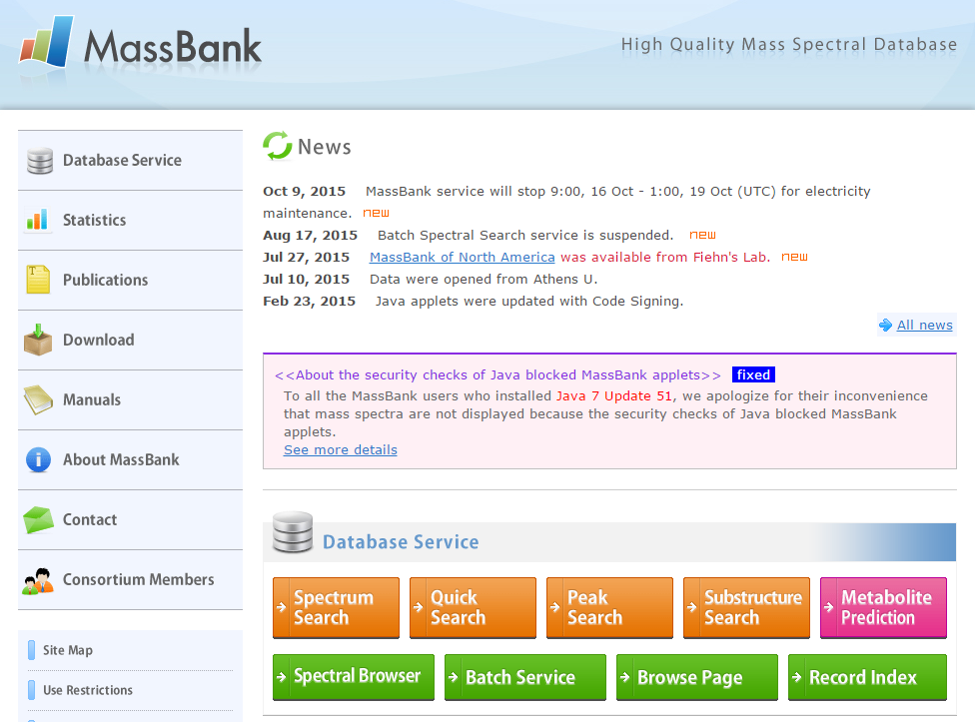
MassBank
40.000+ spectra from different instruments
Fragment search
m/z difference search

Slide 51
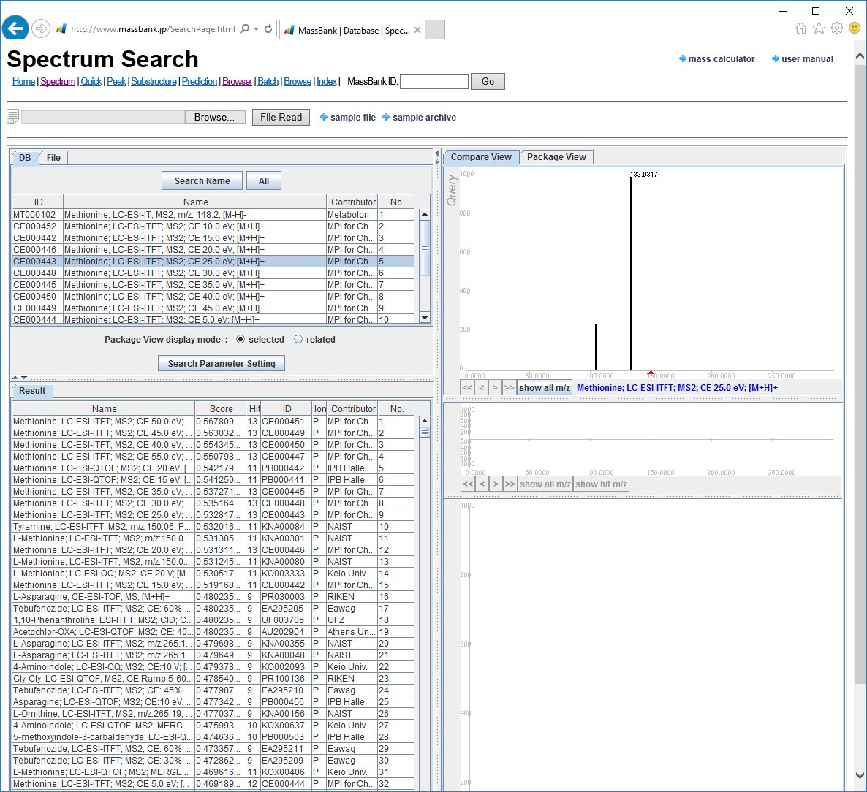
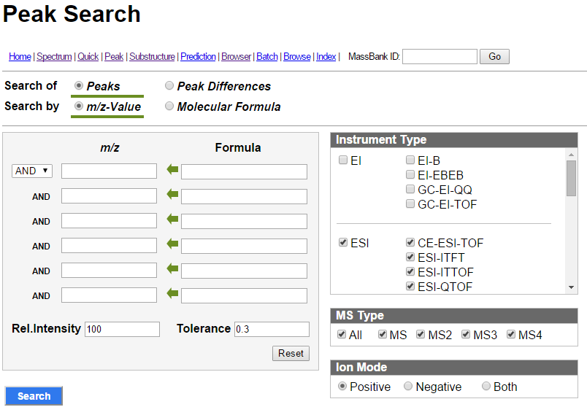
MassBank

Slide 52
In-silico prediction
In-silico fragmentation
MetFrag (msbi.ipb-halle.de/MetFrag)
MetFusion (msbi.ipb-halle.de/MetFusion)
CFM-ID (cfmid.wishartlab.com) – “smarter” than MetFrag. Searches only HMDB/KEGG.
CSI:FingerID (www.csi-fingerid.org) – State of the art. Very computer intensive. Seems down ATM.
In-silico mass spectra
LipidBlast (fiehnlab.ucdavis.edu/projects/LipidBlast)
Automatic annotation
CAMERA (XCMS extension for adduct/fragment annotation)
Retention time prediction/mapping
PredRet (predret.org)
www.retentionprediction.org

Slide 53
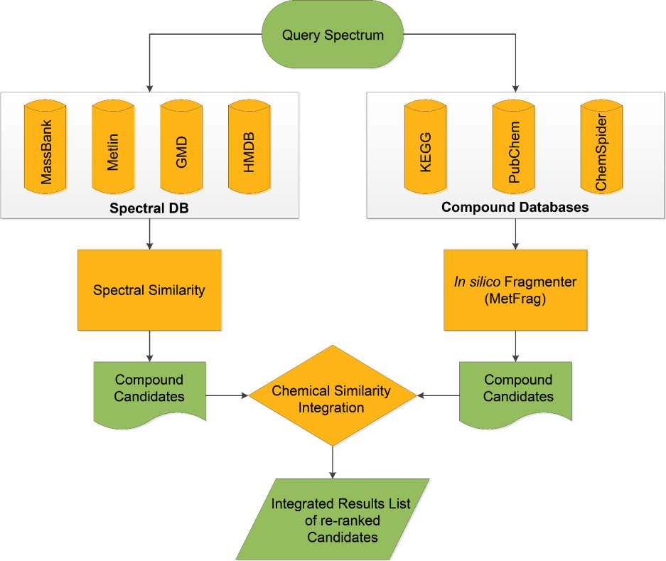
MetFusion
Search spectral databases AND compound databases
Combined score based on
existing experimental spectra of similar compounds
In-silico fragmentation of compounds in compounds database
Suggests fragmentation

Slide 54
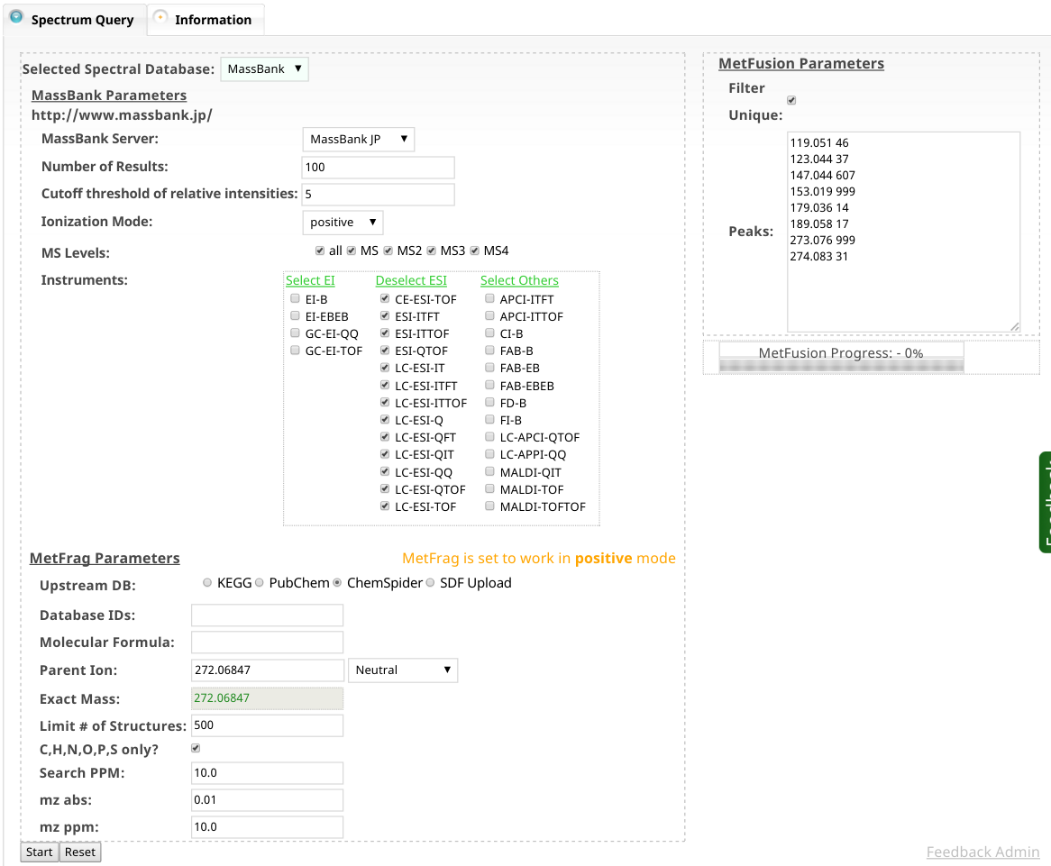
MetFusion

Slide 55
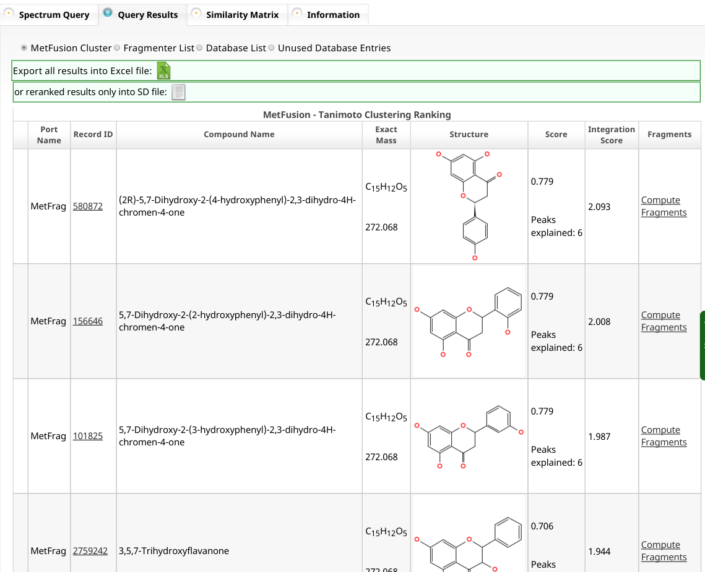
MetFusion

Slide 56
Identification levels
Standard for reporting of identifications proposed by the Metabolomics Standards Initiative (MSI)
LEVEL I: Identified compounds
Two independent measures (eg. RT and m/z)
compared to an authentic standard
LEVEL II: Putatively annotated compounds
Physicochemical properties and/or spectral similarity with public/commercial spectral libraries
LEVEL III: Putatively characterized compound classes
physicochemical properties of a chemical class of compounds, or by spectral similarity to known compounds of a chemical class
LEVEL IV: Unknown compounds
Metabolomics. 2007;3(3):211–21.

Slide 57
Back to exercise 3
Q1: Given the information you have looked at what level of ID is this?
Q2: What do you need to do to get better ID?
Q3: Does MSI level I == 100 % sure ID?
Other compounds could also have ~same RT and ~same spectra
Q4: Could ”100 % sure ID ” mean different things to different people?
Positional isomers (especially lipids)
Cis/trans
Stereoisomers

Slide 58
Summary: From spectra to structure
The mass and isotope pattern help you find the molecular formula Molecular formula of fragments and losses are also informative
Not all possible formula are valid compounds (nitrogen rule, DBE)
Adducts can help find the pseudo-molecular ion
Fragments give info on the structure of the compound
Compound databases show us what compounds are known
Spectral databases give us spectra of real compounds
In-silico tools can help us when no real spectrum is available
It is crucial to report the level of certainly unambiguously

