Slide 1

Compound identification
in MS metabolomics
NEXS, University of Copenhagen
16th February 2017
Jan Stanstrup
jan.stanstrup@regionh.dk
stanstrup@gmail.com
http://stanstrup.github.io
@JanStanstrup

Slide 2
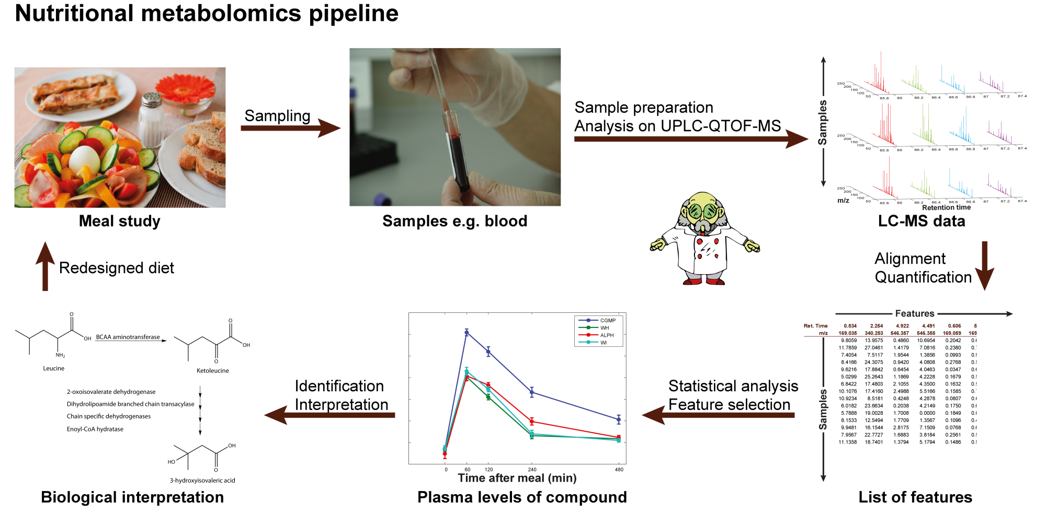
Why is identification important?
No ID → no biological context
Database hits are not enough!
Most time-consuming part of the whole pipeline
Notes:
Where we are in the pipeline
Why ID important
ID and inter together.
That is because they are very much tied in to each other
Therefore I think that everybody - even if you are working mainly on the biological aspects on the study – should have some idea how ID is done

Slide 3
Agenda
The molecular formula
From mass alone
Exercise 1
How to know if a molecular formula is possible (nitrogen rule & DBE)
Using isotopic pattern
Using isotopic fine pattern
Ion charge
Automatic decomposition
Compound candidates from databases
Compound databases
Spectral databases
In silico tools
Retention time
Is it useful?
How can we use it?
The pseudo-molecular ion
MS1: Adducts and In source fragmentation
Automatic deconvolution and annotation
How sure are you?
MSI levels
Are MSI levels all we need to know?
Fragmentation pattern
The manual way
Exercise 3

Slide 4
Finding the molecular formula

Slide 5
Molecular formula: Mass alone – Exercise 1
Mass = 46. What can it be?
 | Mass
H | 1.0078
C | 12.0000
N | 14.0031
O | 15.9949
P | 30.9738
S | 31.9721
Cl | 34.9689

Slide 6
Molecular formula: Nitrogen rule
For organic compounds containing exclusively H, C, N, O, Si, P, S, and the halogens:
odd nominal mass → odd number of N atoms
even nominal mass → zero or even number of N atoms
N.B.:
Reverses for +H and –H charged compounds!
Does NOT reverse for electron impact (i.e. classical GC since only an electron is lost)
Only works for small molecules (the non-integer part of masses will add up)
http://fiehnlab.ucdavis.edu/projects/Seven_Golden_Rules/Nitrogen_Rule
Notes:
No clever reason why this is like this
Consequence of the number of bonds the different atoms make

Slide 7
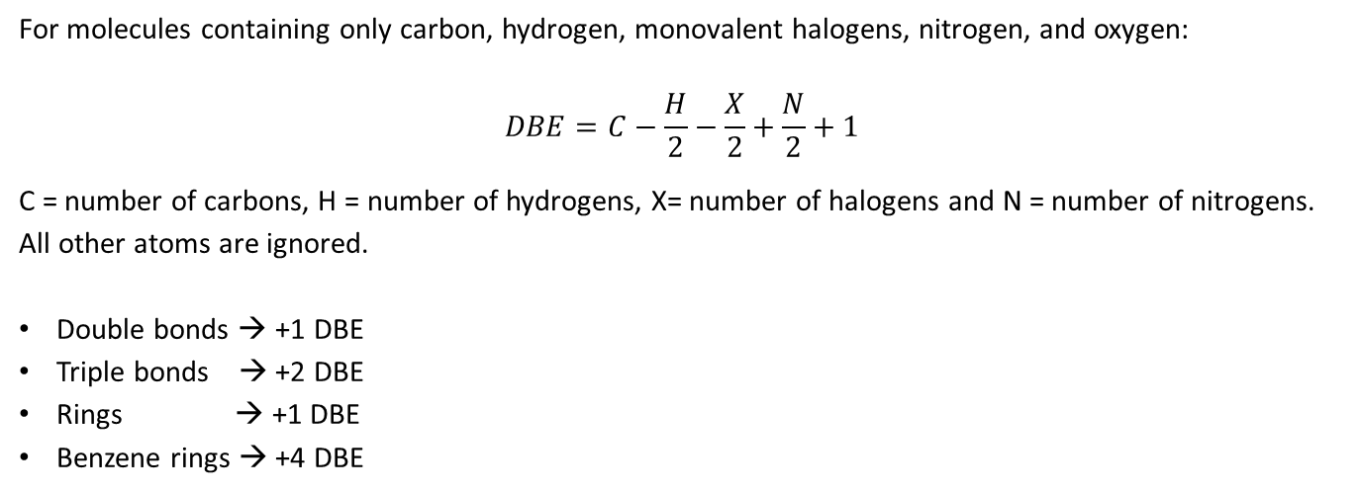
Molecular formula: Double bond equivalent
Double bond equivalent (DBE) == Ring Double Bond Equivalents (RDBE) ==
Degree of unsaturation (UN, DoU) == Pi Bonds or Rings (PBoR)
For molecules containing only carbon, hydrogen, monovalent halogens, nitrogen, and oxygen:
$$DBE=C−\frac{H}{2}−\frac{X}{2}+\frac{N}{2}+1$$
C = number of carbons, H = number of hydrogens, X= number of halogens and N = number of nitrogens.
All other atoms are ignored.
Double bonds → +1 DBE
Triple bonds → +2 DBE
Rings → +1 DBE
Benzene rings → +4 DBE
DBE = 1 !
Fiehn regarding why DBE is misleading: http://fiehnlab.ucdavis.edu/projects/Seven_Golden_Rules/Ring-Double-Bonds
Notes:
Cannot have a negative number of double bonds
Cannot have half a double bond
Hint of benzene

Slide 8
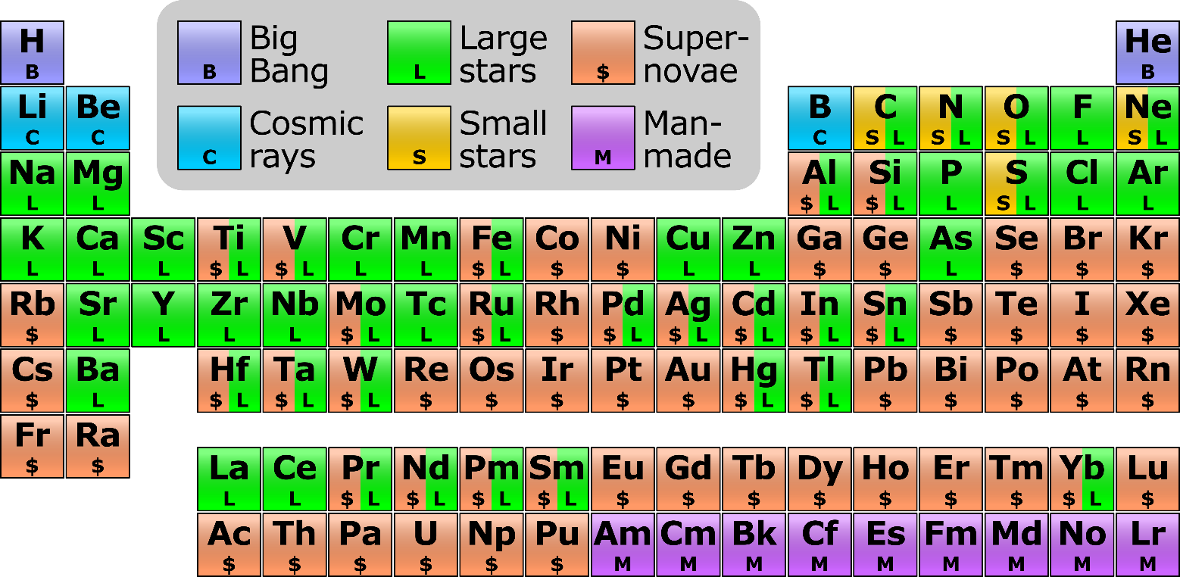
Molecular formula: Isotope pattern
Isotopes: atom with same number of protons and electrons, but different number of neutrons.
The mass of an atom is less than the sum of the parts (up to iron). Think E=mc².
This 'missing mass' is known as the mass defect, and represents the energy that was released when the nucleus was formed
The change in mass defect caused by adding neutrons is different for each atom.
On earth the abundance of isotopes are more or less fixed. → Can be exploited for identification.
https://commons.wikimedia.org/wiki/File:Nucleosynthesis_periodic_table.svg

Slide 9
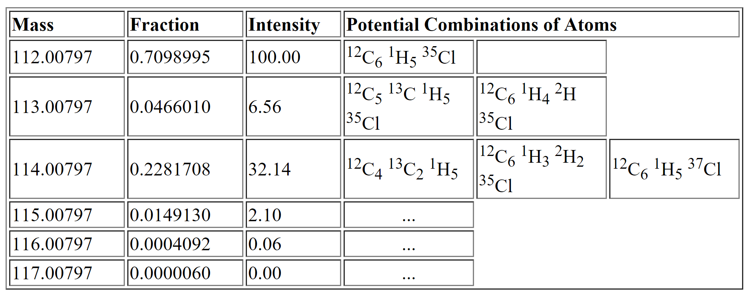
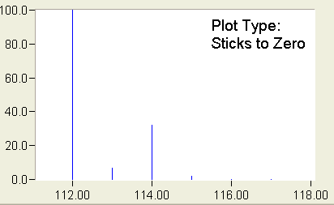
Molecular formula: Isotope pattern
C₆H₅Cl
 | Mass | Rel. abundance
H | 1.0078 | 0.999885
 | 2.0141 | 0.000115
C | 12.0000 | 0.9893
 | 13.0033 | 0.0107
N | 14.0031 | 0.99636
 | 15.0001 | 0.00364
O | 15.9949 | 0.99757
 | 16.9991 | 0.00038
 | 17.9992 | 0.00205
P | 30.9738
S | 31.9721 | 0.9499
 | 32.9715 | 0.0075
 | 33.9679 | 0.0425
Cl | 34.9689 | 0.7576
 | 36.9659 | 0.2424
0.9893⁶ • 0.999885⁵ • 0.7576 = 0.7098
monoisotopic mass
6 • (0.9893⁵ • 0.0107 • 0.999885⁵ • 0.7576) +
5 • (0.9893⁶ • 0.999885⁴ • 0.000115 • 0.7576)
= 0.04647
+1
+2
+3
(difference to table due to differences in
abundances in sources data)
http://www.alchemistmatt.com/mwthelp/isotopicdistribution.htm
http://www.chem.uoa.gr/applets/AppletMS/Appl_Ms2.html
Notes:
Which means if we propose a formula for or our unknown we can check if the experimental isotopic pattern fit the theoretical pattern that we can calculate

Slide 10
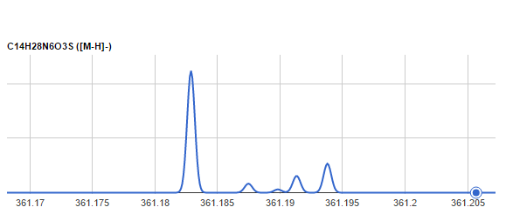

Molecular formula: Isotopic fine pattern
360.1842-360.1905 = -0.0063
→ ¹⁵N
¹³C
+1 Isotope
+2 Isotope
Notes:
So the last calculation we did before with the carbon and hydrogen isotope would actually be two different mass peaks at very slightly different mass.

Slide 11
Molecular formula: Isotopic fine pattern
¹³C,¹⁵N
¹³C
³⁴S
¹³C,³³S
¹⁸O
¹⁵N
²H
¹³C, ¹³C
³³S
+1 Isotope
+2 Isotope
If you have an orbitrap check out exercise 2!
Notes:
So the last calculation we did before with the carbon and hydrogen isotope would actually be two different mass peaks at very slightly different mass.

Slide 12
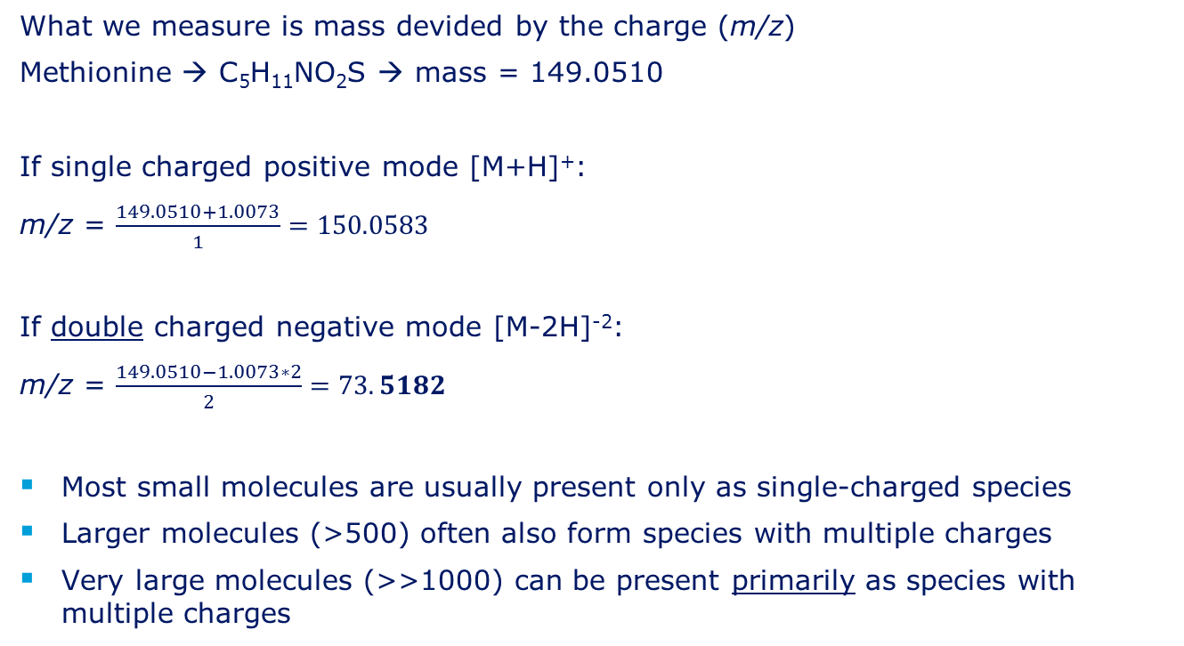
Molecular formula: Ion charge
What we measure is mass devided by the charge (m/z)
Methionine → C₅H₁₁NO₂S → mass = 149.0510
If single charged positive mode [M+H]⁺:
m/z = $\frac{149.0510+1.0073}{1}=150.0583$
If double charged negative mode [M-2H]⁻²:
m/z = $\frac{149.0510−1.0073∗2}{2}=73.5182$
Most small molecules are usually present only as single-charged species
Larger molecules (>500) often also form species with multiple charges
Very large molecules (>>1000) can be present primarily as species with multiple charges
Mass of a proton (H⁺)

Slide 13
Molecular formula: Ion charge
The isotopic pattern can tell us the charge
Methionine single-charge isotopes peaks:
Ion Species | Isotope | Calculation of m/z
[M+H]⁺ | [M]⁺ | (149.0510 + 1.0073)/1 = 150.0583
[M+H]⁺ | [M+1]⁺ | (149.0510 + 1.0073 + 1.0033)/1 = 151.0616
[M+H]⁺ | [M+2]⁺ | (149.0510 + 1.0073 + 1.0033*2)/1 = 152.0649
Difference ∼ 1 Da
= 12C and 13C difference.
Estimation only! Real mass is an ”average” of the contributing isotopes.

Slide 14
Molecular formula: Ion charge
The isotopic pattern can tell us the charge
Methionine double-charged isotopes peaks:
Ion Species | Isotope | Calculation of m/z
[M+2H]²⁺ | [M]⁺ | (149.0510 + 1.0073*2)/2 = 75.5328
[M+2H] ²⁺ | [M+1]⁺ | (149.0510 + 1.0073*2 + 1.0033)/2 = 76.0345
[M+2H] ²⁺ | [M+2]⁺ | (149.0510 + 1.0073*2 + 1.0033*2)/2 = 76.5361
Difference ∼ 0.5 Da

Slide 15
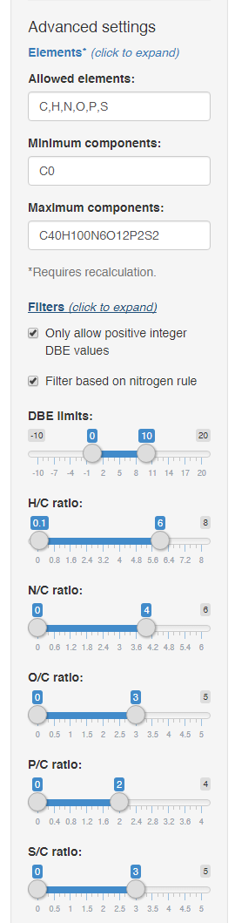
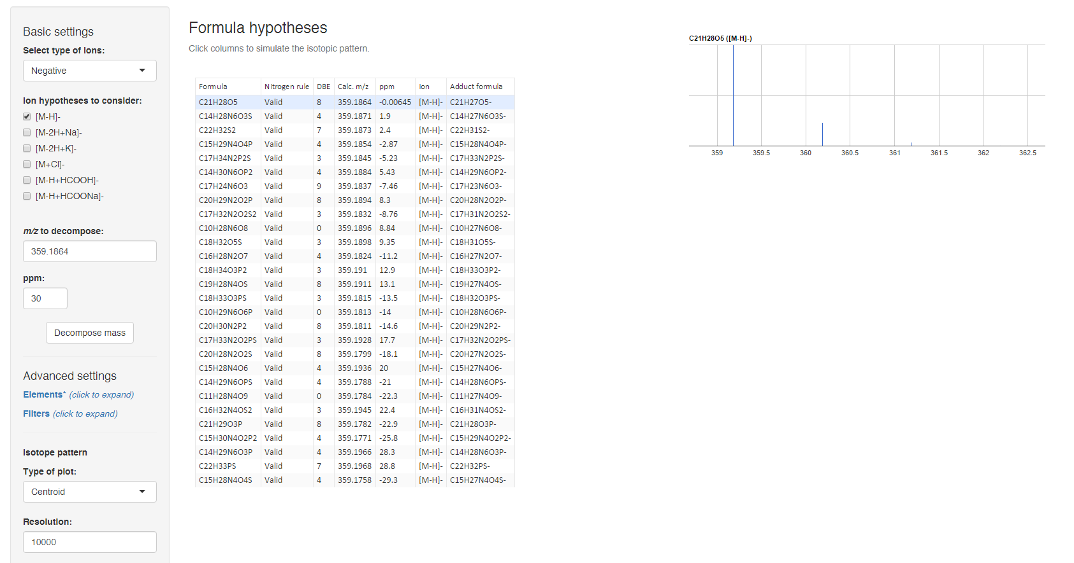

Molecular formula: Automatic decomposition
Kind T, Fiehn O. BMC Bioinformatics. 2007 Mar;8(1):105.
http://predret.org/tools/mass-decomposition/
Notes:
7 golden rules from Oliver Fiehn’s group. Must read paper.

Slide 16
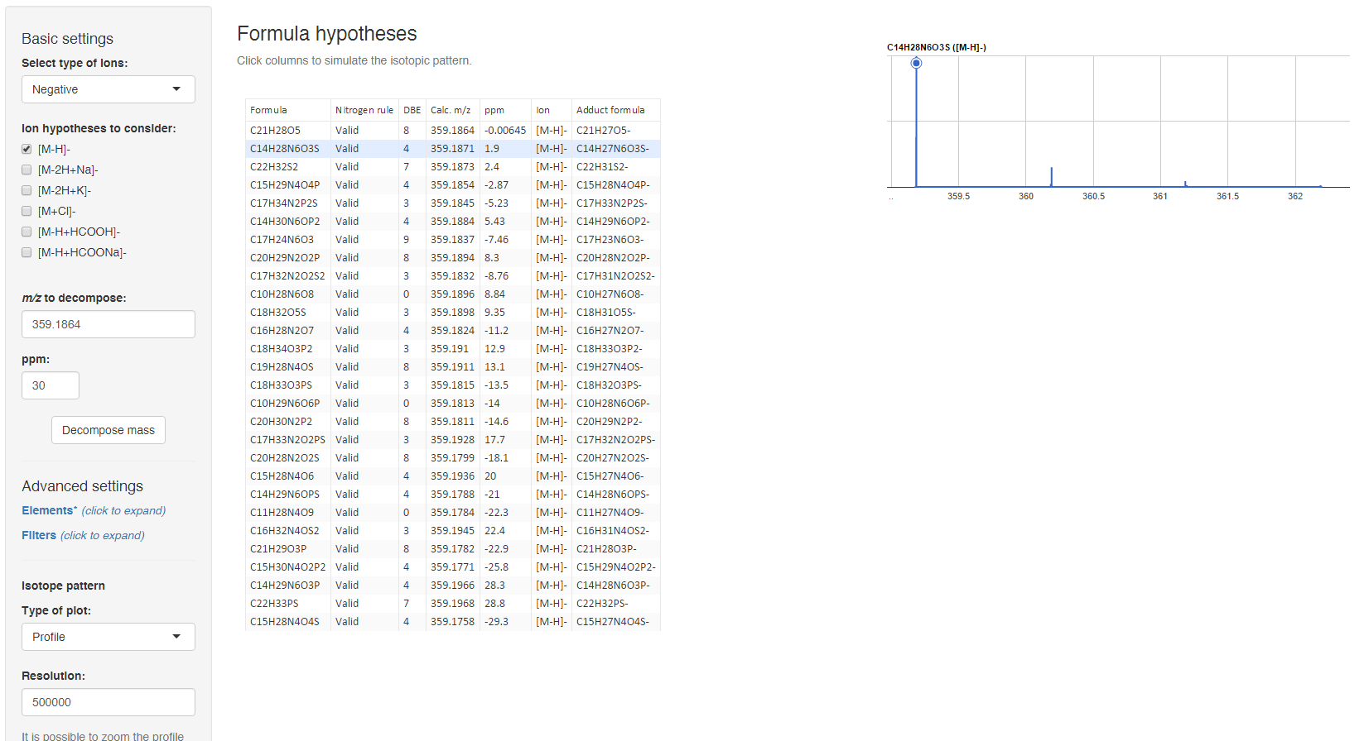
Molecular formula: Automatic decomposition

Slide 17
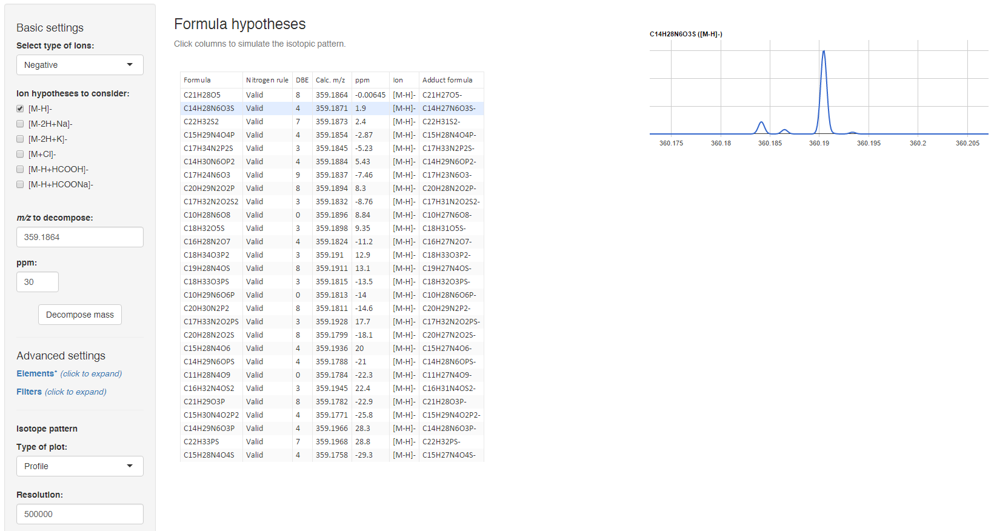
Molecular formula: Automatic decomposition

Slide 18
Finding the pseudo-molecular ion
Notes:
Need to make sure that we are look at the so called pseudo-molecular ion
So let is take a look at what the problem is

Slide 19
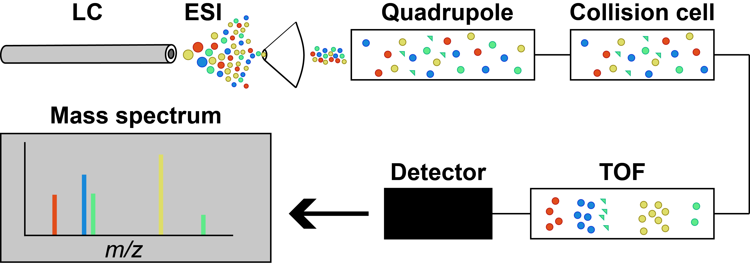
Additional info from fragmentation: MS¹ (Q-TOF)
Ionization in the ESI source. Some in-source fragmentation takes place (green here).
Everything passes the quadrupole
Collision cell is ”off”
TOF separates by m/z
Notes:
Only ionized by adding or removing a hydrogen.
There are other things than fragments that can cause additional peaks from the same compound → adducts

Slide 20
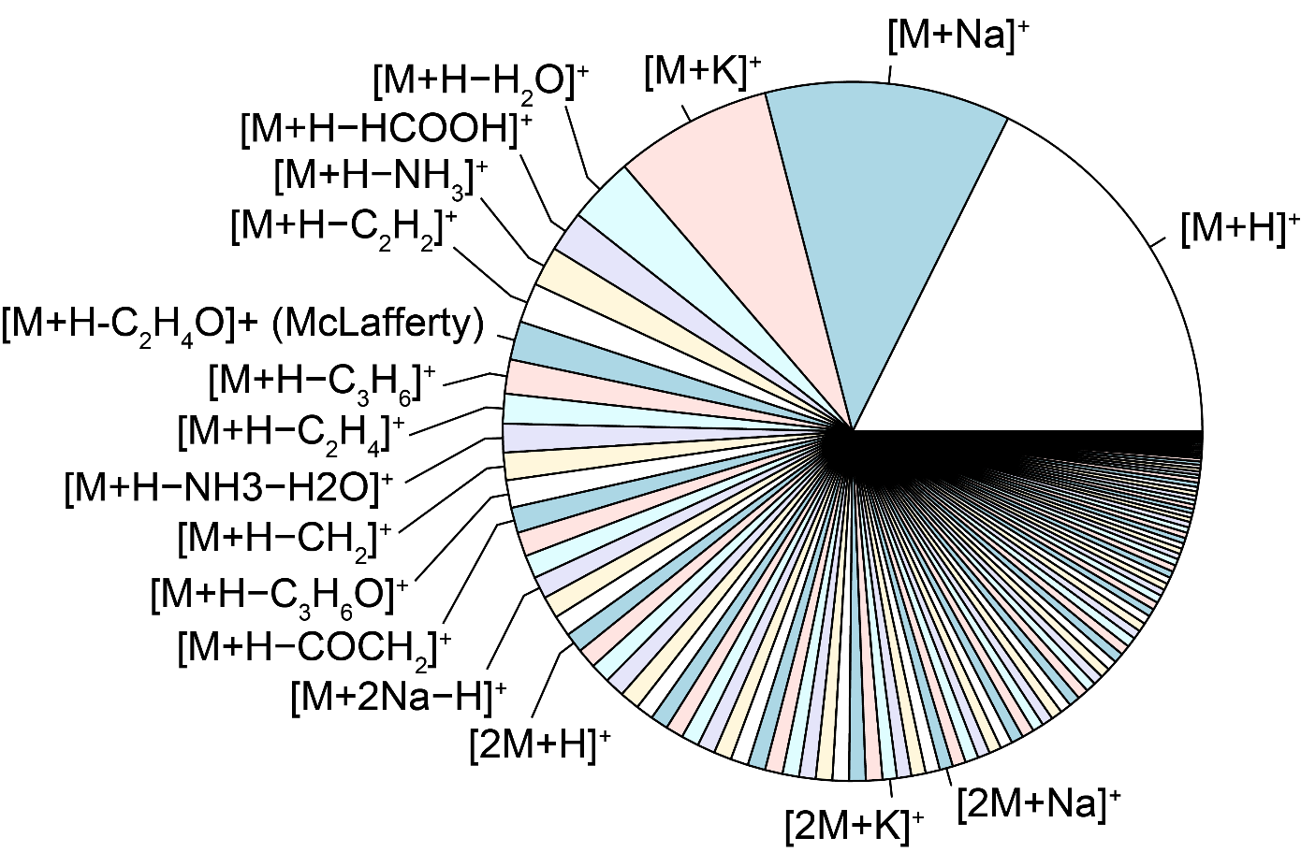
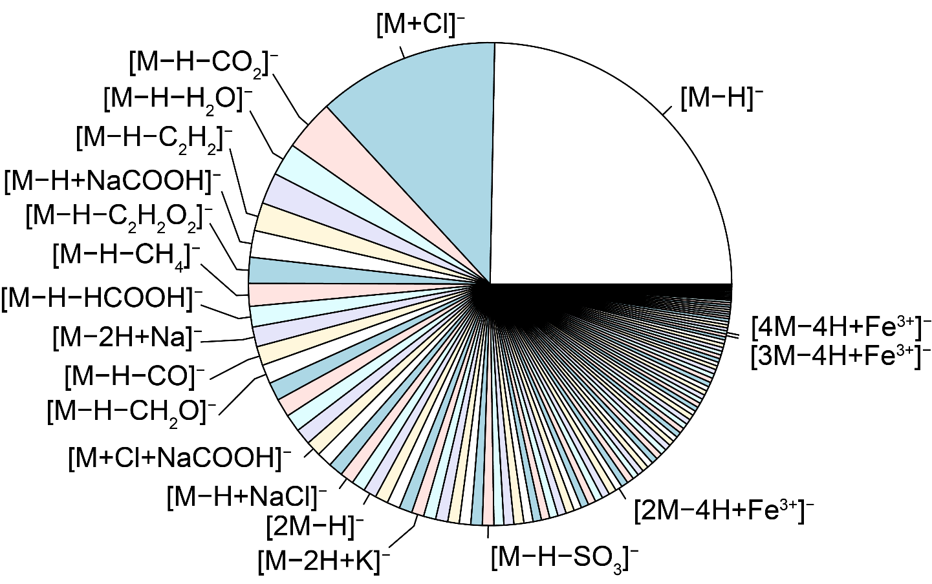
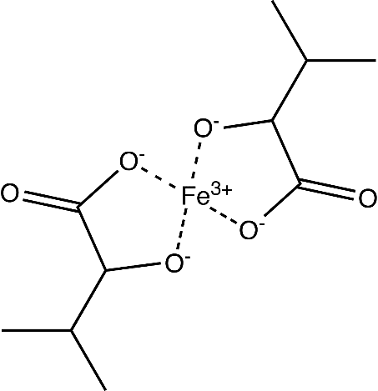
Finding the molecular ion: Adducts
Usually caused by molecules being charge by combining with a charged species other than H (e.g. Na⁺, K⁺, Cl⁻).
Neutral adducts also exist (e.g. formic acid, acetone, sodium formate, NaCl)

Slide 21
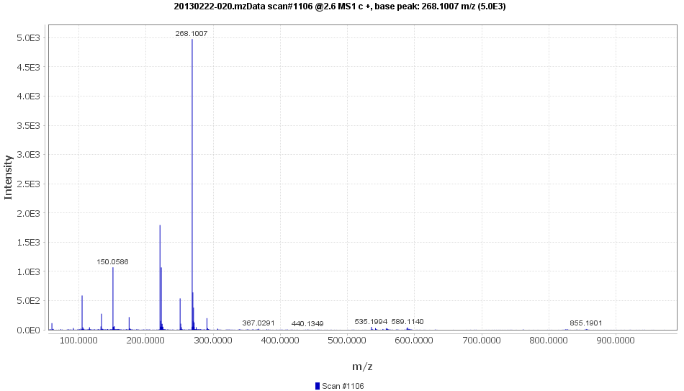
Finding the molecular ion: Adducts

Slide 22
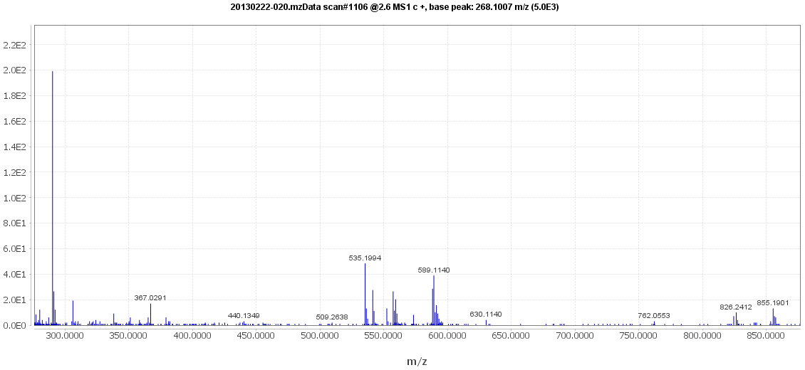
Finding the molecular ion: Adducts
[M+Na⁺]⁺
[2M+NH₄⁺]⁺
[2M+Na⁺]⁺
[2M+K⁺]⁺
[2M+Fe³⁺-2H⁻]⁺
[2M+H⁺]⁺
[M+K⁺]⁺
Notes:
There is not the most common adducts that would be chloride - or at least they are very small – but we see these other adducts… →
Remember this is MS1. so also coeluting compounds
Doing this manually is a very tedious process

Slide 23
Finding the molecular ion:
Adducts and fragments with CAMERA
mz | rt | isotopes | adduct | pcgroup
117.0545 | 1.38 |  |  | 878
144.1019 | 1.41 |  |  | 878
163.0604 | 1.35 |  | [M+H-Leu]+ 293.148 | 878
276.1444 | 1.45 |  | [M+H-H2O]+ 293.148 | 878
280.1393 | 1.41 |  | [M+H-CH2]+ 293.148 | 878
294.1550 | 1.41 |  | [M+H]+ 293.148 | 878
295.1582 | 1.41 |  |  | 878
119.0491 | 1.40 |  | [M+H-NH3-HCOOH]+ 181.074 | 879
123.0440 | 1.40 |  | [M+H-NH3-COCH2]+ 181.074 | 879
136.0756 | 1.40 | [29][M]+ | [M+H-HCOOH]+ 181.074 | 879
137.0790 | 1.40 | [29][M+1]+ |  | 879
147.0441 | 1.40 |  | [M+H-NH3-H2O]+ 181.074 | 879
165.0547 | 1.40 | [65][M]+ | [M+H-NH3]+ 181.074 | 879
166.0581 | 1.40 | [65][M+1]+ |  | 879
182.0812 | 1.40 | [85][M]+ | [M+H]+ 181.074 | 879
183.0841 | 1.40 | [85][M+1]+ |  | 879
184.0854 | 1.40 | [85][M+2]+ |  | 879
204.0633 | 1.40 |  | [M+Na]+ 181.074 | 879
363.1554 | 1.40 |  | [2M+H]+ 181.074 [4M+2H]2+ 181.074 | 879
120.0515 | 1.40 |  |  | 880
122.0792 | 1.40 |  |  | 881
123.0552 | 1.40 |  |  | 882
322.0772 | 1.40 |  |  | 882
348.0708 | 1.40 |  | [M+H-COCH2]+ 389.074 | 882
428.0367 | 1.34 |  | [M+K]+ 389.074 | 882
124.0448 | 1.40 |  |  | 883
126.0298 | 1.40 |  | [M+H-gluc-(H2O)2]+ 337.065 | 884
152.0097 | 1.40 |  | [M+H-NH3]+ 168.029 | 884
169.0357 | 1.40 | [73][M]+ | [M+H]+ 168.029 | 884
170.0390 | 1.40 | [73][M+1]+ |  | 884
171.0402 | 1.40 | [73][M+2]+ |  | 884
185.0308 | 1.42 |  |  | 884
338.0683 | 1.40 |  | [M+H]+ 337.065 | 884
CAMERA says this
is one compounds
Fragment lists @ https://github.com/stanstrup/chemhelper/tree/master/inst/extdata
mzmine2xcmsSet @ https://github.com/stanstrup/chemhelper
Notes:
So now help arrives

Slide 24
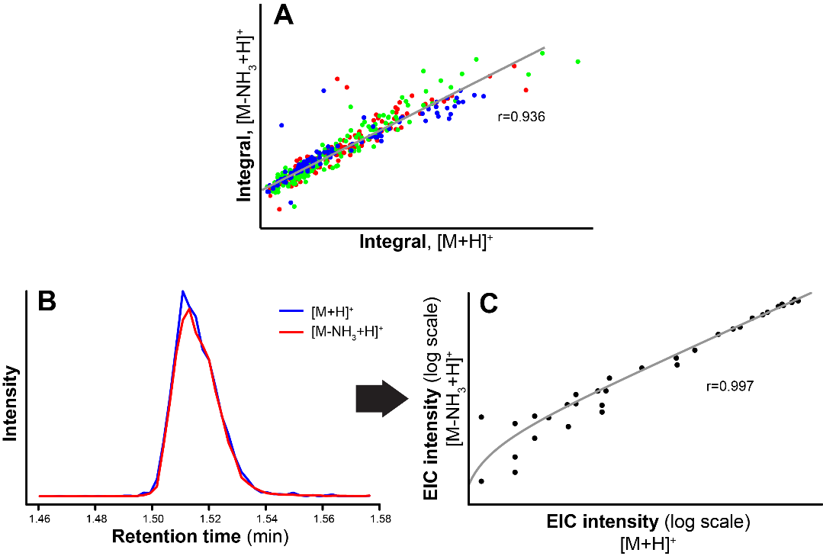
Finding the molecular ion:
Adducts and fragments with CAMERA

Slide 25
Finding the molecular ion:
Adducts and fragments with CAMERA

Slide 26
Finding the molecular ion:
Adducts and fragments with CAMERA

Slide 27
Using the fragmentation pattern

Slide 28
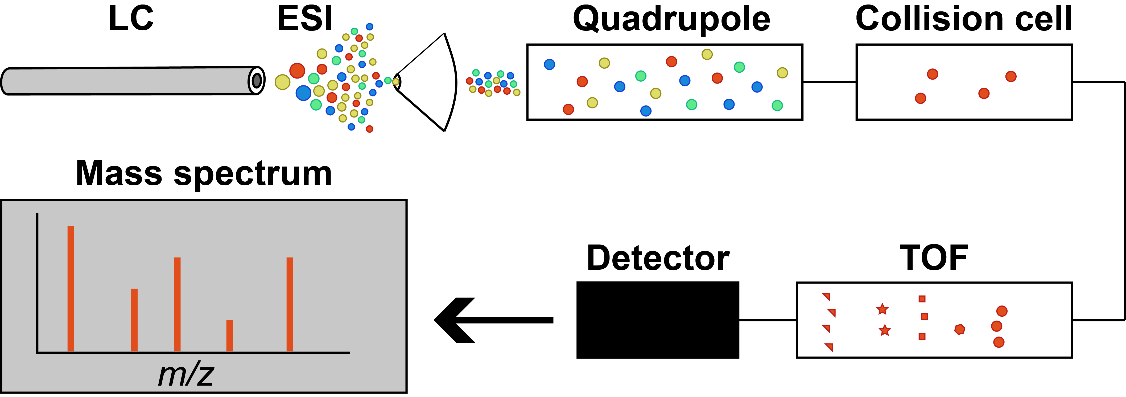
Additional info from fragmentation: MS² (Q-TOF)
Ionization in the ESI source. Some in-source fragmentation takes place (not shown).
Only selection ion passes the quadrupole (red). Careful: Isolation window is usually 1+ Da.
  MS^{n}-like spectra by fragmenting a known fragment (in-source fragmentation)
Fragmentation in the collision cell
TOF separates by m/z
Notes:
Different energies can give different fragments.
Orbitraps have several fragmentation modes

Slide 29
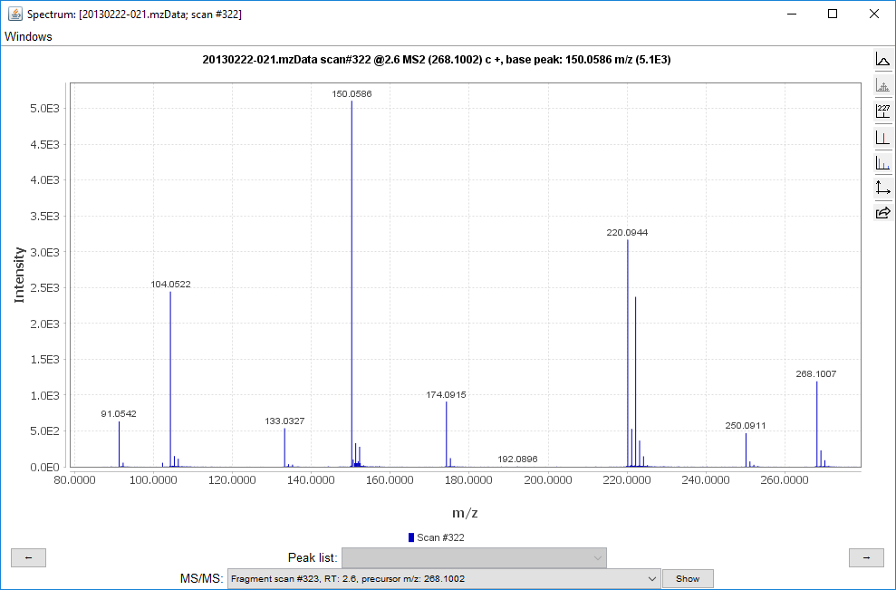
Interpreting fragmentation data: The manual way
-HCOOH
-CH₄S
-H₂O

Slide 30
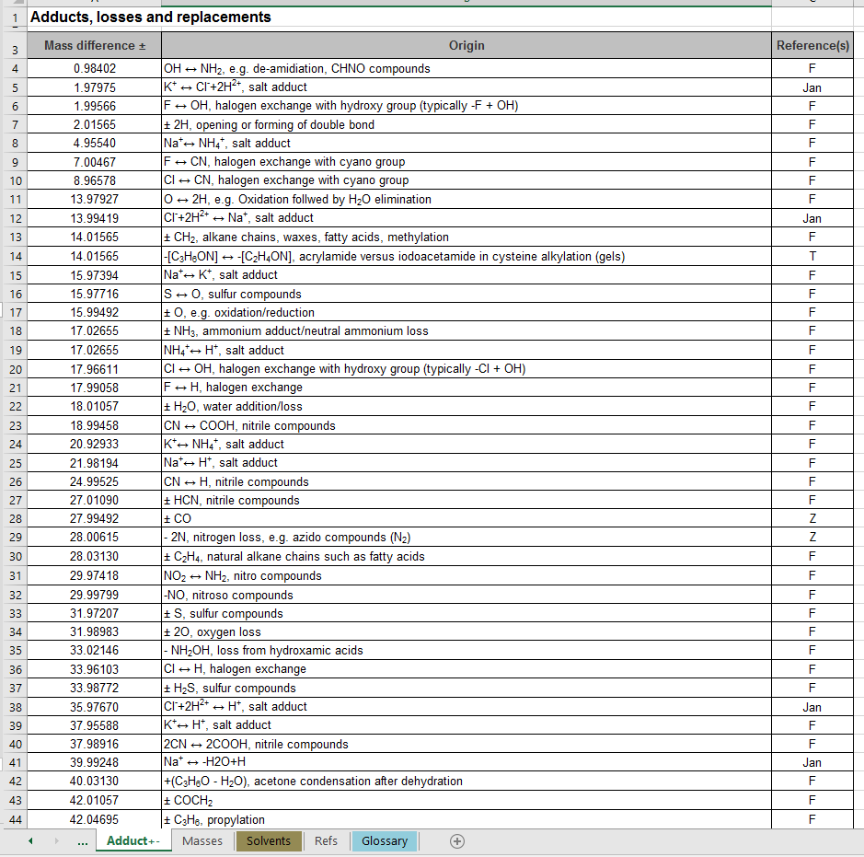
Interpreting fragmentation data: The manual way
Keller BO, Sui J, Young AB, Whittal RM. Anal Chim Acta. 2008;627(1):71–81.
Notes:
This is also the list you can look at when you are looking for adducts

Slide 31
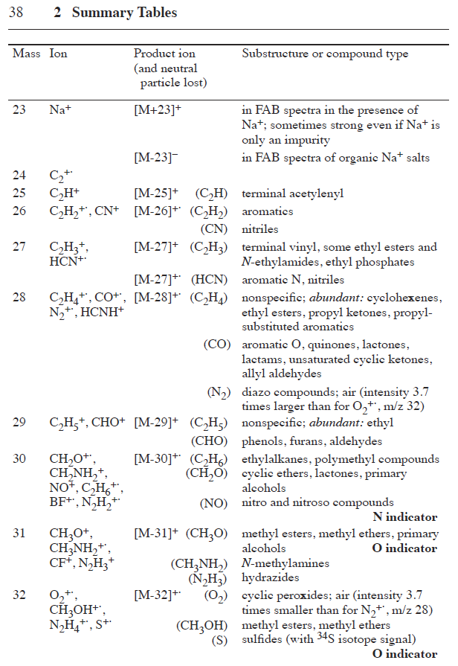
Interpreting fragmentation data: The manual way
Pretsch, Buļhlmann & Badertscher. Structure Determination of Organic Compounds: Tables of Spectral Data.

Slide 32
Interpreting fragmentation data: The manual way
C₅H₁₁NO₂S
→ Methionine!
C₈H₆O
DBE = 6
-HCOOH
-CH₄S
-HCOOH
-H₂O
-NH₃

Slide 33
Interpreting fragmentation data: The manual way
– the good
(
)
-NH₃
-HCOOH
-phenylacetyl
-H₂O
-CH₄S
-CO
-HCOOH
Notes:
This is where biology and identification intersects
Probably this compound was created by a reaction between methionine and Phenyl acetate.
So there used to be an acid group here which made this reaction possible.

Slide 34
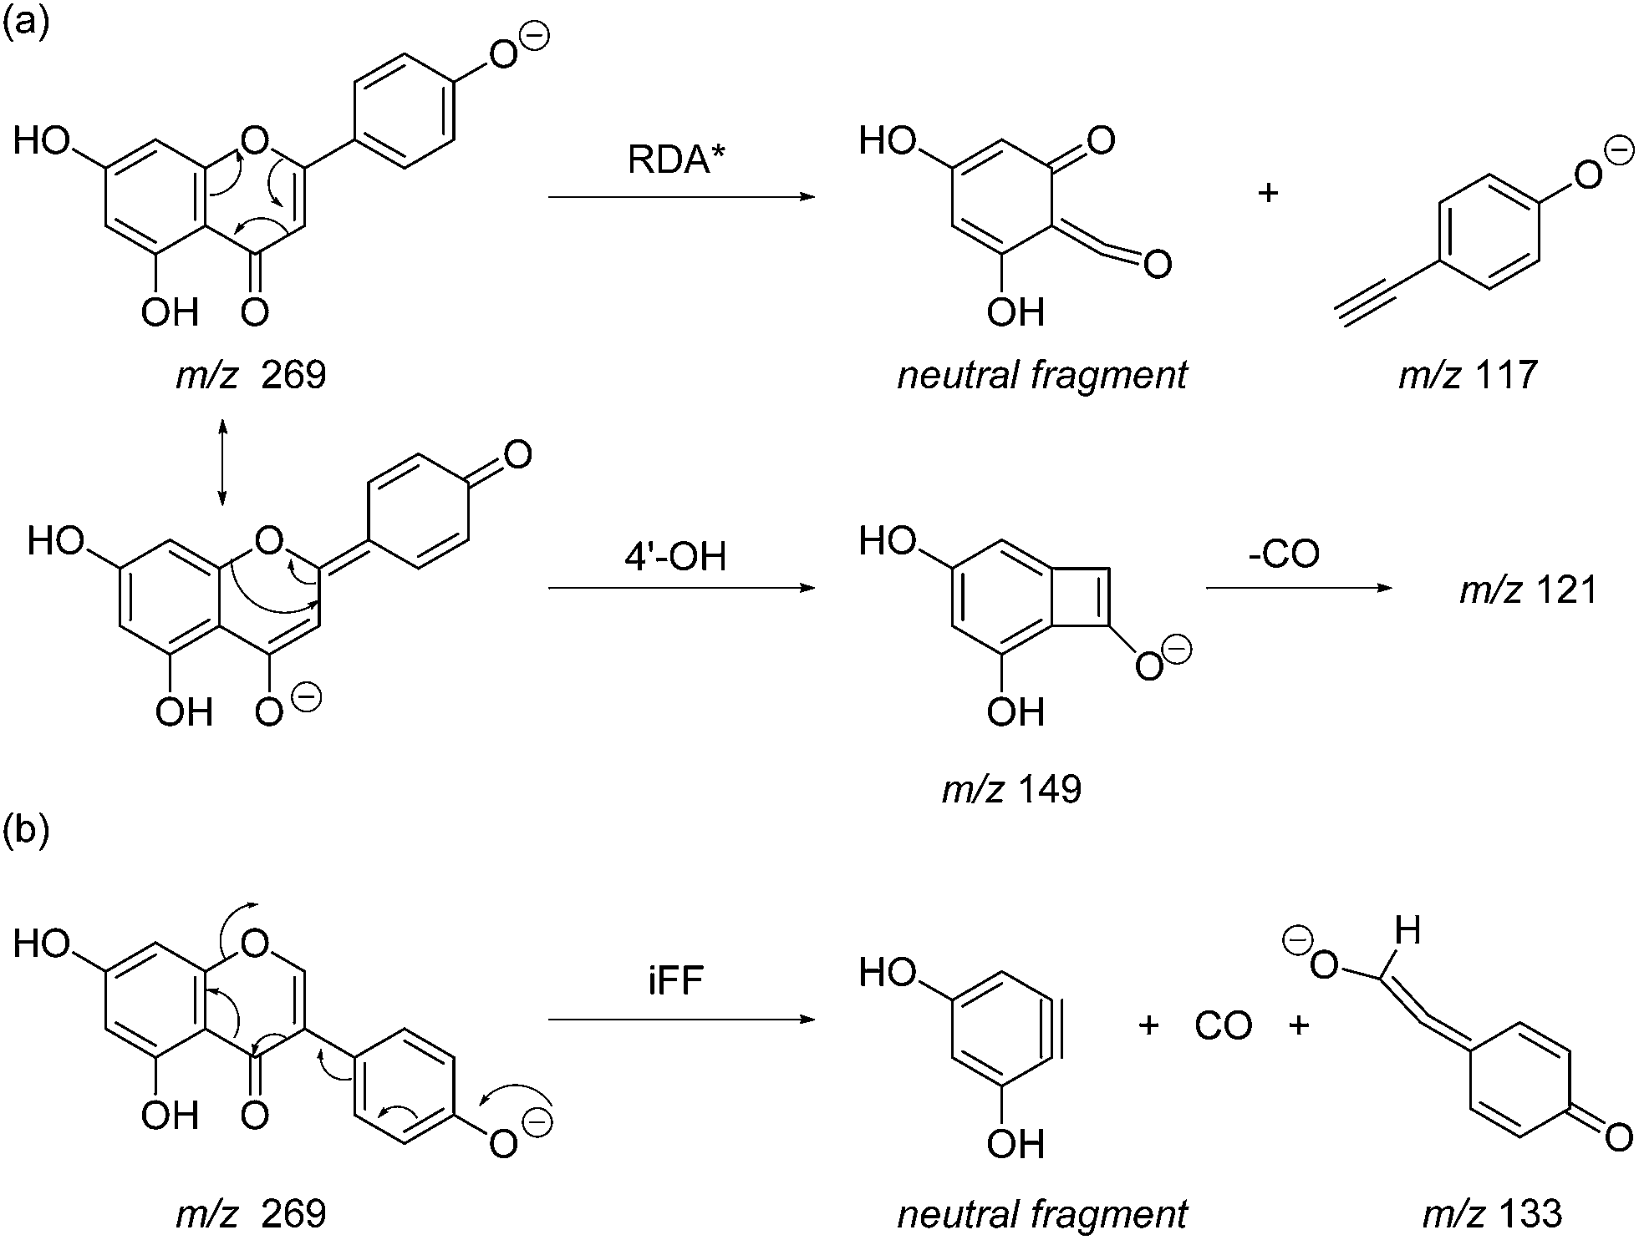
Interpreting fragmentation data: The manual way
– the ugly
Anal. Methods, 2014, 6, 8915-8923

Slide 35
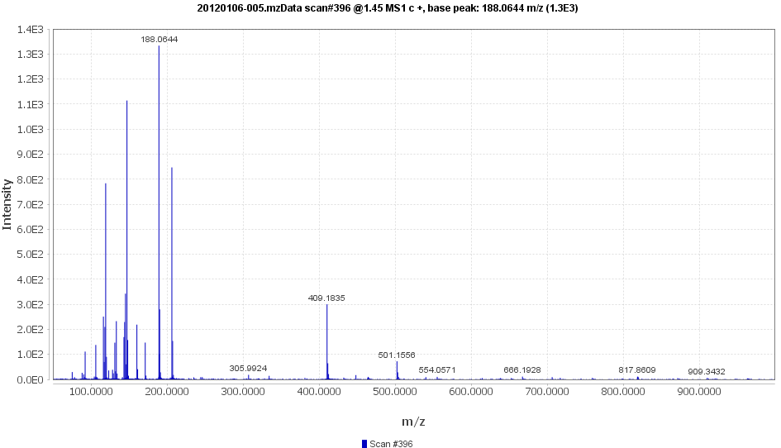
Interpreting fragmentation data: Exercise 3 – part 1
Open ”Exercise (20120106-005).mzData” in MzMine
Go to spectra 396 @ ~1.45 min. This is MS1. Not MS2.
What is the pseudo-molecular ion [M+H⁺]⁺?
What is the charge?
What is the possible/reasonable
molecular formula at this point?

Slide 36
Interpreting fragmentation data: Exercise 3 – part 2
Open ”Exercise (20120106-005).mzData” in MzMine
Go to spectra 396 @ ~1.45 min. This is MS1. Not MS2.
What is the pseudo-molecular ion [M+H⁺]⁺?
What is the charge?
What is the possible/reasonable
molecular formula at this point?
Annotate as many ions as possible
What is the molecular fomula?
What is the compound?

Slide 37
Finding plausible compound candidates from databases

Slide 38
Compound and spectral databases
Compound databases
Global
  Indiscriminant selection of compounds
  Large (tens of millions)
  Contains the structure of compounds. Little other info
Focused
  Biology specific
  Compound class specific
  Relatively small (tens of thousands)
  Can contain additional contextual information
Spectral databases
  Indiscriminant selection of compounds
  Relatively small (tens of thousands)
Contains authentic spectra of compounds
Notes:
Not because you should assume that a hit in the database means you have identified your compound but →
Easier to confirm a hypothesis than to generate one.
Be careful: spectra from different machines are not identical

Slide 39


Compound and spectral databases
HMDB (hmdb.ca)
  My compound ID (www.mycompoundid.org)
METLIN (metlin.scripps.edu)
Lipidmaps (www.lipidmaps.org)
Phenol-explorer (phenol-explorer.eu)
ChEBI (www.ebi.ac.uk/chebi/)
Chemspider (www.chemspider.com)
PubChem (pubchem.ncbi.nlm.nih.gov)
MassBank (www.massbank.jp)
mzCloud (https://www.mzcloud.org)
More in: Medina S et al. Trends in Analytical Chemistry The effects of the intake of plant foods on the human metabolome. Trends Anal Chem. 2013;52:88–99. http://dx.doi.org/10.1016/j.trac.2013.08.002

Slide 40
Compound and spectral databases: HMDB
Small human metabolites (41.993 metabolite entries)
Searches
  MS
  MS/MS
  compound
Metabocards
  Description of metabolite
  MS/MS spectra
  links to other databases
Extended by MycompoundID.com
  “Predicts” biological adducts
  Predicts MS spectra for the predicted compounds
Huan T, Tang C, Li R, Shi Y, Lin G, Li L. MyCompoundID MS/MS Search: Metabolite Identification Using a Library of Predicted Fragment-Ion-Spectra of 383,830 Possible Human Metabolites. Anal Chem. 2015;87(20):10619–26.

Slide 41
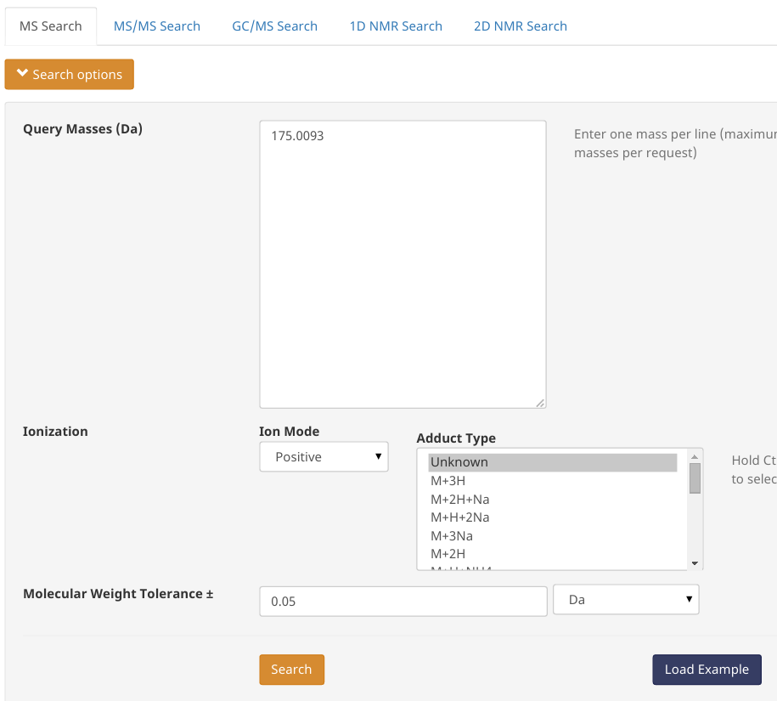
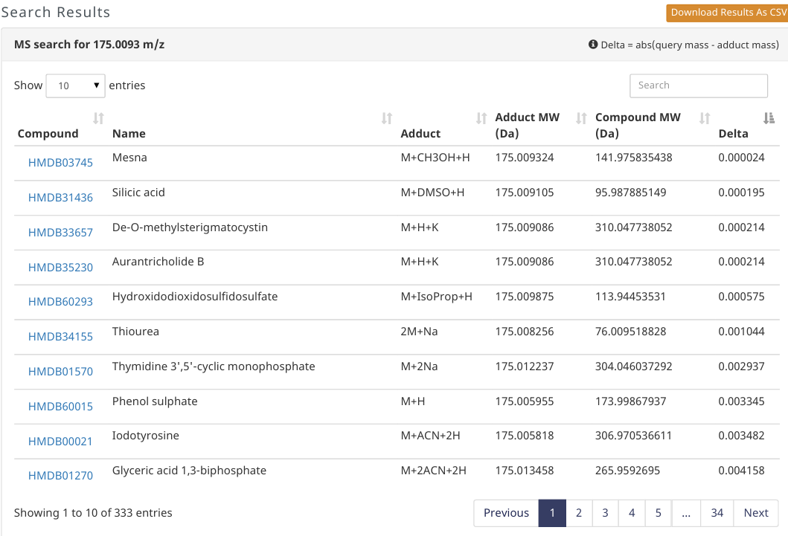
Compound and spectral databases: HMDB

Slide 42
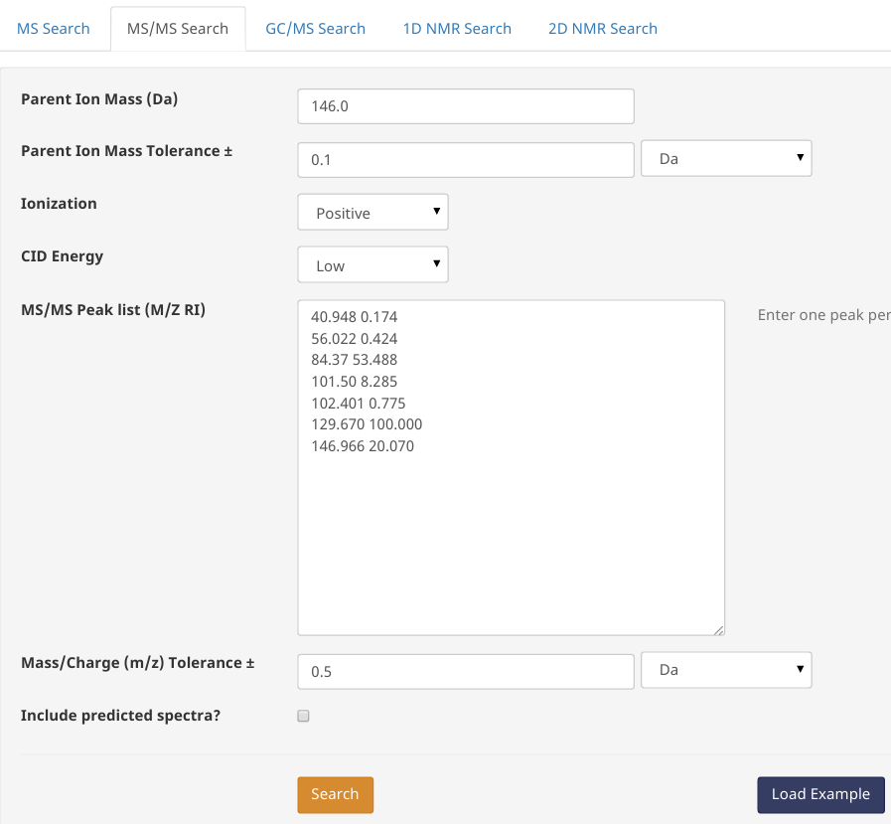
Compound and spectral databases: HMDB

Slide 43
Compound and spectral databases: ChemSpider
Most known compounds (>40 million structures)
Searches
  Name
  Formula
  Structure
Many name synonyms
An alternative is PubChem

Slide 44
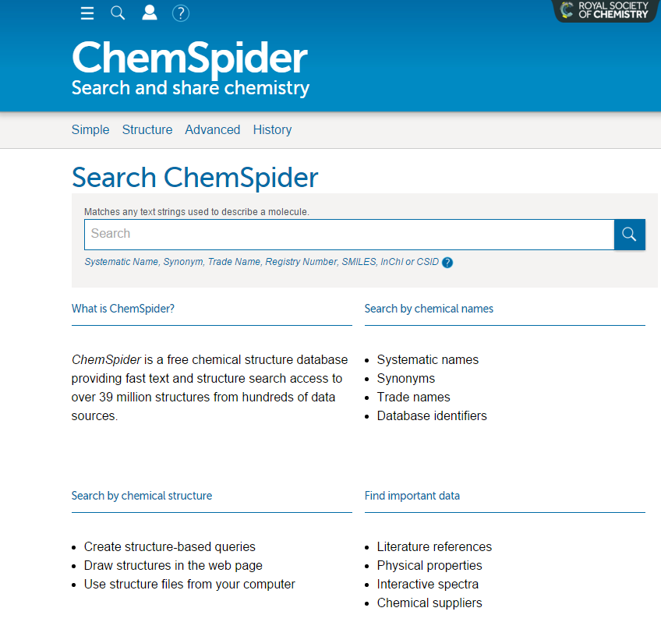
Compound and spectral databases: ChemSpider

Slide 45
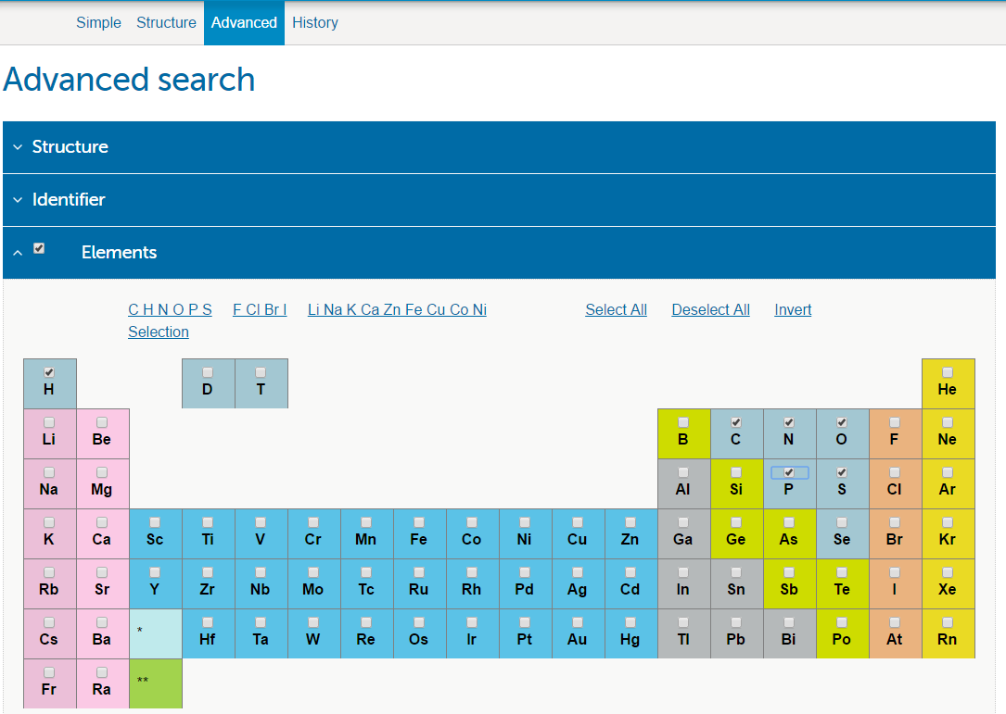
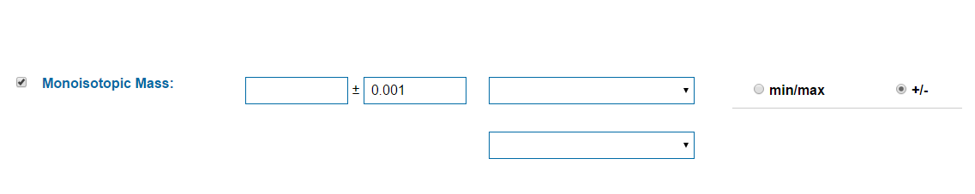
Compound and spectral databases: ChemSpider

Slide 46
Compound and spectral databases:
Spectral database
Metlin (metlin.scripps.edu)
HMDB (hmdb.ca)
MassBank (www.massbank.jp)
MzCloud (www.mzcloud.org)

Slide 47
Compound and spectral databases: METLIN
Searches
  MS (possible to select adduct or parent ion)
  MS/MS
  Fragment
  neutral loss
  compound
Metabolites (242.766 metabolite entries)
MS/MS data high resolution
  same instrument
  many energies
  11.676 metabolites

Slide 48
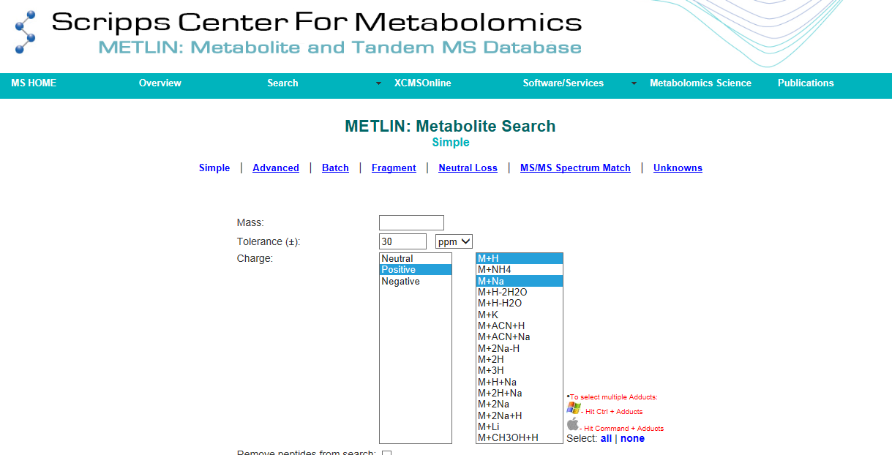
Compound and spectral databases: METLIN

Slide 49
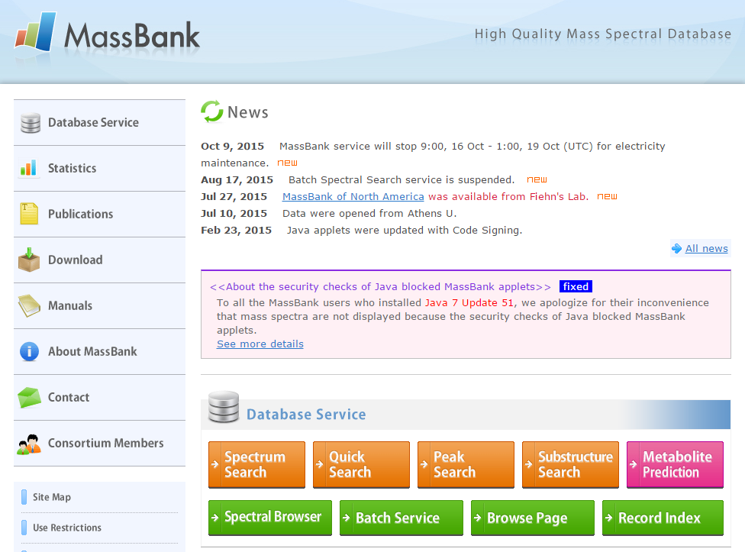
Compound and spectral databases: MassBank
40.000+ spectra from different instruments
Fragment search
m/z difference search

Slide 50
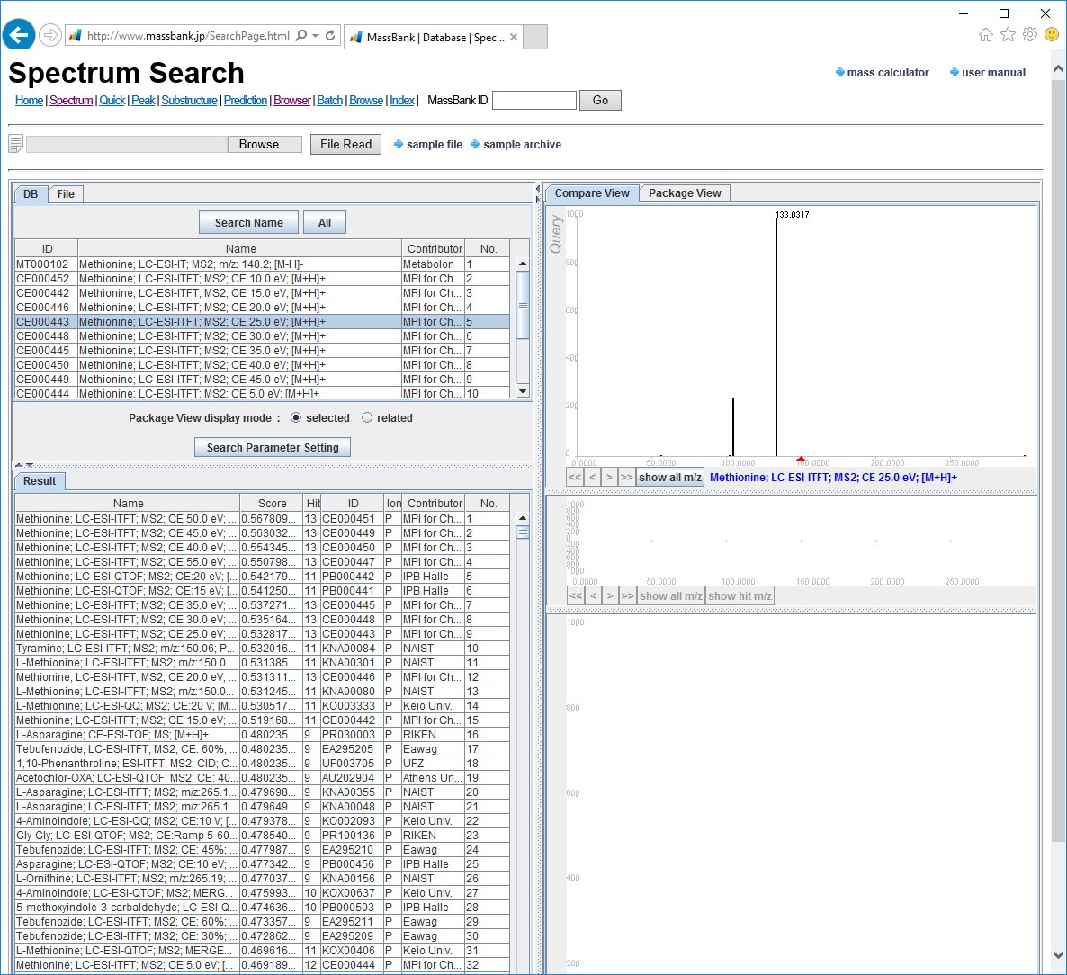
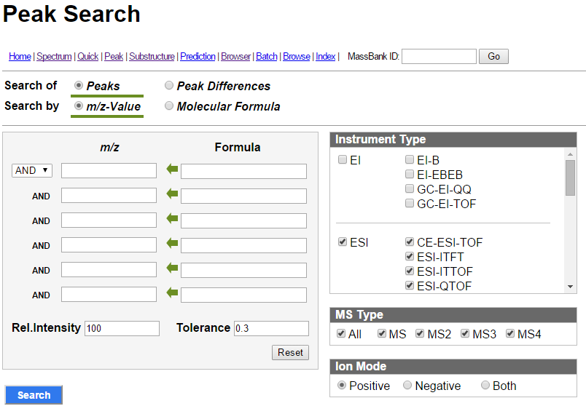
Compound and spectral databases: MassBank

Slide 51
In silico prediction

Slide 52
In silico prediction: Mass spectra
In-silico fragmentation
MetFrag (msbi.ipb-halle.de/MetFrag)
MetFusion (msbi.ipb-halle.de/MetFusion)
CFM-ID (cfmid.wishartlab.com) – “smarter” than MetFrag. Searches only HMDB/KEGG.
CSI:FingerID (www.csi-fingerid.org) – State of the art. Very computer intensive.
In-silico mass spectra
LipidBlast (fiehnlab.ucdavis.edu/projects/LipidBlast)
Automatic annotation
CAMERA (XCMS extension for adduct/fragment annotation)
Retention time prediction/mapping
PredRet (predret.org)
www.retentionprediction.org

Slide 53
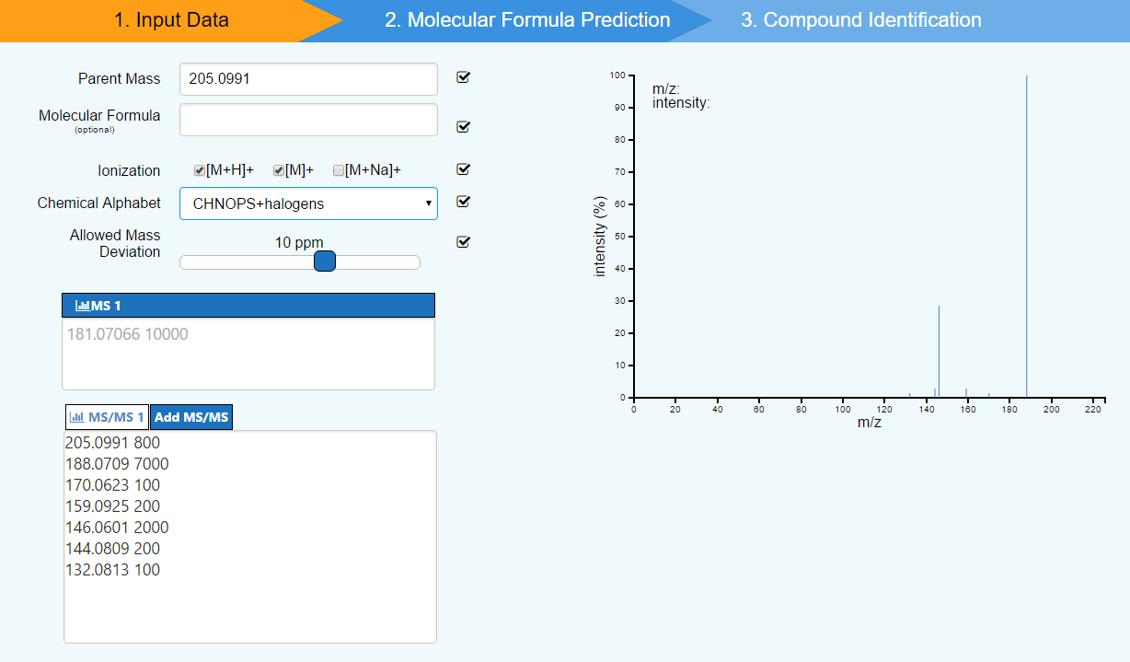
In silico prediction: CSI:FingerID

Slide 54
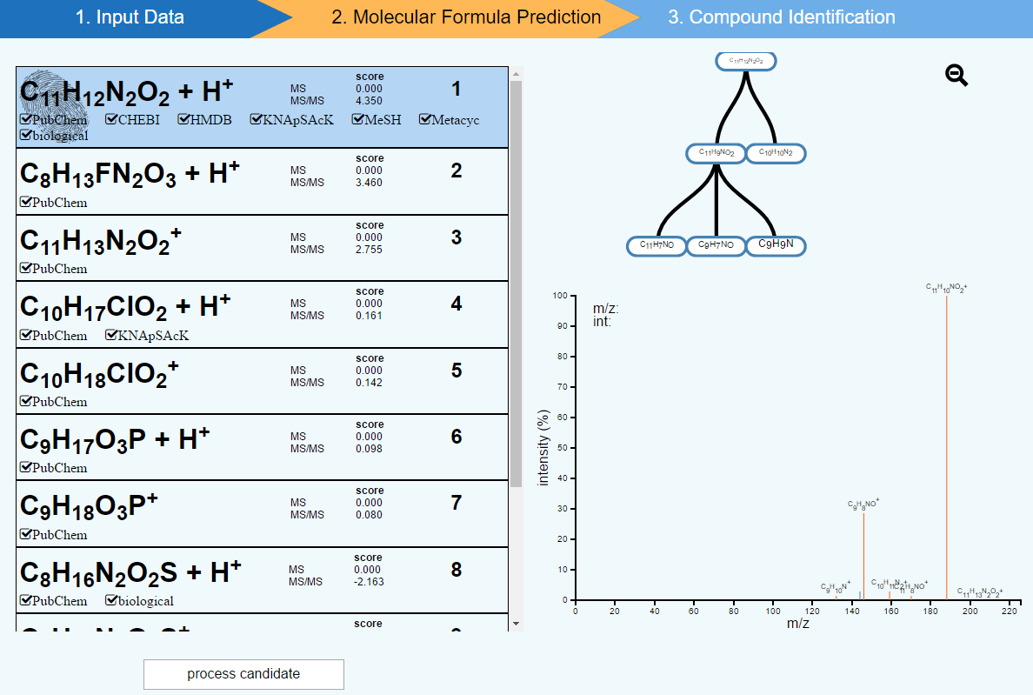
In silico prediction: CSI:FingerID

Slide 55
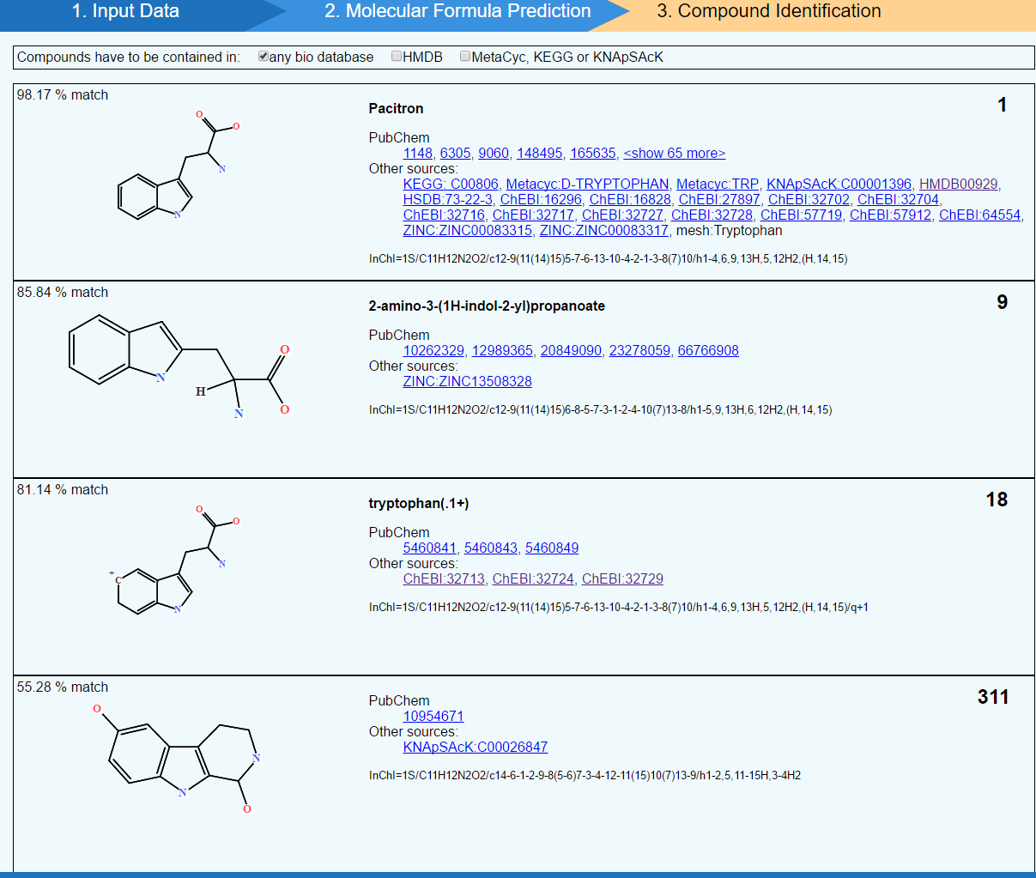
In silico prediction: CSI:FingerID
Notes:
You can also do with MS1
Give you a hypothesis earlier in the game

Slide 56
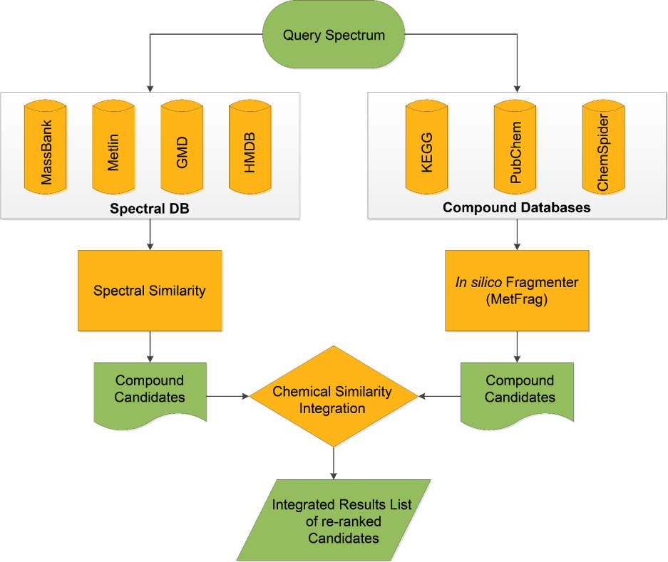
In silico prediction: MetFusion
Search spectral databases AND compound databases
Combined score based on
  existing experimental spectra of similar compounds
  In-silico fragmentation of compounds in compounds database
Suggests fragmentation

Slide 57
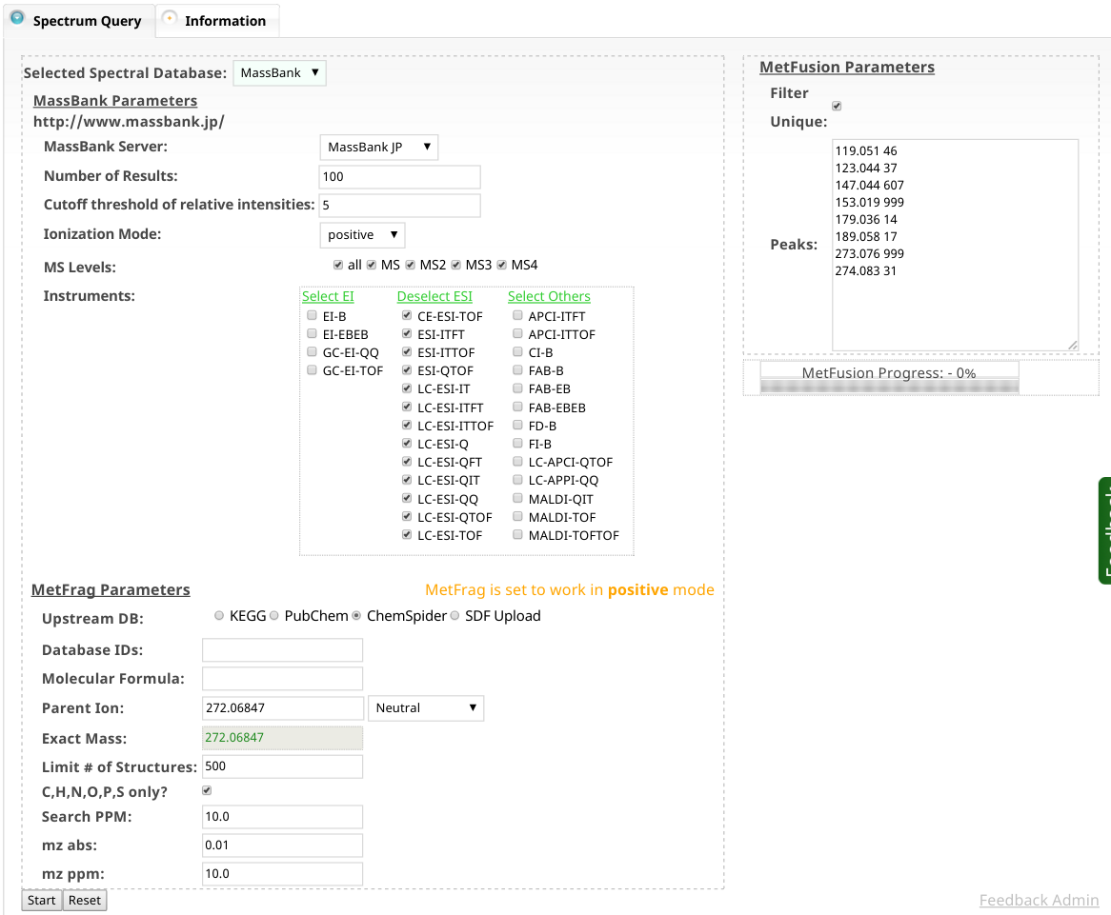
In silico prediction: MetFusion

Slide 58
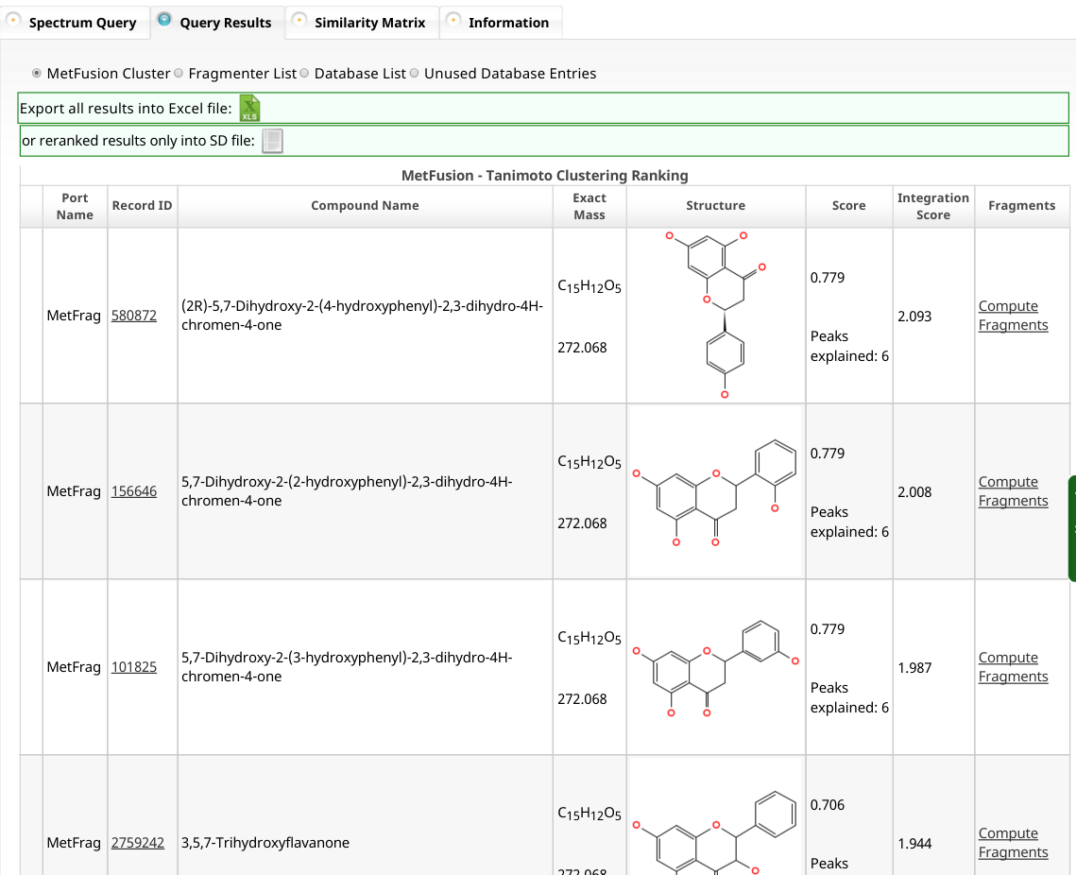
In silico prediction: MetFusion

Slide 59
Fragmentation is not everything

Slide 60
In silico prediction: Retention time
STANDARDS STANDARDS STANDARDS
Retention time prediction/mapping
Quantitative Structure Retention Relationship (QSRR) models ->
  Based on modelling a large number of structural descriptors to the retention time
  Many many system specific models have been published.
Notes:
You cannot have databases like for mass spectra

Slide 61
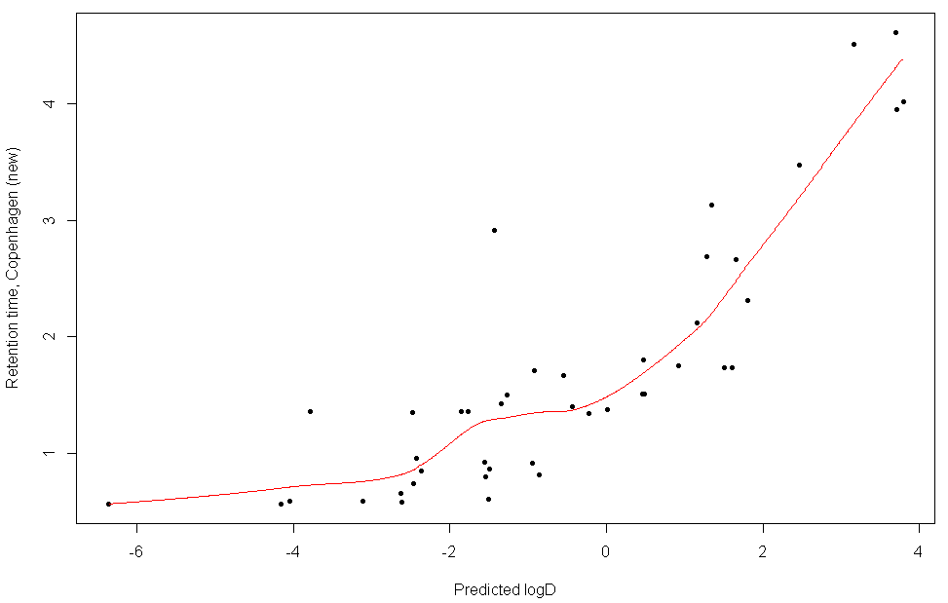
In silico prediction: Simple QSRR model
Stanstrup, J., Gerlich, M., Dragsted, L. O., & Neumann, S. (2013). Metabolite profiling and beyond: Approaches for the rapid processing and annotation of human blood serum mass spectrometry data Metabolomics and Metabolite Profiling. Anal. Bioanal. Chem., 405(15), 5037–5048.

Slide 62
In silico prediction: Retention time
STANDARDS STANDARDS STANDARDS
Retention time prediction/mapping
Quantitative Structure Retention Relationship (QSRR) models ->
  Based on modelling a large number of structural descriptors to the retention time
  Many many system specific models have been published.
www.retentionprediction.org
PredRet (predret.org)

Slide 63
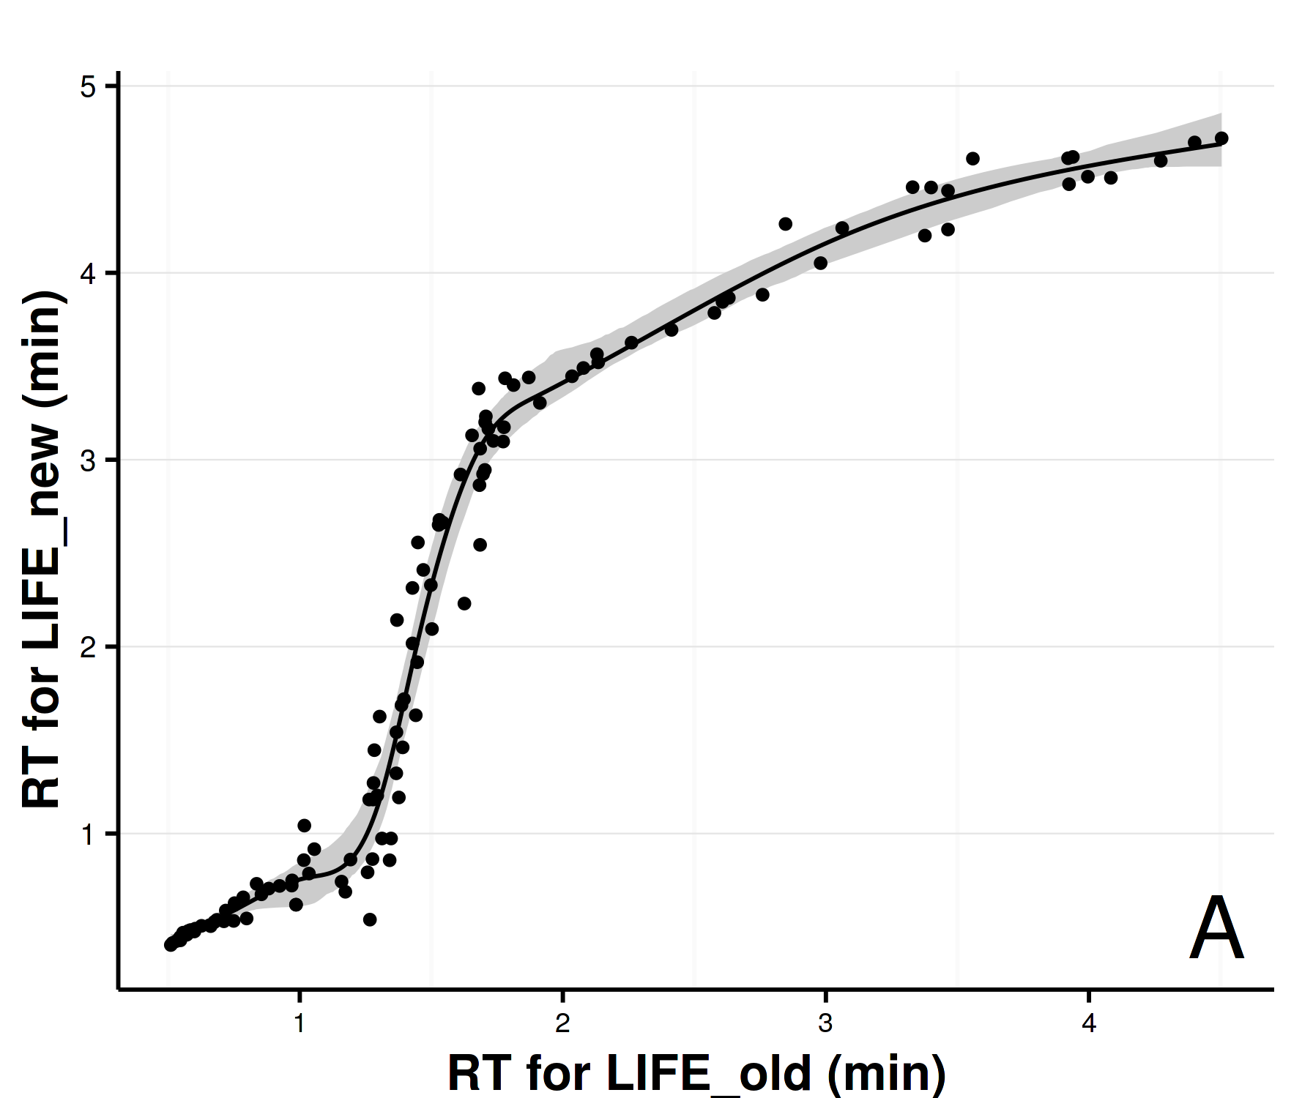
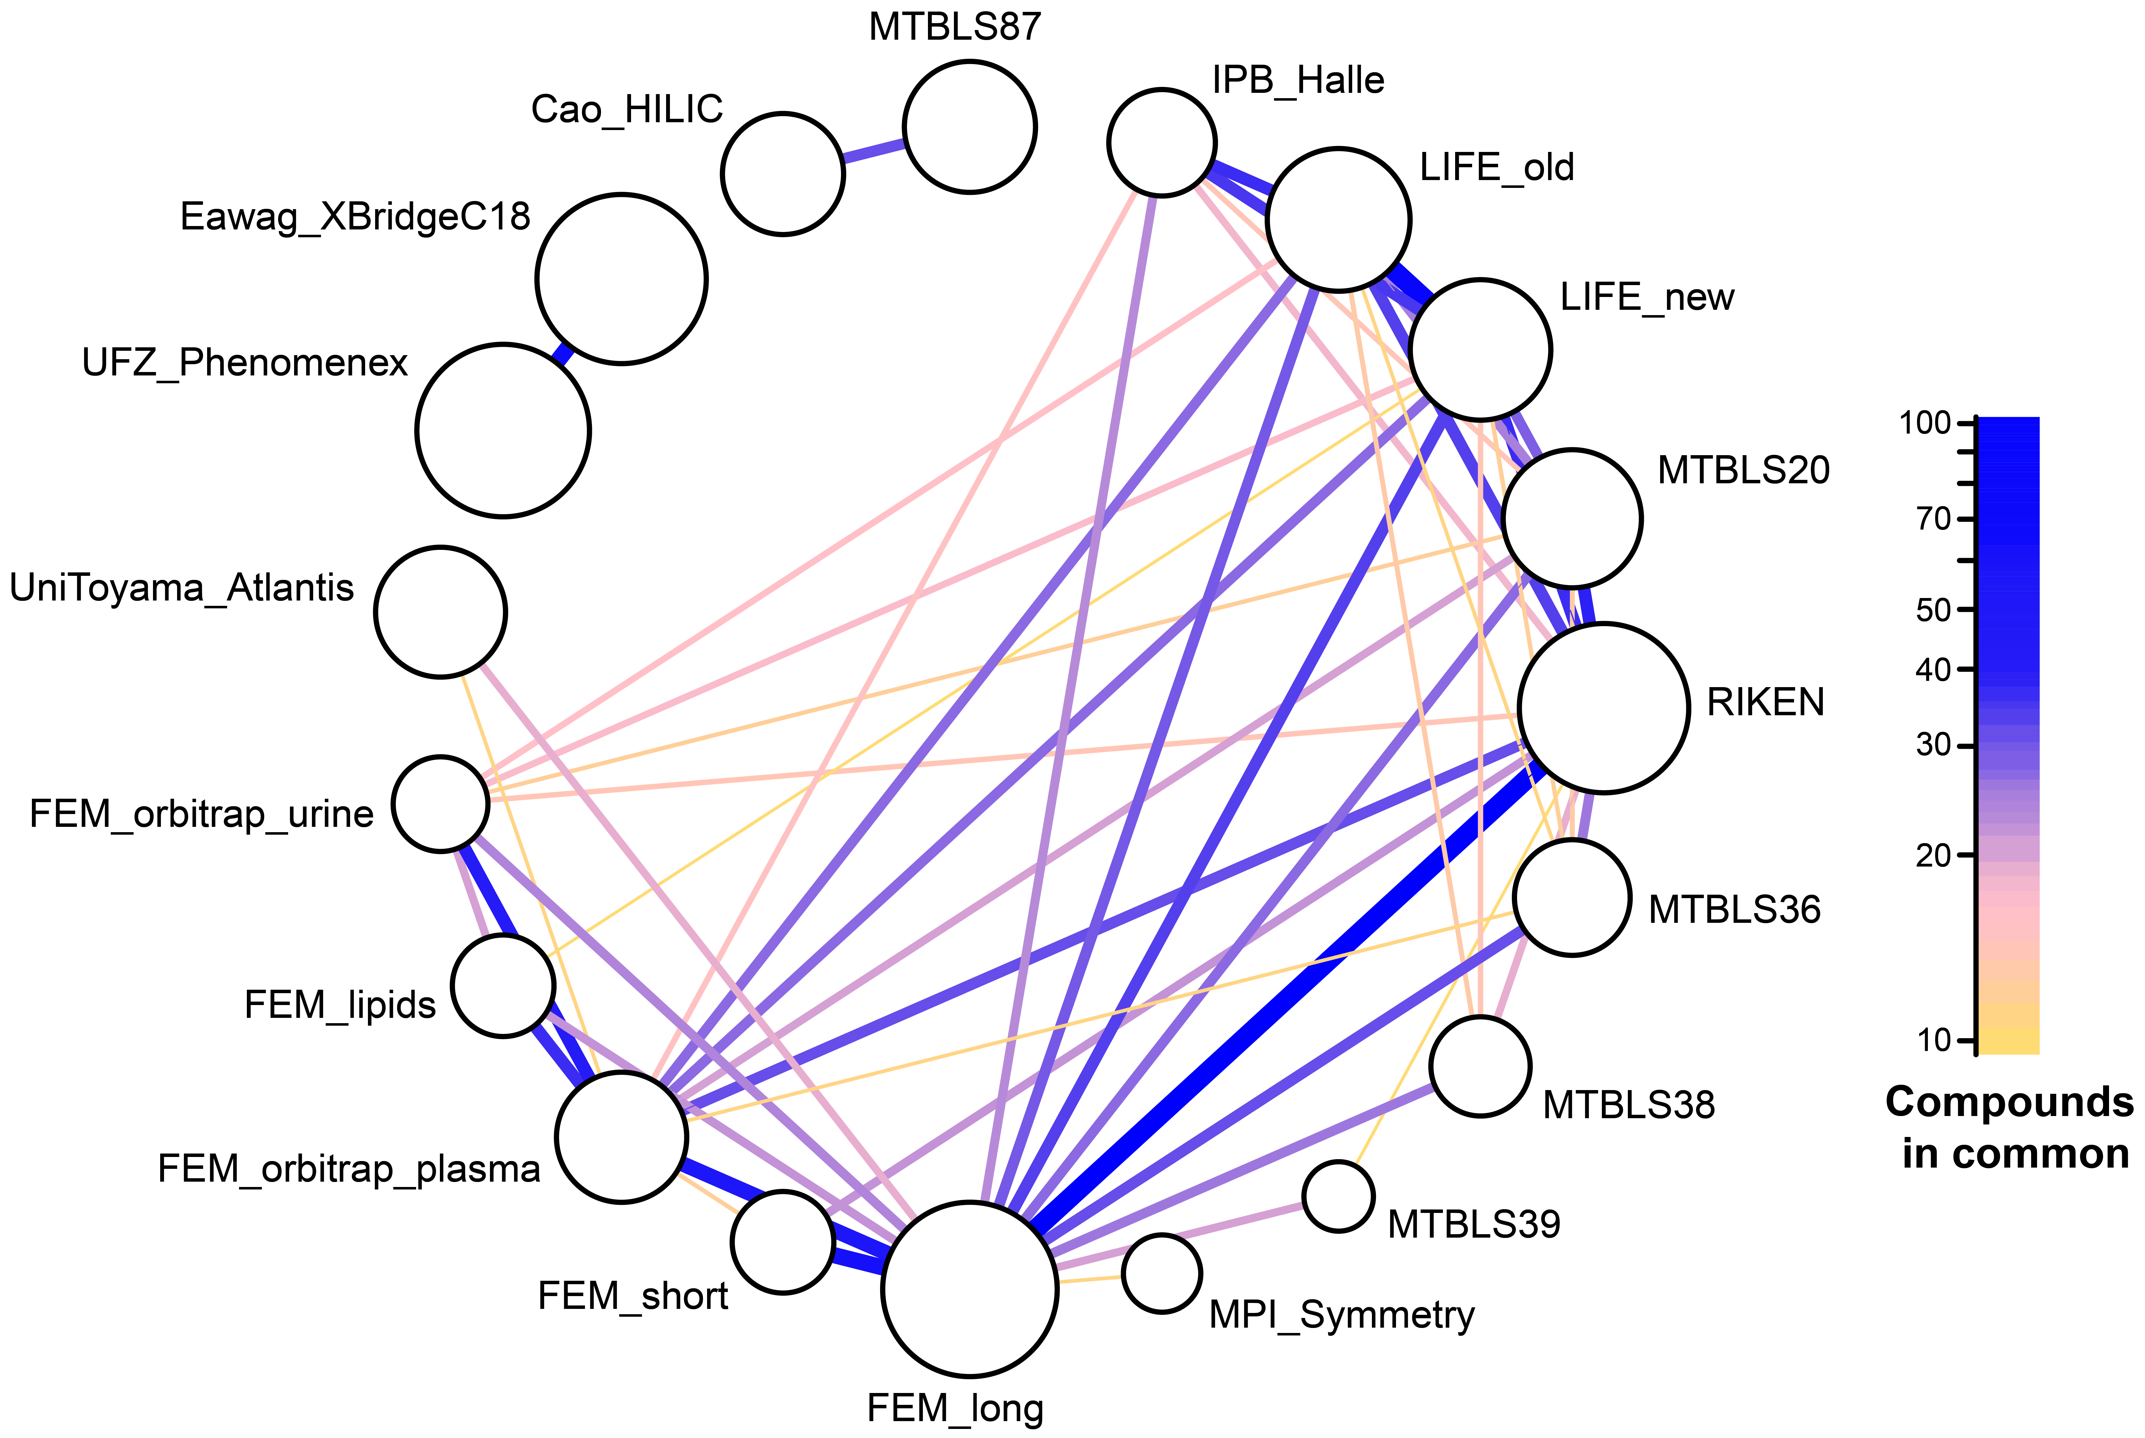
In silico prediction: Retention time with PredRet
Stanstrup, J., Neumann, S., & Vrhovsek, U. (2015). PredRet: Prediction of Retention Time by Direct Mapping between Multiple Chromatographic Systems. Analytical Chemistry.

Slide 64
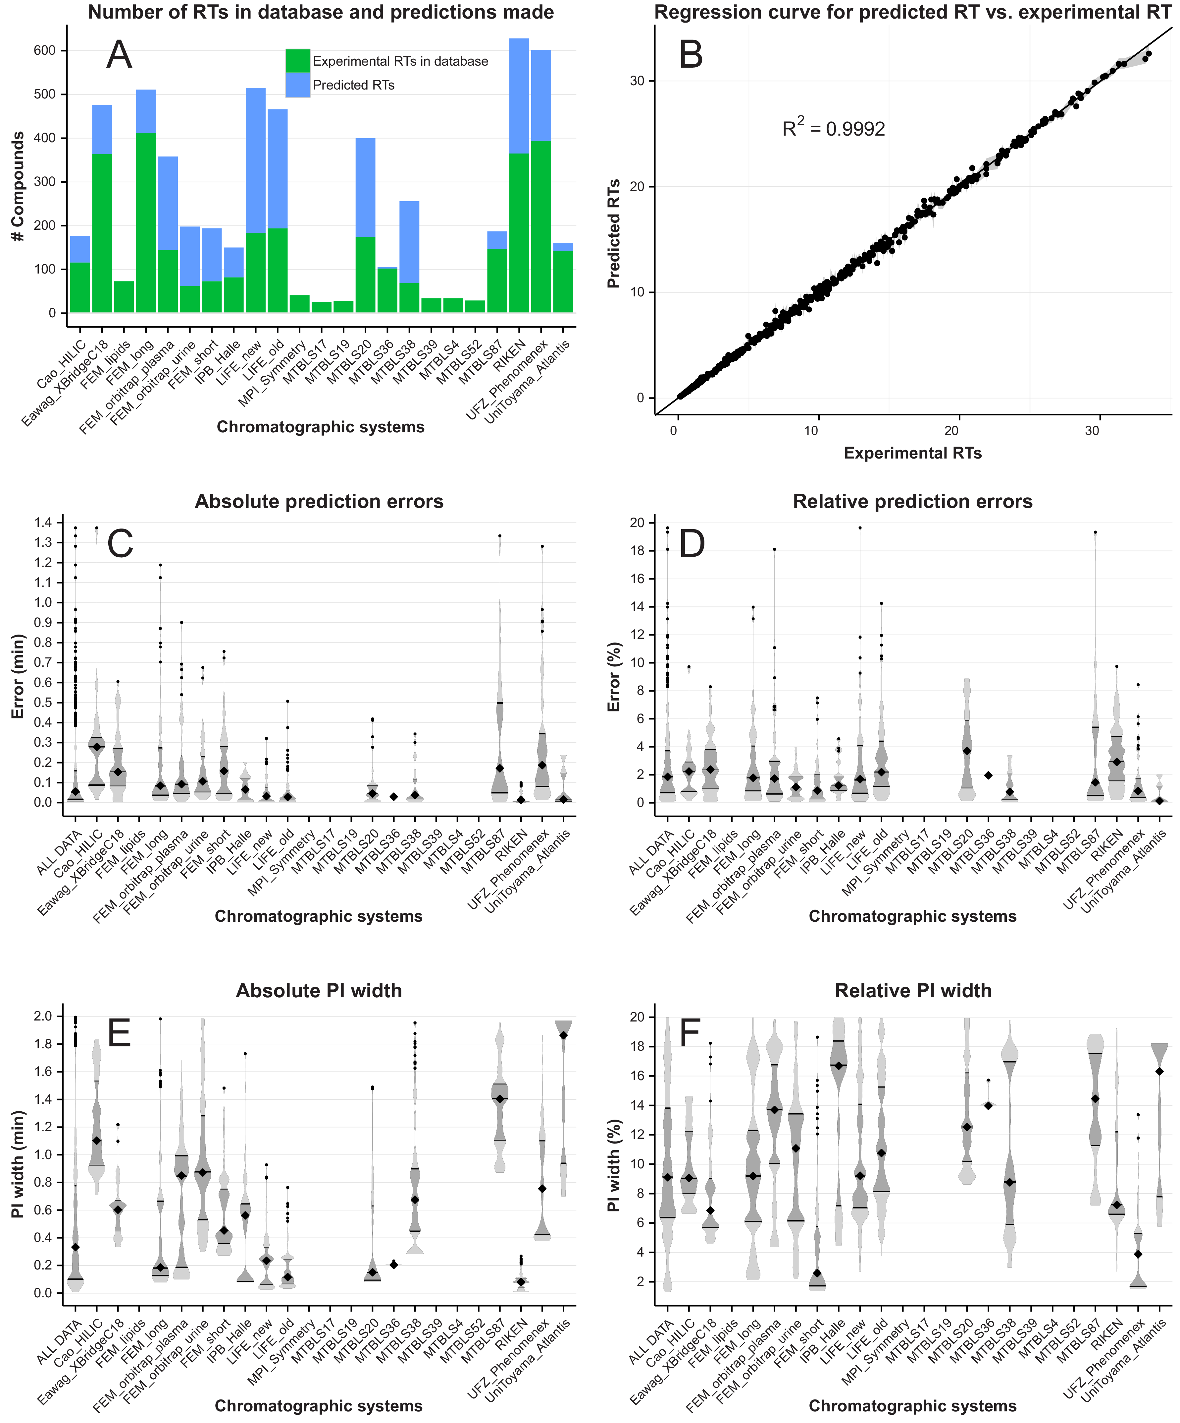
In silico prediction: Retention time with PredRet

Slide 65
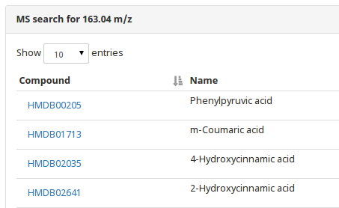
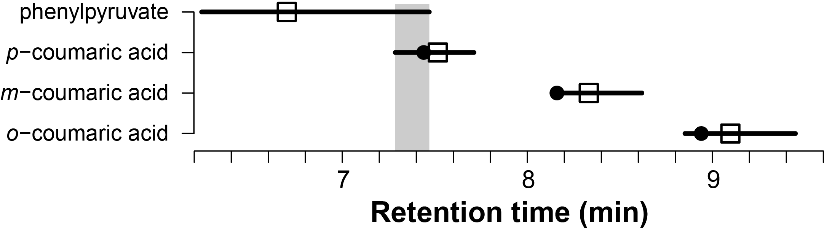
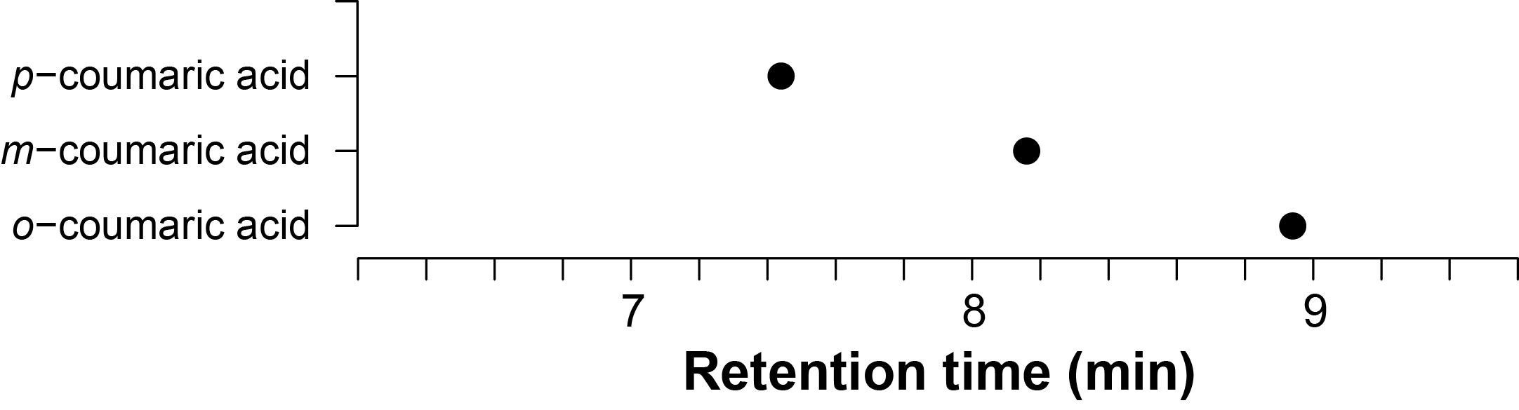
In silico prediction: Retention time

Slide 66
So are you really really sure or just a little sure?

Slide 67
Identification levels (MSI): AKA how sure are you?
Standard for reporting of identifications proposed by the Metabolomics Standards Initiative (MSI)
LEVEL I: Identified compounds
Two independent measures (eg. RT and m/z)
compared to an authentic standard
LEVEL II: Putatively annotated compounds
Physicochemical properties and/or spectral similarity with public/commercial spectral libraries
LEVEL III: Putatively characterized compound classes
physicochemical properties of a chemical class of compounds, or by spectral similarity to known compounds of a chemical class
LEVEL IV: Unknown compounds
Metabolomics. 2007;3(3):211–21.

Slide 68
Identification levels (MSI): Exercise 3 revisited
Q1: Given the information you have looked at what level of ID is this?
Q2: What do you need to do to get better ID?
Q3: Does MSI level I == 100 % sure ID?
  Other compounds could also have ~same RT and ~same spectra
Q4: Could ”100 % sure ID ” mean different things to different people?
  Positional isomers (especially lipids)
  Cis/trans
  Stereoisomers

Slide 69
Summary

Slide 70
Summary: From features to compounds
The mass and isotope pattern help you find the molecular formula
Molecular formula of fragments and losses are also informative
Not all possible formula are valid compounds (nitrogen rule, DBE)
Adducts can help (or make it more difficult to) find the pseudo-molecular ion
Fragments give info on the structure of the compound
Compound databases show us what compounds are known
Spectral databases give us spectra of real compounds
In silico tools can help us when no real spectrum is available
It is crucial to report the level of certainly unambiguously

Slide 71
Recommendations
Start with low hanging fruits.
  Search databases first.
  Give up fast if not enough data or get more data (MS^{n}) if possible/important.
  Accept that you won’t ID everything.
Find the pseudo-molecular ion before you try to ID.
Always check EIC before trying to ID a feature/fragment/adduct.
Don’t use the MSI levels blindly.
Use good chemical sense and report uncertainty meticulously.
Remember: There is no substitute for authentic standard compounds.
But they might not be enough!

